Slide 1
Introduction to Business Retention and Expansion
Notes:
Instructions:
This slide should be up when session participants join the workshop. Specific state or regional information can also be added, such as organizations or university logos.
Before you begin, welcome the participants and allow time for introductions from participants. Names, which community they live in, their role in their community, etc. are all good details for introductions. If participation numbers are very large, participants can introduce themselves at their respective tables or in small groups.
Time: 1-5 minutes or as needed
Materials: None
Handouts: None

Slide 2






Acknowledgements
This curriculum was made possible through funding by Walmart. The findings, conclusions, and recommendations presented in this curriculum are those of the Southern Rural Development Center and its project partners alone, and do not necessarily reflect the opinions of Walmart.
This work is supported by 2022-51150-327212 from the U.S. Department of Agriculture, National Institute of Food and Agriculture.
Any opinions, findings, conclusions, or recommendations expressed in this publication are those of the author(s) and should not be construed to represent any official USDA or U.S. Government determination or policy.
Notes:
Instructions: Share this acknowledgment of the partnerships with CREATE BRIDGES.
Materials: None
Handouts: None
Time: 1 Minute

Slide 3
Outline
What is Business Retention and Expansion (BR&E)?
Why conduct a BR&E and focus on existing businesses?
  What benefit do businesses receive?
How does the process work?
  What resources are required?
BR&E Interview Guide (sample questions)
Q&A
Notes:
Instructions:
This slide serves as an outline or agenda for the session’s topics.
Time: 1 minute
Materials: None
Handouts: None

Slide 4
What is Business Retention and Expansion?
Notes:
Instructions:
The method of BR&E used in the CREATE BRIDGES program is based on the University of Minnesota’s curriculum and training.
https://extension.umn.edu/retaining-community-businesses/introduction-business-retention-and-expansion-bre
Time: 1 minute
Materials: None
Handouts: None

Slide 5

What is Business
Retention and Expansion?
An exciting program, designed to strengthen the connection between businesses and the community.
Direct interactions, events and research
Seeks to gain business insight
  Turns this “business intelligence” into value added services and programs that address shared business challenges and opportunities.
This Photo by Unknown Author is licensed under CC BY-SA-NC
Notes:
Instructions:
Participants may have varying levels of knowledge about BR&E, or they may know nothing about it. This section serves as an introduction to the concept and what it aims to accomplish.
BRE at its core, an intentional effort to understand your local or regional business climate and work to improve it.
It involves active listening
It provides businesses with knowledge or connection to resources
It can be an opportunity to identify and address policies that unnecessarily hinder business growth in the region
And it’s a tool to explore and identify business needs
Time: 2-3 minutes
Materials: None
Handouts: None

Slide 6
Business Retention and Expansion
A BR&E Program:
Assists existing businesses in their survival and expansion.
Is driven by feedback from business owners and managers.
Is proactive in maintaining a vibrant local economy and assisting existing businesses to grow.
Notes:
Instructions:
This slides outlines what the BR&E program aims to accomplish for a community in general.
It assists existing businesses in their survival and expansion. It is driven by feedback from business owners and managers. And it is proactive, maintaining a vibrant local economy and assisting existing businesses to grow.
Time: 2-3 minutes
Materials: None
Handouts: None

Slide 7
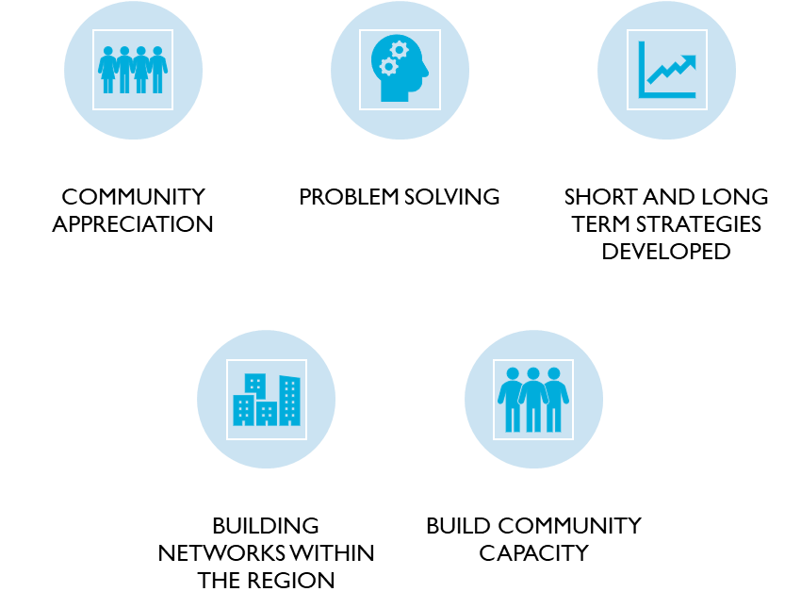

Benefits of BR&E
Notes:
Instructions:
The benefits of BR&E for a community are numerous. This slides outlines a handful of ways the process can serve to improve a community’s relationship with existing businesses.
Time: 1-2 minutes
Materials: None
Handouts: None

Slide 8
Why conduct a BR&E and focus on existing businesses
Notes:
Instructions:
This slide serves as a title slide for the following two slides.
Time: 1 minute
Materials: None
Handouts: None

Slide 9
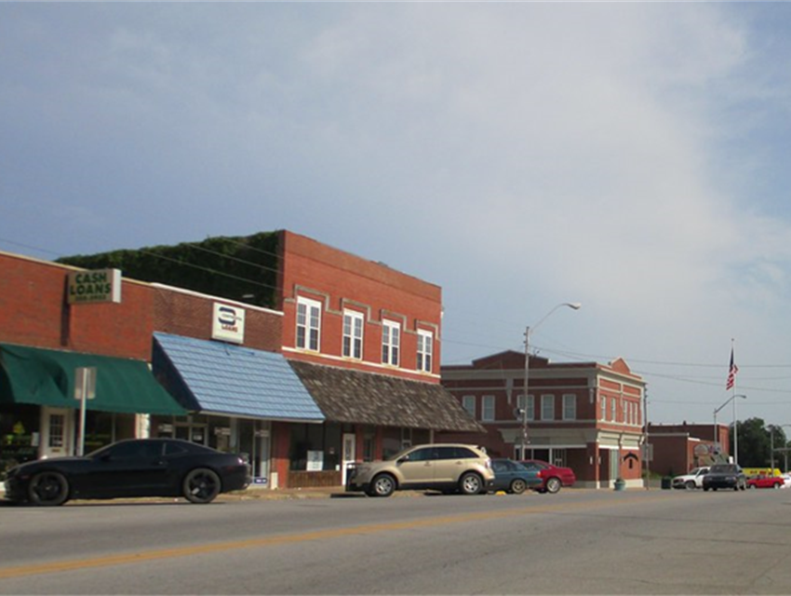
Why BR&E and why focus on existing businesses?
Importance of retaining existing businesses
Community involvement as a
component of economic development
Existing businesses feel valued
Existing businesses can be the best sales voices for your community
“True listening sometimes involves moving your feet.”
Notes:
Instructions:
BR&E offers an opportunity to broaden the community involvement in the economic development process.
The visitation component of BR&E is important, not only to capture important feedback to address problems and opportunities, but then also to turn around and demonstrate to the businesses that their contribution to the community is valued.
Time: 2-3 minutes
Materials: None
Handouts: None

Slide 10

What benefits do businesses receive?
Demonstrates appreciation
Helps solve immediate concerns
  Is the business looking to move or close? Can the community remove any bottlenecks as it pertains to business growth? Who can assist with workforce concerns? Etc.
Establishes and implements a strategic plan for growth and retention
This Photo by Unknown Author is licensed under CC BY-SA
Notes:
Instructions:
In addition to what was mentioned on the previous slide, what potential benefits does a business receive from participating in BR&E?
Demonstrates to local businesses that the community appreciates their contribution to the economy
Help existing businesses solve problems that they might be facing
It works to establish and implement a strategic plan for economic development
Time: 2-3 minutes
Materials: None
Handouts: None

Slide 11
How does the process work?
Notes:
Instructions:
This slide serves as a title slide for the following four slides.
Time: 1 minute
Materials: None
Handouts: None

Slide 12
Business Retention & Expansion
BR&E process: How does it work?
  Research, Prioritize, Implement
Resources required:
  PEOPLE! leadership, volunteers, analytical capacity, community/business buy-in
RESEARCH
PRIORITIZE
IMPLEMENT
Notes:
Instructions:
A traditional BR&E process can be divided into three segments: Research, Prioritize, and Implement.
The following three slides will outline that process in more detail.
Time: 2 minutes
Materials: None
Handouts: None

Slide 13
BR&E Process
PRIORITIZE
IMPLEMENT
RESEARCH
Step 1: Research
Inform community and businesses
about BR&E
Organize the leadership team*
Recruit and train volunteers*
Visit businesses to conduct interview (~1 hour)
Tabulate interview data
Notes:
Instructions:
This slide, and the following two slides, outline the BR&E process as broken down by the three segments mentioned in the previous slide.
Step 1: Research phase
In this step, the program facilitators will inform the communities and businesses about BR&E, its role in the CREATE BRIDGES process and how it aims benefit existing businesses. This very presentation is a great resource to introduce the concept to communities and can be used as a tool to begin organizing a leadership team.
A separate presentation is included in the Resources section, designed to recruit and train BR&E volunteers. It is titled: BRE Volunteer Visitor Training.
The last two steps in the Research phase are to visit the businesses to conduct the actual interviews and then once all the businesses you intend to visit have been interviewed the data will be tabulated into a format that can be used to create the summary, which will be shared back with the communities.
Time: 3 minutes
Materials: None
Handouts: None

Slide 14
BR&E Process
PRIORITIZE
IMPLEMENT
RESEARCH
Step 1: Research
Inform community and businesses
about BR&E
Organize the leadership team*
Recruit and train volunteers*
Visit businesses to conduct interview (~1 hour)
Tabulate interview data
Step 2: Prioritize*
Review immediate concerns
Analyze interview data
Prioritize potential projects
Draft a summary to share survey results and priority projects
Host a regional event to announce projects and plans to implement
Notes:
Instructions:
Step 2: Prioritize
Review warning flags- a BR&E “immediate concern” is information shared during an interview that is cause for concern. Examples include an impending closure, move, or workforce concerns that will severely limit their ability to do business in the community. With the owner’s permission, you can offer to follow up on this specific concern with the specific business to address the issue.
During this phase, the BR&E team will analyze the summarized data and look for emerging themes. This data will then be used to draft a summary to share results. An example of the summarized results is included in the Appendix titled, “Key Findings rom CREATE BRIDGES Survey Responses in Oklahoma”.
Once the results are summarized and priority projects are identified, the region will host an event to share the results and proposed projects. At this event, regional steering committee members, community leaders, and businesses will work together to plan project implementation.
Time: 3 minutes
Materials: None
Handouts: None

Slide 15
BR&E Process
PRIORITIZE
IMPLEMENT
RESEARCH
Step 1: Research
Inform community and businesses
about BR&E
Organize the leadership team*
Recruit and train volunteers*
Visit businesses to conduct interview (~1 hour)
Tabulate interview data
Step 2: Prioritize*
Review warning flags
Analyze interview data
Prioritize projects
Draft a summary to share survey results and priority projects
Host a regional event to announce projects and plans to implement
  Step 3: Implement
  Develop project teams and commence work on projects
  Sustain leadership
  Provide updates on projects to the region
  Evaluate projects
Notes:
Instructions:
Step 3: Implement
Once priority projects are reviewed and decided upon, develop project teams to begin working on each project. Consider how “low hanging fruit” or “easy win” projects can be accomplished quickly. Accomplishing low-effort, low-resource projects quickly will help to sustain momentum for longer term projects.
Continue to provide leadership and encouragement to the project teams throughout the process.
Provide regular updates to the region on the status of selected projects.
Develop a method (such as a survey) for evaluating the chosen projects.
Time: 3 minutes
Materials: None
Handouts: None

Slide 16
Interview Guide
Opening statement:
  CREATE BRIDGES (Celebrating REtail, Accommodations, Tourism, and Entertainment by Building Rural Innovations and Developing Growth Economies) is an economic development initiative that raises awareness of the role retail, accommodations, tourism, and entertainment industries play in the local economy; examines current support and issues for these businesses and their workforce; and develops and implements strategies to strengthen these sectors within a multi-county region.
  Retaining and expanding local businesses is a central component of CREATE BRIDGES. The Business Retention & Expansion process engages local businesses to assess the strengths and challenges of running a business, and inform strategies to address issues that may affect critical business activities.
Notes:
Instructions:
This slide, along with the next five slides will provide insight into the actual survey. Consider having full copies of the survey for participants to review as well.
The survey begins with a short explanation of what CREATE BRIDGES is, what it aims to accomplish and how the BR&E process fits within the larger project.
Time: 1 minute
Materials: None
Handouts: Full BR&E Survey for Participants to Review

Slide 17
Interview Guide Topic Areas
Labor Force
Customers
Changes (renovation, moving, business transition, closing?)
Community Factors
Travel and Tourism Outlook
Notes:
Instructions:
The BR&E survey developed for CREATE BRIDGES covers topic areas that are most relevant to the CREATE sectors- Retail, Accommodations, Tourism, and Entertainment. The survey was adapted to gain insight into these specific areas while also serving to identify themes that can be addressed to support these sectors.
Time: 1 minute
Materials: None
Handouts: None

Slide 18
Labor Force: Sample Questions
How many workers (including yourself) are employed….
  Full time
  Part time
  Seasonal
  Temp
What are your hours of operation? Do these change seasonally?
Has the number of employees changed from three years ago? If so, how?
Does your rate of employee turnover create a barrier for your business?
  If yes, what do you see as reasons for turnover?
What are some barriers you face when recruiting quality employees?
Notes:
Instructions:
This slide, along with the next two slides pull questions directly from the survey to show as examples. The facilitator can add additional topic questions as needed.
Time: 1-2 minutes
Materials: None
Handouts: None

Slide 19
Labor Force: Sample Questions Cont.
Do you provide a formal employee orientation or onboarding process? If so, what does it entail?
Do you provide training beyond orientation?
  To address changes in technology, policy, trends?
  To provide opportunities for cross training, leadership, or career advancement?
  How is the training delivered?
  Is it optional or mandatory?
  Do you pay for your employees to participate in training?
How do the following factors impact your employees’ ability to work?
  Transportation availability
  Housing availability
  Broadband access
  Healthcare access
  Child or elder care
Other:
Notes:
Instructions:
This slide shows additional questions that are included in the Labor Force section of the survey.
Review these questions with the participants.
If needed, discuss how things like onboarding, transportation, housing, or one of the other factors listed here, affects an employee’s ability to work.
Time: 2-3 minutes
Materials: None
Handouts: None

Slide 20
Community Factors Impacting the Business
How has the region’s business climate for retail, accommodations, tourism and entertainment changed in the past three years?
How do the following factors impact your business?
  Cost and availability of land
  Cost and availability of buildings
  Access to credit to support business operations/expansion
  Transportation infrastructure and planning (roads, zoning, design)
  Physical infrastructure limitations (sidewalks, signage)
  Utilities
    Water
Notes:
Instructions:
This slide shows questions that are included in the Community Factors section of the survey.
If needed, discuss how community factors can impact businesses in the region. If you do, help steer the conversation in a constructive way so that it does not just become a session where participants complain about local barriers to businesses.
Time: 2-3 minutes
Materials: None
Handouts: None

Slide 21
Resources Required for BR&E
Leadership- University/Extension in partnership with local Chambers of Commerce, Main Street organizations and local leadership, using asset map list
Volunteers
  Steering Committee members, community leaders, students, older 4-H or FFA members, civic club members, etc.
Analytical capacity
Commitment from businesses, as well as local governments and community leadership
Notes:
Instructions:
Facilitating a BR&E program requires dedication from a variety of community leaders. But as the saying goes “many hands make light work”. Most of the resources needed for BR&E will be in the form of personnel and their volunteer time.
This includes:
Local organizations such as Chambers of Commerce and Main Street organizations that can advertise the opportunity with local businesses and help connect the BR&E team to owners and managers.
Presenting about CREATE BRIDGES and the BR&E component at local civic organization meetings is a great way to network and promote the program.
Depending on which format(s) your region selects, volunteers will be needed to visit businesses to conduct interviews or serve as round table discussion moderators if your region.
Once all the survey data is collected, you will need someone (or a small group) with analytical capacity who can summarize the qualitative and quantitative data into a format that can be used to identify themes and draft the summary report. For this task, consider connecting with a local college or university to see if any students would like to take this on as a project.
A successful BR&E program also requires support from local governments, community leadership and the businesses themselves.
Time: 3-4 minutes
Materials: None
Handouts: None

Slide 22
Questions and Discussion?
Notes:
Instructions:
At the conclusion of the presentation, allow time for Q&A and discussion.
Time: Remaining
Materials: None
Handouts: None

