Slide 1
4-H Tech Changemakers
Understanding Your Audience
This material was developed in support of the 4-H Tech Changemakers project
https://4-h.org/ways-to-give/corporate-foundation-support/tech-changemakers/

Slide 2






Our Objectives
Learn ways to enhance the learning experience of Adult Learners
Learn strategies to teach technology
Practice adapting teaching techniques to meet audience needs
Understand how aging and disability impacts learning

Slide 3

Getting Started with New Learners
Motivating factors
Barriers to adoption
©Getty Images/Monkey Business
Notes:
Instructions
Watch the “Introduction to Teaching Technology” video
Not all of us were born with technology. Trainers need to be aware that many of the adults they are working with are new to the digital world. Trainers need to have an understanding of motivating factors to engage older adults in adopting technology as well as some of the barriers for adoption.
Can you think of other motivating factors someone would what to improve their technology skills?
Materials
Laptop, Speakers, Projector
YouTube Link: https://youtu.be/kyMtINvwKro
Handouts
Time allotted: 10 min

Slide 4
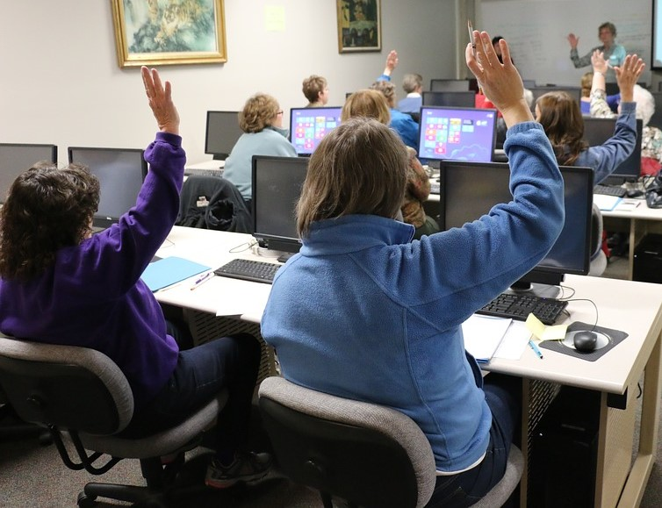
Experiential Learning
Low Vision Simulation
Hearing Loss Simulation
Loss of Dexterity and Touch Sensation
Technology Jargon/Vocabulary Activity
©Photo by Donna Matturri
Notes:
Instructions
For this section of the orientation, we will work with a partner. We will work through a series of activities that require us to perform a variety of technology tasks while wearing simulation gear.
The simulation gear we will be wearing includes low vision simulators, hearing loss simulators, and gloves. We will also tape the index and middle fingers together on each hand to simulate joint stiffness a person with arthritis might experience. Cataracts refer to a clouding of the lens of our eye that can make seeing more difficult.
We have materials at each table for the activities. Many of the stations require the use of your personal cell phone or tablet so be sure to bring it with you. One partner will wear the simulation gear and the other partner will guide them through the stations. You will have 1 minute for each activity. After the first partner has completes their turn, you will switch roles. Are there any questions?
Materials
Handouts
Time allotted

Slide 5
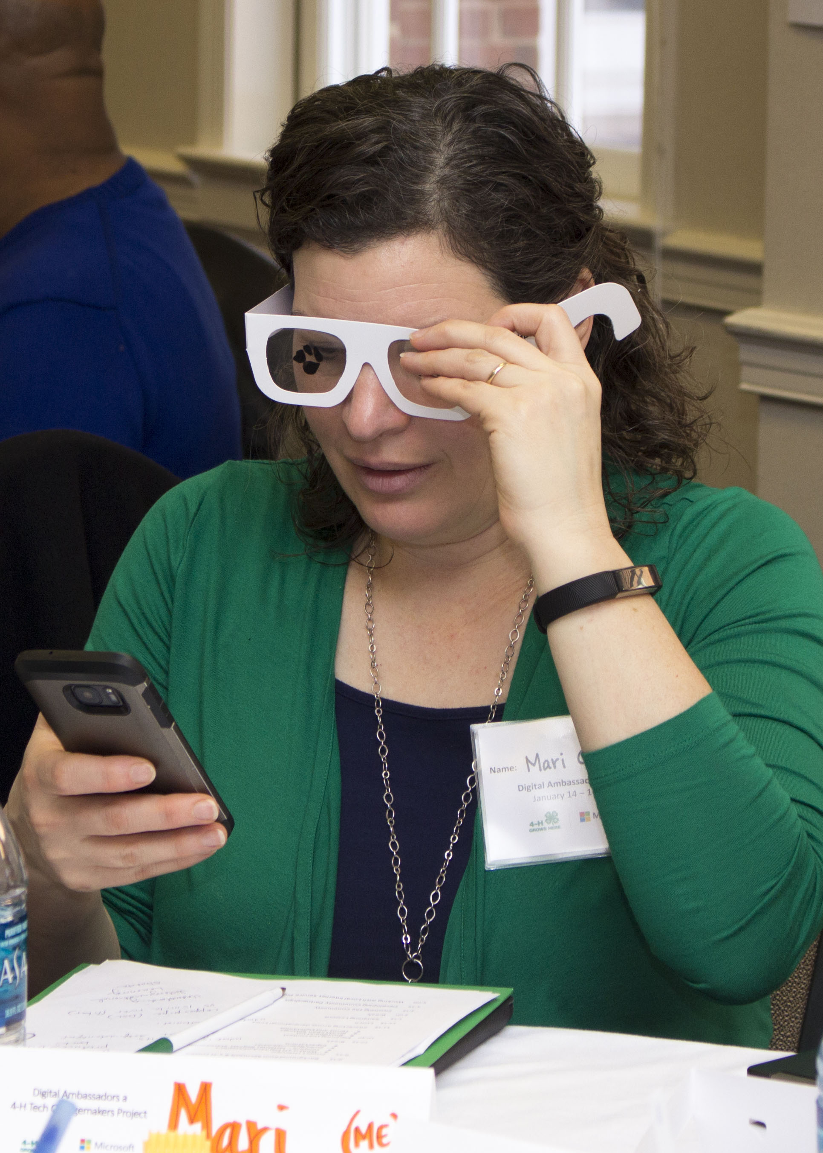
Low Vision Simulation
Experiencing technology through:
Cataracts
Glaucoma
Macular degeneration
Diabetic retinopathy
Use Phone or Tablet to take a picture
Navigate on a browser to the NDIA Website
Notes:
Instructions
This activity will demonstrate common vision problems in older adults. For example, cataracts refer to a clouding of the lens of our eye that can make seeing more difficult. Other issues may include glaucoma, macular degeneration, and diabetic retinopathy
Display the Eye Chart on the computer Screen or Print and place several around the room
Divide into pairs. One person wears the glasses. (Try different type of vision loss simulation)
Read the Eye Chart with the glasses on
Use Phone or Tablet to take a picture
Navigate to the 4-H Website in a browser
Let the other person in the pair wear the glasses and repeat the activities.
What are some adaptions you can make to counteract these issues when teaching technology?
Materials:
Low Vision glasses https://megadepot.com/product/eschenbach-c-simulator-kit-4-low-vision-simulator-kit?format=v&p=ms&source=ads&gclid=CjwKCAiAgrfhBRA3EiwAnfF4tvrqlcMOnSVl-hWpnMXxr6vzwhi6GOSROU2ucA7jexqMf1ZBc2WuLBoC8c0QAvD_BwE
Handouts
Time allotted: 7 min

Slide 6
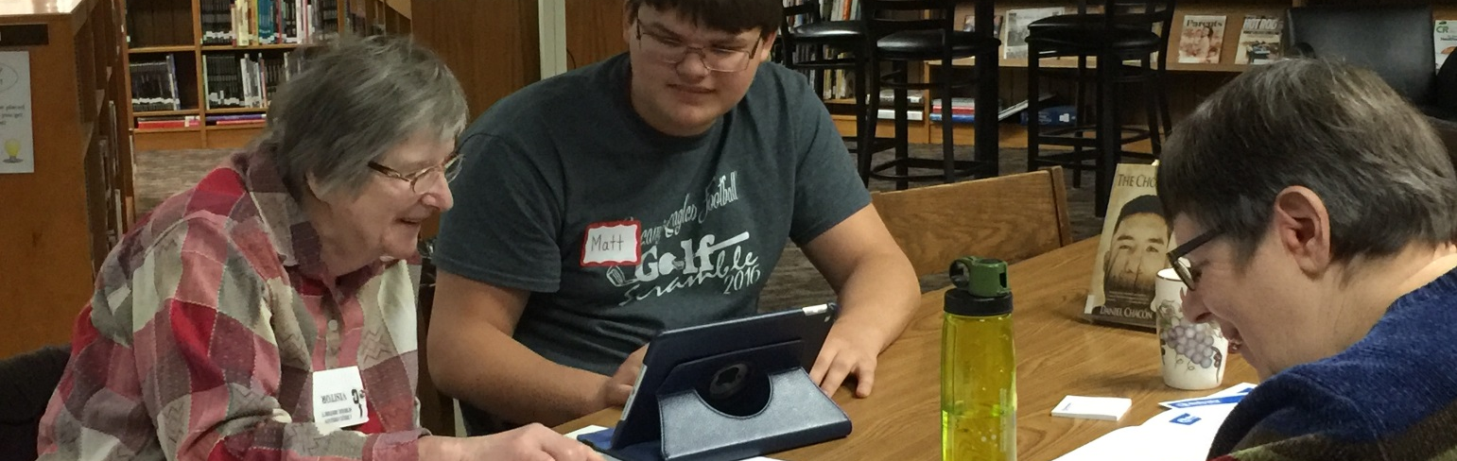
Hearing Loss Activity
How old are your ears?
https://youtu.be/VxcbppCX6Rk
Notes:
This activity will remind volunteers that hearing loss often accompanies aging. This impacts the volume of devices and the speaking volume of the technology coaches.
Instructions
Place earplugs into ears
Play Video
At 15 seconds into the video a series of tones will play.
At this point, the audience will raise their hand and keep their hand up until they can no longer hear the tone.
Repeat without earplugs
What are some adaptions you can make to counteract these issues when teaching technology?
Materials
Foam Earplugs Laptop, Speakers, Projector
YouTube Link: https://youtu.be/VxcbppCX6Rk
Handouts
Time allotted: 5 Min

Slide 7
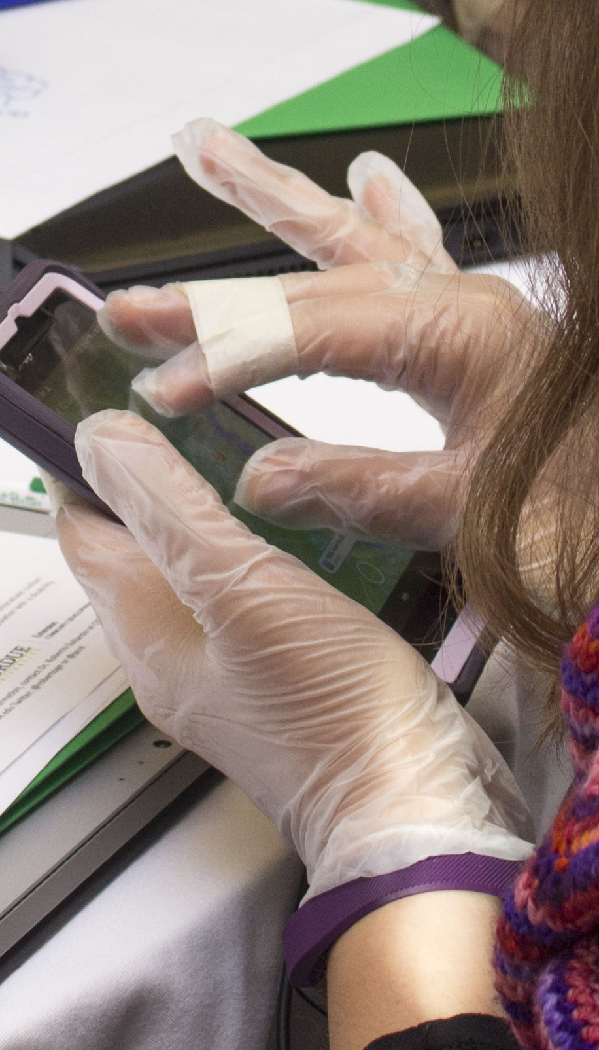
Loss of Dexterity
Challenges to technology usage
Type message while wearing gloves
Take picture with phone or tablet using non-dominate hand.
Pinch to enlarge the photo using non-dominate hand.
Notes:
This activity will help remind volunteers about the difficulty of performing technology tasks with the limited use of hands and fingers. Older adults can experience arthritis or injury that inhibit their use of devices. New users of technology may not be a proficient navigating touch screens or other input features. Using your non-dominate hand and wearing gloves will let you experience what a new technology user might be like.
Instructions
Place gloves on hand while typing a message on a keyboard
Tape index and middle fingers together to demonstrate stiffness of joints
What are some adaptions you can make to counteract these issues when teaching technology?
Materials
Gloves
Masking Tape
Tablets or Phones or Laptops
Handouts
Time allotted: 10 Min

Slide 8

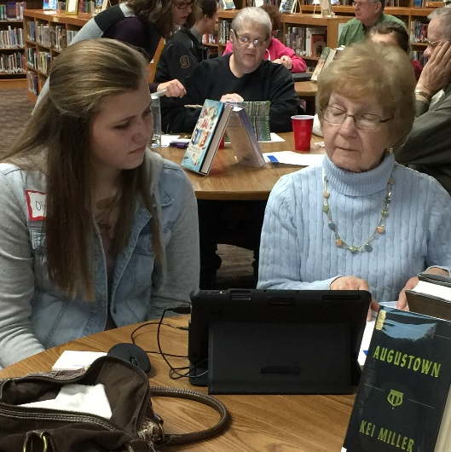
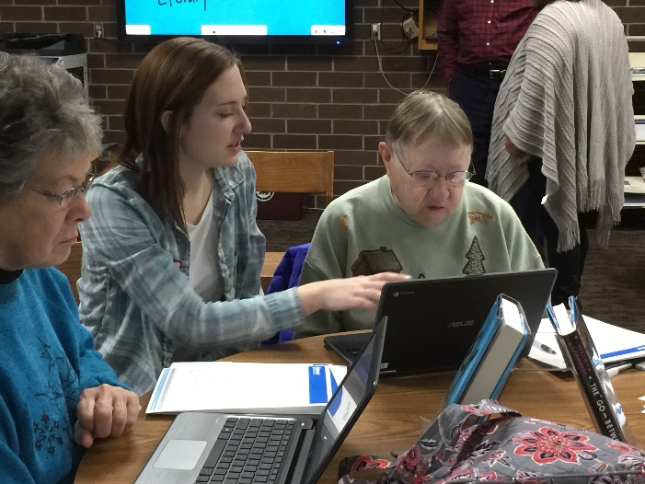
Technology Jargon/Vocabulary Activity
Brainstorm technology words
Find words with double meaning
Illustrate those meanings
Notes:
This activity is designed to remind volunteers about the significant amount of vocabulary associated with technology. Why this matters is because some words have meanings completely unrelated to technology. This can make learning more difficult for some adult learners.
What are some adaptions you can make to counteract these issues when teaching technology?
Instructions
Divide the larger group in groups of 2 to 3 people.
The goal is for each group to brainstorm as many technology words as possible.
Set the timer for 60 seconds.
After the time ends, ask each group to count the number of words and write the number next to their list.
Ask the volunteers to return to their seats.
Review the words as a group, looking closely for words that have applications unrelated to technology.
(If time allows) As if playing Pictionary, choose two of the terms and draw them from each perspective
The key takeaway is that we have to be aware of the complex language that has emerged as a result of technology when teaching Adult Learners.
Example of words: Account, Application, Button, Chrome, Crop, Feed, Folder, Home, Cloud, Message, Mouse, Pandora, Pinch, Post, Safari, Sticker, Tablet, Text, Wallpaper, Windows, Word, Table
Materials
Dry erase board or flip chart
Markers
Stop watch
Handouts
Time allotted: 15 min

Slide 9
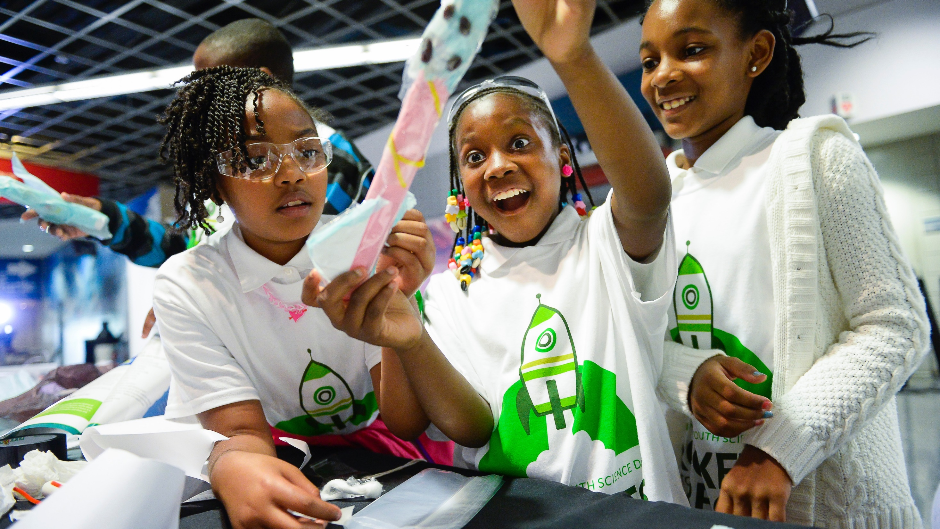
Reflect
What are the most important learning moments you take away from this experience?
What are the benefits of participating in this learning activity?
Did anything surprise you? If so, what?
What are some other audience adaptions that you may need to consider?
How will this help you teach technology?
Notes:
Instructions
After completing the activities, volunteers should talk in small groups about the discussion questions. Allow 3-5 minutes for small group discussions. Invite small groups to share their thoughts with the larger group. Use flip chart or dry erase board to records thoughts.
PLEASE NOTE: These hands-on activities provide valuable insight about the experiences of some Adult Learners, particularly those with disabilities. However, we don’t want volunteers to be left with the impression that all the adults they help will have severe disabilities. Remind them these activities are an exaggeration and that every adult they teach will have different abilities and technology experience.
Materials
Dry Erase Board or Flip Chart
Markers
Handouts
Time allotted

Slide 10

Acknowledgement
This material was developed by members of the National Digital Education Extension Team in support of the 4-H Tech Changemaker Project.
Authors:
Gail Huycke, University of Wisconsin
Kenneth Sherin, North Carolina State University
http://www.srdc.msstate.edu/ecommerce/index.html

Slide 11
Thank you

