Slide 1


Communication and Conflict
in Succession
Notes:
Instructions: Introduction to Module 1
Time: 1 minute
Materials: None
Handouts: None

Slide 2




Partnering Organizations
Notes:
Instructions: This slide highlights the partnering organizations that have worked together to develop materials and host trainings.
Time: 1 minute
Materials: None
Handouts: None

Slide 3

Purpose:
Succession planning encompasses many emotional and financial aspects of a family and a business, making decisions and moving forward more difficult. This research-based curriculum with comprehensive handouts integrated will give participants the confidence they need to learn strategies for moving succession forward with their property or business. Both soft and hard skills are covered in the materials and will empower owners to develop and implement their succession plan.
Funding to develop this training provided by:
&
Notes:
Instructions: Explain the purpose of the overall curriculum.
Time: 1 minute
Handouts: None
Materials: none

Slide 4
Primary Authors
Renee Wiatt
Research and Extension Specialist | North Central Regional Center for Rural Development
Family Business Management Specialist | Purdue Institute for Family Business
Department of Agricultural Economics | Purdue University, West Lafayette, IN
Dr. Kurt Smith
Assistant Professor of Forestry and Environmental Resources
North Carolina State University
Dr. Rebecca Smith
Associate Extension Professor | Mississippi State University Extension
Notes:
Instructions: Please acknowledge the primary and contributing authors to this material as well as the funding stream through the Southern Rural Development Center and the Socially Disadvantaged Farmers and Ranchers Policy Research Center at Alcorn State University.
Time: 1 minute
Materials: none
Handouts: none

Slide 5
PRESENTERS
Enter presenter information on this slide
Notes:
Instructions: Add presenter information and introduce yourselves.
Time: 1 minute
Materials: none
Handouts: none

Slide 6
Important notes before we begin:
These materials are intended to present general information on succession planning.
The information may not be applicable to every state or territory.
These materials do not provide legal advice. Specific advice should be obtained from an attorney or another professional well versed in the facts and circumstances related to the individual seeking advice and the jurisdiction where the property is located.
Notes:
Instructions: Read the disclaimer and answer any questions that may arise.
Time: 1 minute
Materials: none
Handouts: None

Slide 7
PROTECTING YOUR INFORMATION
No personal stories
General questions are welcome
Personal questions should be asked outside of the group setting
Notes:
Instructions: Go over these guidelines with participants to ensure that participants understand the reasons for not including stories or questions of a personal nature.
Time: 1 minute
Materials: none
Handouts: None

Slide 8
Warm Up and Introductions
Notes:
Instructions: Introduction to Warm up and Introductions.
Time: 1 minute
Materials: None
Handouts: None

Slide 9



ICE BREAKER
Let’s invest a minute to get to know each other…
Take a minute and write down
Your favorite food
The most interesting place you have ever visited
One interesting fact about yourself nobody in this room would know
Notes:
Instructions: Go around the room quickly, give some folks a chance to comment or ask questions of each other. Typically, people make connections with each other through this exercise that will carry through the workshop.
Time: 3-4 minutes
Materials: None
Handouts: Ice Breaker
Notes:

Slide 10

SHARE WITH YOUR BREAKOUT ROOM
Notes:
Instructions: Don't force anyone to share if they are not interested or uncomfortable.
Time: 15 minutes
Materials: None
Handouts: None
Notes:

Slide 11
Defining Succession Planning & Estate Planning
When we say: | We are referring to:
Succession Planning | The plan for transfer of management (decision-making abilities and authority) and/or ownership (shares, farm or forest assets, etc.) during the life of the owner(s)
Estate Planning | The plan for transfer of personal assets and property that will transition after the owner’s life to designated beneficiaries
*Disclaimer: The terms Succession Planning and Estate Planning are defined differently depending on state/region. However, for use of this training, the definitions above are implemented.
Notes:
Instructions: Be sure that attendees understand the difference between “Succession Planning” and “Estate Planning” as we move through the program.
Time: 1 minute
Materials: none
Handouts: None

Slide 12
Defining Generations and Roles in Succession
When we say: | We are referring to:
Successor | The junior generation in the land/business, next individual(s) who will manage and/or own the land/business
Incumbent | The senior generation in the land/business, current owner/manager of the land/business
Notes:
Instructions: Be sure that attendees understand the difference between “Successor” and “Incumbent” as we move through the program.
Time: 1 minute
Materials: none
Handouts: None

Slide 13
Defining Businesses and Land
When we say: | We are referring to:
Businesses | Entities that could be farms, an LLC, sole proprietorship, land in a trust, corporation, company, and/or partnerships
Land | Any type of land, including but not limited to forests, bare land, vacant land, farmland, pasture, and land with buildings/barns
Notes:
Instructions: Be sure that attendees understand the difference between “Businesses” and “Land” as we move through the program.
Time: 1 minute
Materials: none
Handouts: None

Slide 14
TOPICS TO EXPLORE
MODULE #1: COMMUNICATION AND CONFLICT IN SUCCESSION | Why are we fighting?
 | Incumbent and Successor: Commitment to the Process
 | Conflict Modes and How to Use Them
 | Conflict Example
 | Resolution in Succession
Purpose of Module #1
To better understand why conflict occurs in succession, explores communication styles and strategies of dealing with conflict in the succession process.
Notes:
Instructions: Give instructions including any activities.
Time: 1 minute
Materials: None
Handouts: None

Slide 15
Why are we fighting?
Notes:
Instructions: Intro to section “Why are we fighting?”
Time: 1 minute
Materials: None
Handouts: None

Slide 16
WHY IS THERE SO MUCH CONFLICT IN SUCCESSION?
Family legacy
Large amounts of assets
Mixing business and family
Communicating across generations
Different values
Different conflict styles
Misaligned goals
Lack of communication
Emotions can run high!
Not always a fair/equitable/equal way to distribute the farm/property to the next generation
Ambiguity in the succession plan (timeline, who will control what, what everyone will receive)
Notes:
Instructions: Before populating the slide with answers, have the attendees shout out some answers as to why there is so much conflict in succession, then populate and discuss options one by one.
Time: 3 minutes
Materials: None
Handouts: None
Notes: One thing to understand is that conflict is not good or bad. It is part of life. You should make the most out of each situation and use it as a learning opportunity or a leadership opportunity.

Slide 17
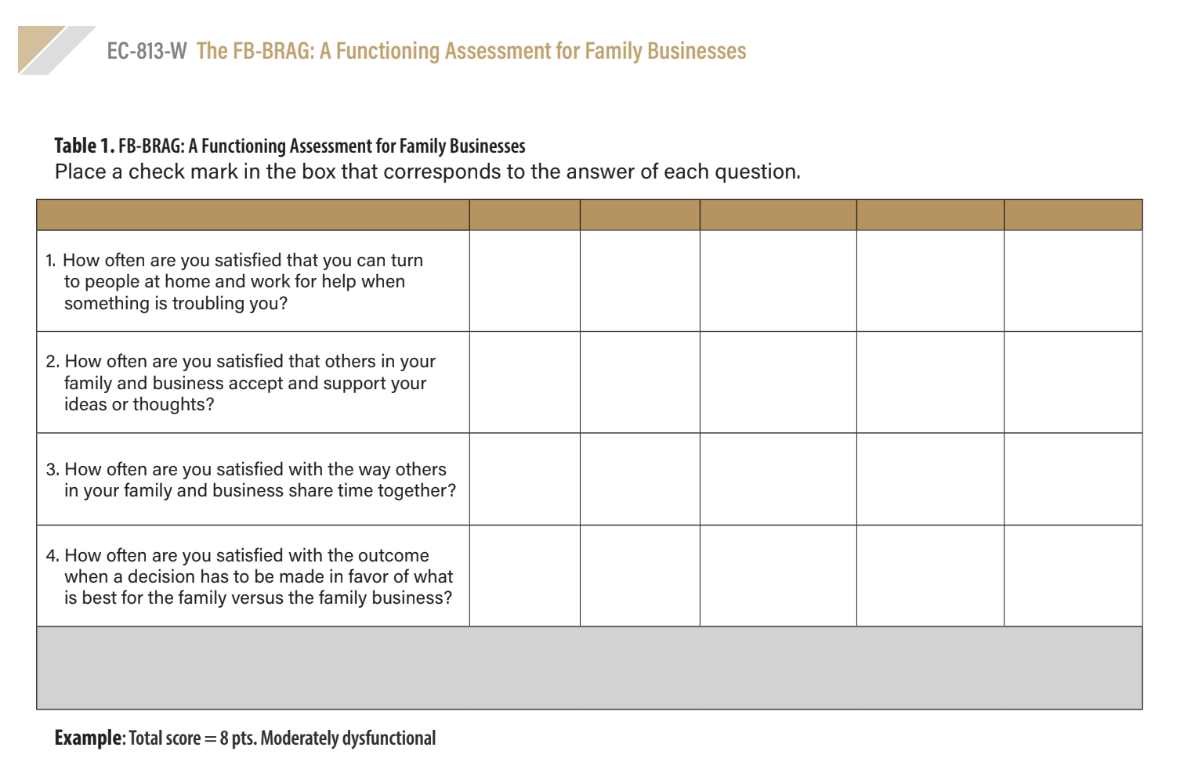
HANDOUT:
FB-BRAG FUNCTIONING ASSESSMENT
Let’s take a few minutes to assess the functioning of your family/business!
Refer to page 3 where the assessment grid is located.
Scores range from dysfunctional to highly functional.
Notes:
Instructions: Allow attendees 3-4 minutes to assess their own family/business and tally their score.
Time: 4 minutes
Materials: None
Handouts: None

Slide 18
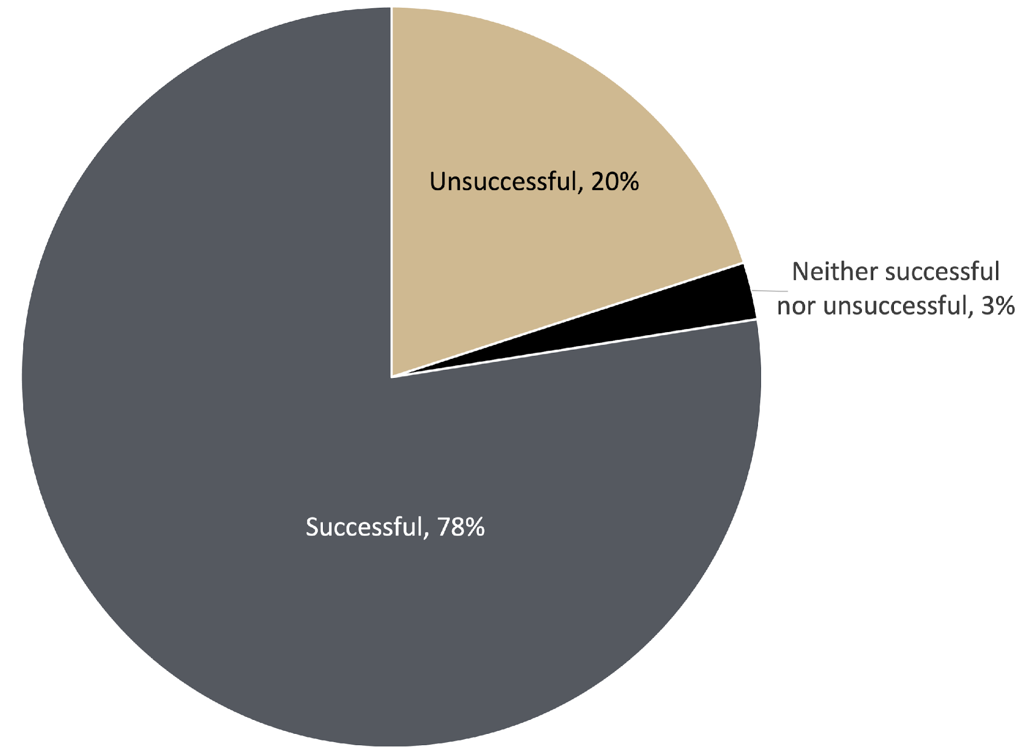
You inherited the business from a family member.
How successful did you perceive that transfer?
Most cited reason for being:
Unsuccessful: The process was not what I expected
Successful: I felt certain and secure on the timeline for succession and who was to be included
Source: 2023 North Central Region Farm Succession Survey
(Wiatt, Marshall and Langemeier)
Notes:
Instructions: Highlight that just because the next generation inherits the business, or land does not mean that they were pleased with the transfer process. Damage on family relationships and ties can happen when succession is not handled with intentionality and when conflict is not handled with care.
Time: 1 minute
Materials: None
Handouts: None

Slide 19
HIGHLY FUNCTIONAL FAMILY
(AND/OR BUSINESSES)
Foster a culture in which:
People in the family (and/or business) can turn to each other for help when something is troubling them
People in the family (and/or business) feel that others accept and support their ideas or thoughts
People in the family (and/or business) are satisfied in the way that others in their family (and/or business) share time together
People in the family (and/or business) are satisfied with the outcome when a decision must be made in favor of what is best for the family versus the business or other commitments
Notes:
Instructions: How can we have a functional family and business? There is a self-assessment that families can utilize to see how functional their family (and/or business) are.
Time: 2 minutes
Materials: none
Handouts: The FB-BRAG: A Functioning Assessment for Family Businesses
Source: Wiatt and Marshall, 2021, The FB-BRAG: A Functioning Assessment for Family Businesses

Slide 20
Incumbent and Successor:
Commitment to the Process
Notes:
Instructions: Intro to section
Time: 1 minute
Materials: None
Handouts: None

Slide 21
DEFINING GENERATIONS: HOW DO WE DEFINE INCUMBENTS AND SUCCESSORS?
Incumbent: senior generation in the farm or forest business, control majority of the ownership and/or management of the farm or forest, the owner, or holding generation
Sandwich generation: the generation in between
Successor: junior generation, individual(s) looking to take over the management and/or ownership of the farm
Notes:
Instructions: Define the different generations. Understanding the different motivations and concerns of each generation can help smooth the succession process.
Time: 1 minute
Materials: None
Handouts: None

Slide 22
ADAPTING ROLES FOR INCUMBENT
AND SUCCESSOR
In succession:
It’s not only about changing roles, but also about a change in self-understanding of the people involved
Incumbent is the one that initiates the transition process
  They must realize the need for the transition to the next generation
Notes:
Instructions: You must adapt the roles of incumbents and successors as the land or business transfers from generation to generation. The incumbent “holds all of the cards” in terms of getting the process started.
Time: 2 minutes
Materials: None
Handouts: None

Slide 23
GOALS OF INCUMBENT AND SUCCESSOR
Incumbents often seek a fit between their own personal values and preferences and the characteristics of the successor
Incumbent and successor are mutually dependent; both parties need to acknowledge each other’s goals and concerns
It is critical to make the goals, considerations, and fears of both sides clear and explicit; if understanding is lacking, it is difficult if not impossible, to close the deal to the satisfaction of both parties
Notes:
Instructions: Different generations have different motivations and goals. Both/all need to be acknowledged and addressed.
Time: 2 minutes
Materials: None
Handouts: None

Slide 24
GOALS OF INCUMBENT AND SUCCESSOR
“The continuity of a family business depends on the capacity of the family who owns the company to reach unity and commitment between its members.”
-Gallo and Amat, 2003
Notes:
Instructions: Commitment and buy in of all members of the family are necessary to completing the succession process.
Time: 1 minutes
Materials: None
Handouts: None
Source: Gallo, M. Á. and Amat, J. M., Empresas Familiares Centenarias, 2003, 159: “La continuidad de una empresa familiar depende de la capacidad de la familia que es propietaria de la empresa para alcanzar la unidad y el compromiso entre sus integrantes”.

Slide 25
QUALITIES ESSENTIAL TO A SUCCESSFUL FAMILY (AND BUSINESS)
Shared values
Shared power
Tradition
A willingness to learn and grow
Strong family ties
Commitment
Notes:
Instructions: Members of the family need to have shared values, power, and commitment to make the transition possible.
Time: 2 minutes
Materials: None
Handouts: None
To avoid the problems of conflicting values and goals:
Make it clear to every family member that they are not required to join the business on a full-time basis.
Do not assume that a successor must always come from within the family.
Give family members the opportunity to work outside of the business first to learn first-hand how others conduct business.
Shared power: dividing responsibilities along the lines of expertise is an important way of acknowledging respect for each family member’s talents and abilities
Tradition: The key is to select those traditions that provide a solid foundation for positive behavior while taking care not to restrict the future growth of the business

Slide 26
TYPES OF COMMITMENT
Calculative Commitment | Choice to join the business will benefit or “pay off” for successor | “Ought to” join the business
Affective Commitment | Desire to pursue the business as a career, wants to join the business | “Want to” join the business
Normative Commitment | Successor feels an obligation to join the business | “Need to” join the business
Notes:
Instructions: There are different types of commitment when it comes to the family land/business and each different commitment has consequences for how each party will behave based on their commitment.
Time: 2 minutes
Materials: None
Handouts: None
Source: Berkel, H.G. (2007). Father to Son: The Mediation of Family Firm Succession Conflict. Springer Grabler, Wiesbaden, Germany.

Slide 27
Conflict Modes &
How to Use Them
Notes:
Instructions: Intro to section
Time: 1 minute
Materials: None
Handouts: None

Slide 28

WHAT IS CONFLICT?
Conflict is . . .
any situation in which your concerns or desires differ from those of another person
Notes:
Instructions: Every relationship has some sort of conflict; the choice is how to react and handle it.
Time: 1 minute
Materials: None
Handouts: None

Slide 29

RESOLUTION
Is an outcome, not a specific process
The condition of the parties and their resources after a conflict is put to rest
Returns parties to productivity and coordination
  Coordination is based on relationships
Brings parties to address their relationship and resume coordination
Notes:
Instructions: Cover resolution as an outcome. Discuss
Time: 1 minute
Materials: None
Handouts: None

Slide 30
What Determines Conflict Modes?
Your Conflict Mode =
Skill + Situation
Two basic aspects of all conflict-handling modes
ASSERTIVENESS
COOPERATIVENESS
© Thomas-Kilmann Conflict Mode Instrument (TKI)
Notes:
Instructions: Intro to conflict modes. Each mode depends on your skills and the situation that you are in.
Time: 1 minute
Materials: None
Handouts: None

Slide 31
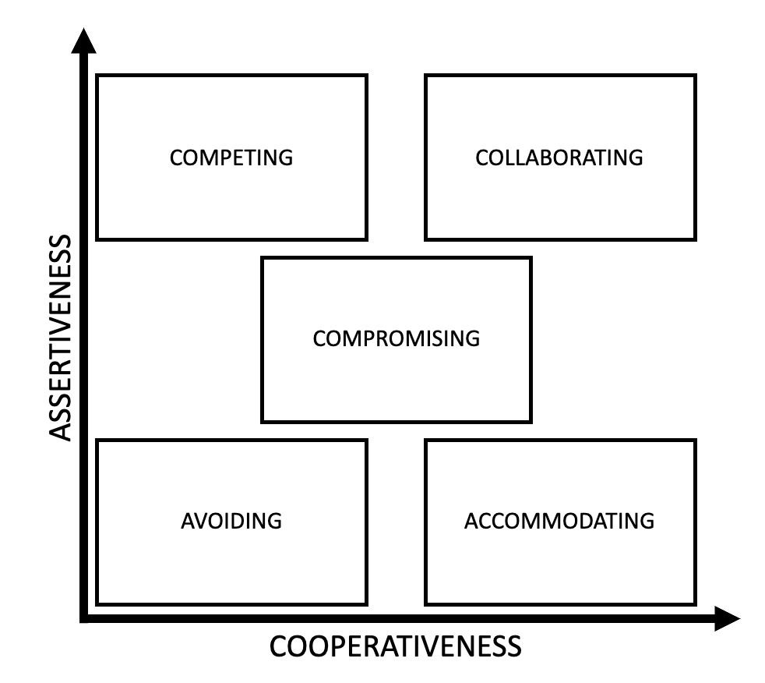
The Five Conflict-
Handling Modes
© Thomas-Kilmann Conflict Mode Instrument (TKI)
Notes:
Instructions: Intro to conflict modes. Each mode depends on your skills and the situation that you are in.
Time: 1 minute
Materials: None
Handouts: None

Slide 32
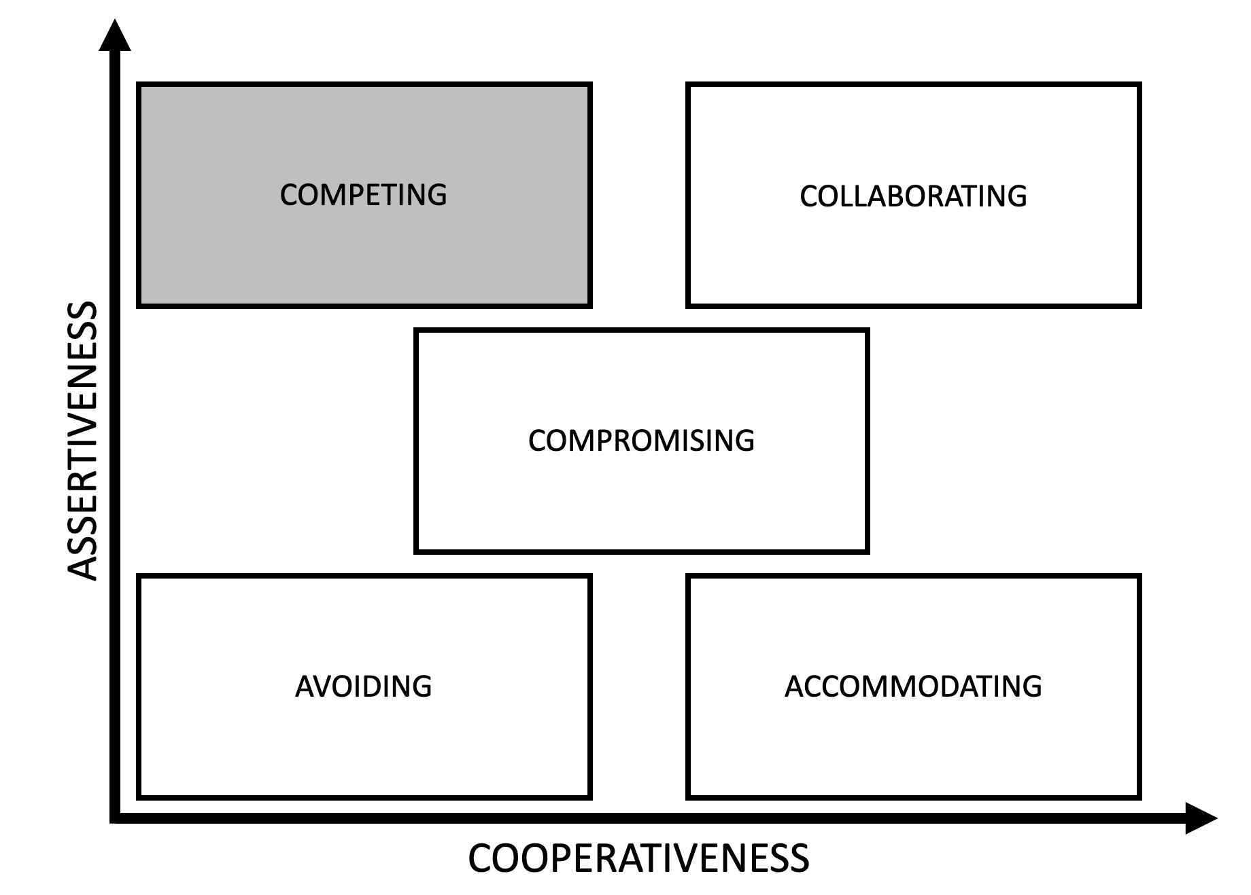

#1: COMPETING
Taking quick action
Making unpopular decisions
Standing up for vital issues
Protecting yourself
“Might makes right”​
© Thomas-Kilmann Conflict Mode Instrument (TKI)
Notes:
Instructions: Cover the “competing” conflict handling mode.
Time: 2 minute
Materials: None
Handouts: None
Notes:
Uses
When quick, decisive action is vital—for example, in an emergency
On important issues when unpopular courses of action need implementing—for example, cost cutting, enforcing unpopular rules, discipline
On issues vital to company welfare when you know you’re right When you need to protect yourself from people who take advantage of noncompetitive behavior
Questions to Ask
However, the questions below can help you determine if you are overusing or underusing competing in specific situations
Signs of overuse Are you surrounded by “yes” people? If so, perhaps it’s because they have learned that it’s unwise to disagree with you or have given up trying to influence you. This closes you off from information.
Are others afraid to admit ignorance and uncertainties to you? In a competitive climate, one must fight for influence and respect, acting more certain and confident than one feels. This means that people are less able to ask for information and opinions—they are less likely to learn.

Slide 33
WHEN TO USE THE COMPETING STYLE
When to use competing style in general:
A quick, decisive action is vital—for example, in an emergency
On important issues when unpopular courses of action need implementing—for example, cost cutting, enforcing unpopular rules, discipline
On issues vital to company welfare when you know you’re right
You need to protect yourself from people who take advantage of non-competitive behavior
© Thomas-Kilmann Conflict Mode Instrument (TKI)
Notes:
Instructions: Cover the “competing” conflict handling mode and when to use it in general and in succession.
Time: 2 minute
Materials: None
Handouts: None

Slide 34
WHEN TO USE THE COMPETING STYLE
How and when to use the competing style in succession:
To stand up for non-negotiables (for each generation) in the succession plan
To be sure that your voice is heard in the planning process
© Thomas-Kilmann Conflict Mode Instrument (TKI)
Notes:
Instructions: Cover the “competing” conflict handling mode and when to use it in general and in succession.
Time: 2 minute
Materials: None
Handouts: None

Slide 35
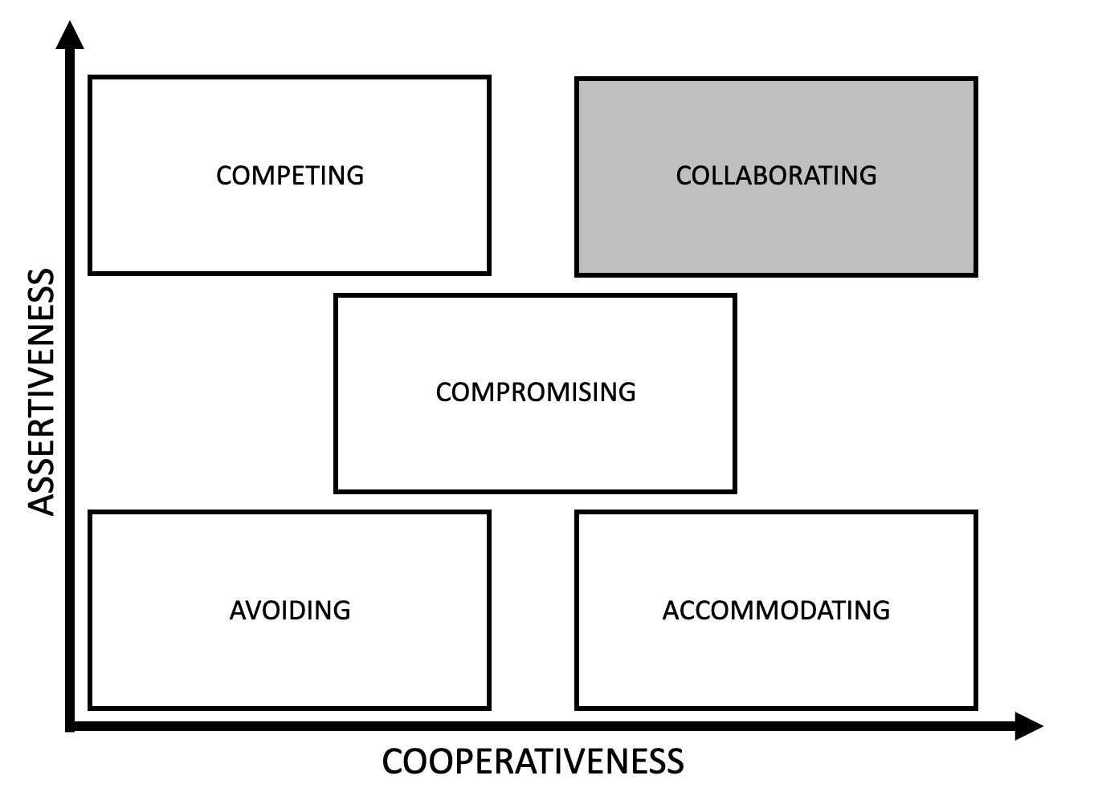

#2 COLLABORATING
Integrating solutions
Learning
Merging perspectives
Gaining commitment
Improving relationships
“Two heads are better than one”
© Thomas-Kilmann Conflict Mode Instrument (TKI)
Notes:
Instructions: Cover the “collaborating” conflict handling mode.
Time: 2 minute
Materials: None
Handouts: None
Notes:
Complete opposite of avoiding.
Uses:
You may be using this mode most frequently because of the circumstances you face. A group of company presidents identified the following situations as times when collaborating is especially useful and effective: When you need to find an integrative solution and the concerns of both parties are too important to be compromised When your objective is to learn and you wish to test your assumptions and understand others' views When you want to merge insights from people with different perspectives on a problem When you want to gain commitment by incorporating others’ concerns into a consensual decision When you need to work through hard feelings that have been interfering with a relationship Collaborating as a Style Your frequent use of collaborating may also be part of a collaborating style you have developed to deal with conflict. Styles are rooted in personal beliefs, values, and motives that “push” one’s conflict behavior in a consistent direction. Collaborators tend to see conflicts as problems to be solved, wanting quality decisions that truly resolve the issues. They believe in the power of consensus and in sharing information and understandings. They regard teammates as allies and tend to see people outside the team as potential allies. They build on others’ ideas and listen well. Collaborators value innovation, open-mindedness, learning, and consensus. They look for the value in what others say and combine that with their own insights to find win-win solution.

Slide 36
WHEN TO USE THE COLLABORATING STYLE
When to use COLLABORATING style in general:
You need to find an integrative solution
The concerns of both parties are too important to be compromised
You want to merge insights from different perspectives on a problem
When you need to work through hard feelings that have been affecting a relationship
© Thomas-Kilmann Conflict Mode Instrument (TKI)
Notes:
Instructions: Cover the “collaborating” conflict handling mode and when to use it in general and in succession.
Time: 2 minute
Materials: None
Handouts: None

Slide 37
WHEN TO USE THE COLLABORATING STYLE
How and when to use the COLLABORATING style in succession:
USE THIS STYLE A LOT IN SUCCESSION!
Succession is such an important process; the collaborating style is priceless
To maintain both the family relationships and the farm/forest/property
© Thomas-Kilmann Conflict Mode Instrument (TKI)
Notes:
Instructions: Cover the “collaborating” conflict handling mode and when to use it in general and in succession.
Time: 2 minute
Materials: None
Handouts: None

Slide 38
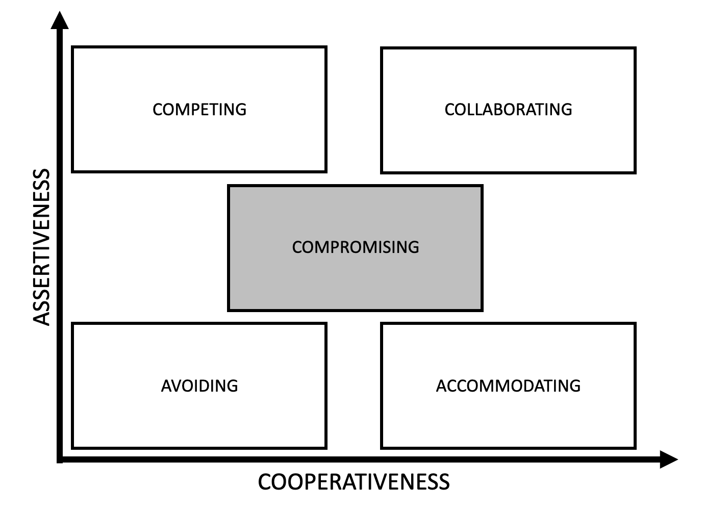

#3 COMPROMISING
Resolving issues of moderate importance
Reaching resolution with equal power and strong commitment
Creating temporary solutions
Dealing with time constraints
Backing up competing/ collaborating
“Split the difference”
© Thomas-Kilmann Conflict Mode Instrument (TKI)
Notes:
Instructions: Cover the “compromising” conflict handling mode.
Time: 2 minute
Materials: None
Handouts: None
Notes:
Uses:
When goals are moderately important but not worth the effort or the potential disruption involved in using more assertive modes When two opponents with equal power are strongly committed to mutually exclusive goals—as in labor–management bargaining When you want to achieve a temporary settlement of a complex issue When you need to arrive at an expedient solution under time pressure As a backup mode when collaboration or competition fails

Slide 39
WHEN TO USE THE COMPROMISING STYLE
When to use COMPROMISING style in general:
When goals are moderately important but not worth the effort or the potential disruption involved in using more assertive modes
When two opponents with equal power are strongly committed to mutually exclusive goals
When you want to achieve a temporary settlement of a complex issue
When you need to arrive at an expedient solution under time pressure
As a backup mode when collaboration or competition fails
© Thomas-Kilmann Conflict Mode Instrument (TKI)
Notes:
Instructions: Cover the “compromising” conflict handling mode and when to use it in general and in succession.
Time: 2 minute
Materials: None
Handouts: None

Slide 40
WHEN TO USE THE COMPROMISING STYLE
How and when to use the COMPROMISING style in succession:
Use with caution and very sparsely in succession
Avoid when issues are important to both parties; resentment will ensue after decisions have been made if there is too much compromise from any generation
© Thomas-Kilmann Conflict Mode Instrument (TKI)
Notes:
Instructions: Cover the “compromising” conflict handling mode and when to use it in general and in succession.
Time: 2 minute
Materials: None
Handouts: None

Slide 41

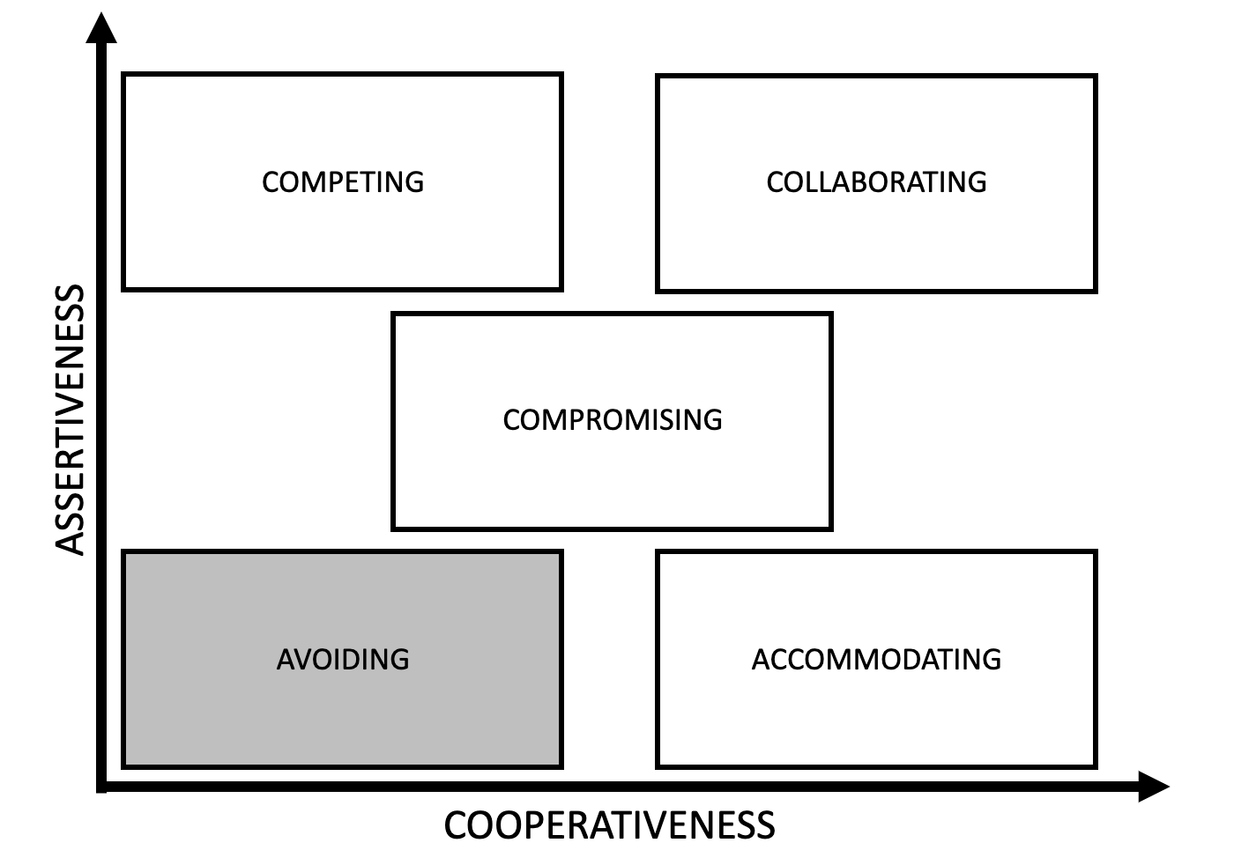
#4 AVOIDING
Leaving unimportant issues alone
Reducing tensions
Buying time
Knowing your limitations
Allowing others ownership
Recognizing issues as symptoms
“Leave well enough alone”
© Thomas-Kilmann Conflict Mode Instrument (TKI)
Notes:
Instructions: Cover the “avoiding” conflict handling mode.
Time: 2 minute
Materials: None
Handouts: None
Notes:
Uses:
When an issue is unimportant or when other, more important issues are pressing
When you perceive no chance of satisfying your concerns—for example, when you have low power, or you are frustrated by something that would be very difficult to change
When the potential costs of confronting a conflict outweigh the benefits of its resolution
When you need to let people cool down—to reduce tensions to a productive level and to regain perspective and composure
When gathering more information outweighs the advantages of an immediate decision When others can resolve the issue more effectively
When the issue seems tangential or symptomatic of another, more basic issue

Slide 42
WHEN TO USE THE AVOIDING STYLE
When to use AVOIDING style in general:
When an issue is unimportant
When you perceive no chance of satisfying your concerns
When the potential costs of confronting a conflict outweigh the benefits of its resolution
When you need to let people cool down
When gathering more information outweighs the advantages of an immediate decision
When others can resolve the issue more effectively
When the issue seems symptomatic of another, more basic issue
© Thomas-Kilmann Conflict Mode Instrument (TKI)
Notes:
Instructions: Cover the “avoiding” conflict handling mode and when to use it in general and in succession.
Time: 2 minute
Materials: None
Handouts: None

Slide 43
WHEN TO USE THE AVOIDING STYLE
How and when to use the AVOIDING style in succession:
Use with caution and very sparsely in succession – succession is too important to avoid
If you avoid when issues are important to both parties; resentment will ensue after decisions have been made if there is too much not discussed
© Thomas-Kilmann Conflict Mode Instrument (TKI)
Notes:
Instructions: Cover the “avoiding” conflict handling mode and when to use it in general and in succession.
Time: 2 minute
Materials: None
Handouts: None

Slide 44

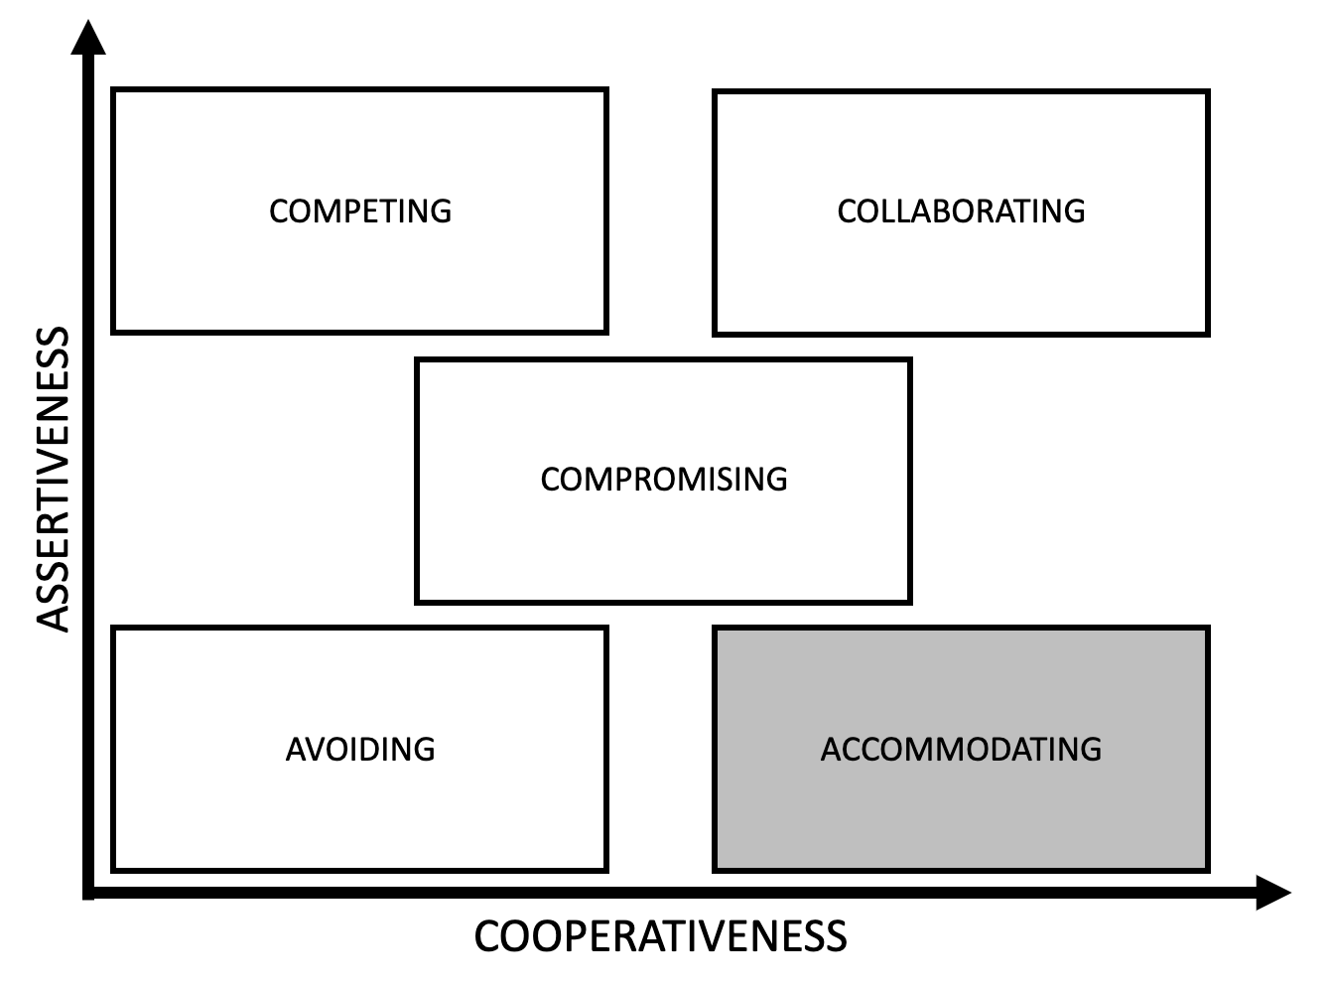
#5 ACCOMMODATING
Showing reasonableness
Creating goodwill
Keeping “peace”
Retreating
Maintaining perspective
“It would be my pleasure”
© Thomas-Kilmann Conflict Mode Instrument (TKI)
Notes:
Instructions: Cover the “accommodating” conflict handling mode.
Time: 2 minute
Materials: None
Handouts: None
Notes:
Uses:
When you realize that you are wrong—to allow a better solution to be considered, to learn from others, and to show that you are reasonable
When the issue is much more important to the other person than it is to you—to satisfy the needs of others and as a goodwill gesture to help maintain a cooperative relationship
When you want to build up social credits for later issues that are important to you
When you are outmatched and losing and more competition would only damage your cause
When preserving harmony and avoiding disruption are especially important
When you want to help your employees develop by allowing them to learn from their mistakes

Slide 45
WHEN TO USE THE ACCOMMODATING STYLE
When to use ACCOMMODATING style in general:
When you realize that you are wrong
When the issue is much more important to the other person than it is to you
When you want to build up social credits for later issues that are important to you
When you are outmatched and losing, and more competition would only damage your cause
When preserving harmony and avoiding disruption are especially important
When you want to help your employees develop by allowing them to learn from their mistakes
© Thomas-Kilmann Conflict Mode Instrument (TKI)
Notes:
Instructions: Cover the “accommodating” conflict handling mode and when to use it in general and in succession.
Time: 2 minute
Materials: None
Handouts: None

Slide 46
WHEN TO USE THE ACCOMMODATING STYLE
How and when to use the ACCOMMODATING style in succession:
Use with topics in succession that are unimportant to you (potentially who gets a particular asset)
Do not accommodate when issues are important to both parties; resentment will ensue after decisions have been made if there is too much accommodation
© Thomas-Kilmann Conflict Mode Instrument (TKI)
Notes:
Instructions: Cover the “accommodating” conflict handling mode and when to use it in general and in succession.
Time: 2 minute
Materials: None
Handouts: None

Slide 47
APPLYING THE CONFLICT MODES
Each of us can use all five conflict-handling modes
  Each has its place, depending on the situation
Your conflict mode behavior in your family and business is therefore a result of both your personal predispositions and the requirements of the situation in which you find yourself
You can have different ”default modes” for business vs. family
© Thomas-Kilmann Conflict Mode Instrument (TKI)
Notes:
Instructions: Highlight that every person is capable of applying all of the conflict modes. You need to practice.
Time: 2 minute
Materials: None
Handouts: None
Notes:
In the case of conflict-handling behavior, there are no right or wrong answers. All five modes are useful in some situations: each represents a set of useful social skills. None of us can be characterized as having a single style of dealing with conflict. But certain people use some modes better than others and, therefore, tend to rely on those modes more heavily than others—whether because of temperament or practice.

Slide 48
Conflict Example
Notes:
Instructions: Intro to section
Time: 1 minute
Materials: None
Handouts: None

Slide 49

CONFLICT SCENARIO
Trish has joined the family hog operation with hopes of one day owning and managing the business. With no other siblings interested in joining the business, she seems the obvious successor.
After 15 years of being an employee and no plans or discussion of Trish taking over the business, she applies for an outside job. Her parents are devastated at the news; they always assumed that Trish would take over the business when they decided to retire.
What could have been done to avoid this issue altogether?
Notes:
Instructions: Read through scenario and ask audience “what could have been done to avoid this issue altogether?”
Time: 4 minutes
Materials: None
Handouts: None

Slide 50
CONFLICT SCENARIO
INSIGHT
What could have been done to avoid this issue altogether?
COMMUNICATION!
Sometimes, you do not have to avoid the conflict; it can be mitigated altogether. With proper communication, planning, and discussion, roles and expectations can be clarified, and conflict will not be created.
Notes:
Instructions: Discuss how proper communication can help avoid conflict and make the succession process smoother.
Time: 2 minutes
Materials: None
Handouts: None

Slide 51
Resolution in Succession
Notes:
Instructions: Intro to section
Time: 1 minute
Materials: None
Handouts: None

Slide 52



GETTING TO RESOLUTION
Resolution may not always occur
When you do (X) in situation (Y), I feel (Z)
Ex: When you don’t return my calls after I leave you a message about our contract, I feel like my concerns are not important.
Have an attitude of resolution
Notes:
Instructions: Discuss resolution.
Time: 2 minutes
Materials: None
Handouts: None
Notes:
Attitude of resolution: evaluating the situation through the lens of resolution, you become an observer of what might be fair to everyone in the situation even if you are directly involved. It is a skill you can cultivate.

Slide 53




GETTING TO RESOLUTION IN SUCCESSION
Communication is required
Realization that succession will take time
Outside help can be needed
Commitment to the process is necessary
Notes:
Instructions: Discuss resolution.
Time: 2 minutes
Materials: None
Handouts: None
Notes:
Attitude of resolution: evaluating the situation through the lens of resolution, you become an observer of what might be fair to everyone in the situation even if you are directly involved. It is a skill you can cultivate.

Slide 54
Questions
Notes:
Instructions: Thank the participants and ask for any additional questions.
Time: 1 minute
Materials: None
Handouts: None

