Slide 1
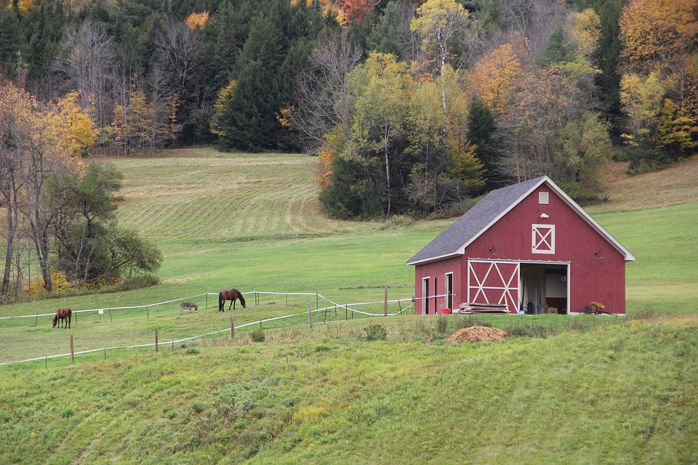
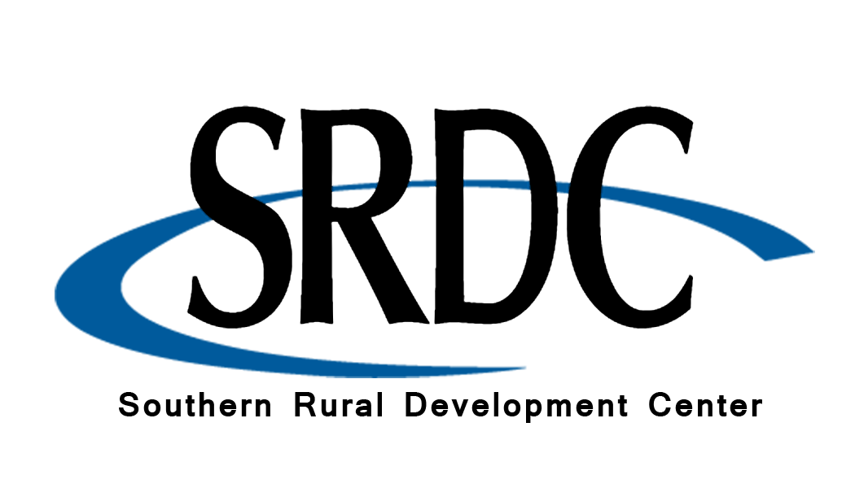
Legal and Business Structure
Notes:
Instructions: Introduction to Module 3
Time: 1 minute
Materials: None
Handouts: None

Slide 2




Partnering Organizations
Notes:
Instructions: This slide highlights the partnering organizations that have worked together to develop materials and host trainings.
Time: 1 minute
Materials: None
Handouts: None

Slide 3

Purpose:
Succession planning encompasses many emotional and financial aspects of a family and a business, making decisions and moving forward more difficult. This research-based curriculum with comprehensive handouts integrated will give participants the confidence they need to learn strategies for moving succession forward with their property or business. Both soft and hard skills are covered in the materials and will empower owners to develop and implement their succession plan.
Funding to develop this training provided by:
&
Notes:
Instructions: Explain the purpose of the overall curriculum.
Time: 1 minute
Handouts: None
Materials: none

Slide 4
Primary Authors
Renee Wiatt
Research and Extension Specialist | North Central Regional Center for Rural Development
Family Business Management Specialist | Purdue Institute for Family Business
Department of Agricultural Economics | Purdue University, West Lafayette, IN
Dr. Kurt Smith
Assistant Professor of Forestry and Environmental Resources
North Carolina State University
Dr. Rebecca Smith
Associate Extension Professor | Mississippi State University Extension
Notes:
Instructions: Please acknowledge the primary and contributing authors to this material as well as the funding stream through the Southern Rural Development Center and the Socially Disadvantaged Farmers and Ranchers Policy Research Center at Alcorn State University.
Time: 1 minute
Materials: none
Handouts: none

Slide 5
PRESENTERS
Enter presenter information on this slide
Notes:
Instructions: Add presenter information and introduce yourselves.
Time: 1 minute
Materials: none
Handouts: none

Slide 6
Important notes before we begin:
These materials are intended to present general information on succession planning.
The information may not be applicable to every state or territory.
These materials do not provide legal advice. Specific advice should be obtained from an attorney or another professional well versed in the facts and circumstances related to the individual seeking advice and the jurisdiction where the property is located.
Notes:
Instructions: Read the disclaimer and answer any questions that may arise.
Time: 1 minute
Materials: none
Handouts: None

Slide 7
PROTECTING YOUR INFORMATION
No personal stories.
General questions are welcome.
Personal questions should be asked outside of the group setting.
Notes:
Instructions: Go over these guidelines with participants to ensure that participants understand the reasons for not including stories or questions of a personal nature.
Time: 1 minute
Materials: none
Handouts: None

Slide 8
Defining Succession Planning & Estate Planning
When we say: | We are referring to:
Succession Planning | The plan for transfer of management (decision-making abilities and authority) and/or ownership (shares, farm or forest assets, etc.) during the life of the owner(s)
Estate Planning | The plan for transfer of personal assets and property that will transition after the owner’s life to designated beneficiaries
*Disclaimer: The terms Succession Planning and Estate Planning are defined differently depending on state/region. However, for use of this training, the definitions above are implemented.
Notes:
Instructions: Be sure that attendees understand the difference between “Succession Planning” and “Estate Planning” as we move through the program.
Time: 1 minute
Materials: none
Handouts: None

Slide 9
Defining Generations and Roles in Succession
When we say: | We are referring to:
Successor | The junior generation in the land/business, next individual(s) who will manage and/or own the land/business
Incumbent | The senior generation in the land/business, current owner/manager of the land/business
Notes:
Instructions: Be sure that attendees understand the difference between “Successor” and “Incumbent” as we move through the program.
Time: 1 minute
Materials: none
Handouts: None

Slide 10
Defining Businesses and Land
When we say: | We are referring to:
Businesses | Entities that could be farms, an LLC, sole proprietorship, land in a trust, corporation, company, and/or partnerships
Land | Any type of land, including but not limited to: forests, bare land, vacant land, farmland, pasture, and land with buildings/barns
Notes:
Instructions: Be sure that attendees understand the difference between “Businesses” and “Land” as we move through the program.
Time: 1 minute
Materials: none
Handouts: None

Slide 11
TOPICS TO EXPLORE
MODULE #3 LEGAL AND BUSINESS STRUCTURES | Intestate Title: Tools for Remediation and Prevention
 | Transfer Options
 | Ownership Structure & Transfer
 | During Life Transfer or After Death Decisions
 | Before You Visit Professional Advisors
Purpose of Module #3
To introduce primary tools for the transfer of land and business interests.
Notes:
Instructions: Introduction to Module 3
Time: 1 minute
Materials: None
Handouts: None

Slide 12
Intestate Title:
Tools for Remediation and Prevention
Notes:
Instructions: Introduce the section on Intestate title: “Tools for remediation and prevention”
Time: minutes
Materials: None
Handouts: None
Notes:
1 Minute
Heirs' property has a historical past in its creation and land loss for both African American and Native American populations, but it is also a current problem, with new property being created at among every demographic in the United States.
Point out we have the ability to work towards decreasing new heirs property being created through good successional planning.

Slide 13
INTESTATE TITLE
Remediating the Past
Prevent in the Present
Planning for the Future
Notes:
Instructions: Highlight past training as having addressed some of these broad topics. Give an example of succession for a business (farm or forest) and an example of how you might consider planning for real property transfer (buildings, land, equipment, funds).
Time: 2 minutes
Materials: None
Handouts: None
Notes:

Slide 14
INTRODUCTION
It is noteworthy that 40% of the nation’s farm and forest land is owned by individuals aged 65 and older, and more than 370 million acres will change ownership by 2040 through succession executed by wills and probate. This creates a great deal of vulnerability to accelerating land fragmentation throughout the United States and represents one of the largest transfers of intergenerational wealth in history.
Smith, K.; Cubbage, F. Land Fragmentation and Heirs Property: Current Issues and Policy Responses. Land 2024, 13, 459. https://doi.org/10.3390/land13040459
Notes:
Instructions: Emphases on the huge transfer of wealth that is going to take place by 2040. Done well, it will protect fragmenting and breaking up important farm and forest lands.
Time: 2 minutes
Materials: None
Handouts: None
Notes:

Slide 15
These land transfers are important for keeping both forest and farmlands for succeeding generations. Intergenerational land transfer depends on the abilities of families to work together to find the best solution for their situation. Differences among family members in values, goals, and critical skills can often lead to disaster.
Succession planning is the human side of estate planning. This training will help you assist landowners by describing strategies that will assist landowners in ensuring a successful intergenerational transfer of land, wealth, and assets occurs from one generation to the next.
Notes:
Instructions: This training deals with the human side of successional planning, emphasize giving participant tools to communicate and create a thinking map to work with other generations to find the best solution for your land and business.
Time: 3 minutes
Materials: None
Handouts: None
Notes:

Slide 16
LACK OF SUCCESSION AND ESTATE PLANNING HAS LED TO PAST PRESENT AND FUTURE CHALLENGES:
Past
Heirs Property
Theft
Fraud
Lack of Equal Access USDA
Loss of Intergenerational Wealth
Land Loss: African American and Native American
Present
Unresolved Heirs Property
Partitioning
UPHPA (not in all states)
Land Fragmentation
Loss of Intergenerational Wealth
Loss of Prime Agricultural Land
Future
Development
Roads
Loss of Prime Agricultural Lands
Greater Land Fragmentation
Inventory-Food and Fiber
Continued Loss Intergenerational Wealth
Notes:
Instructions: A quick synopsis of the past history of heirs' property, ramifications of new property being created, and the future threat of permanent land loss of prime farm and forest soils in the future.
Time: 3 minutes
Materials: None
Handouts: None
Notes:

Slide 17
COMMON TRIGGERS TO ESTABLISH OR REVIEW YOUR SUCCESSION AND ESTATE PLANS
Marriage or Divorce: The presence or absence of a spouse could have a tremendous impact on how your estate is eventually divided.
Children and Adoption: Revisit your will and other documents to make sure they include all your children (natural, adopted and/or stepchildren) as you would like. The government may not divide your assets the way you want if you don’t have a written estate plan in place.
Buying or Selling a Home: The purchase or sale of real estate can dramatically impact the value and liquidity of your estate. A will could also ensure that your estate doesn't wind up mired in probate court.
Notes:
Instructions: Talk about some of the common triggers that cause review or creation of succession and estate plans.
If possible, use some quick examples.
Time: 1 minute
Materials: None
Handouts: None
Notes:

Slide 18
New Financial Accounts: Changes in your finances, such as receiving an inheritance. It should be reflected in your estate plan so that your executor will have an accurate listing of your financial assets.
Starting or Selling a Business: Business succession planning provides an outline of the way that your business is to be managed. You may need to establish or update your plan to address changes.
Moving to a New State: When you move to another state, you should also plan to review your succession and estate documents. Since laws vary from state to state, you want to be aware of the differences and make changes accordingly.
Notes:
Instructions: Talk about some of the common triggers that cause review or creation of succession and estate plans.
If possible, use some quick examples.
Time: 2 minutes
Materials: None
Handouts: None
Notes:

Slide 19
Death: There is always the possibility you may outlive some people named in your estate documents. Whether it is a beneficiary, executor, appointed guardian, durable or medical power of attorney designee, make sure to update your relevant documents to fill any gaps created by the unfortunate loss of a friend, partner, or family member.
Medical Condition: A serious medical diagnosis or sudden accident should prompt an urgent review of your estate planning needs. It may be time to change your designations regarding who you want to handle health care decisions or financial business if you become incapacitated.
Change in Wishes: What you want for your estate plan today might not be what you want in the future. If you’ve had a change of heart regarding how you want your estate handled, work with your attorney to make sure your wishes are clear, ad reflected in your legal documents.
Notes:
Instructions: Talk about some of the common triggers that cause review or creation of succession and estate plans.
If possible, use some quick examples.
Time: 2 minutes
Materials: None
Handouts: None
Notes:

Slide 20
TRANSFER OPTIONS
Notes:
Instructions: Introduce the section on “Transfer Options”
Time:1 minute
Materials: none
Handouts: none

Slide 21
EDUCATE YOURSELF BEFORE GOING TO VISIT YOUR ATTORNEY, TAX SPECIALIST AND FINANCIAL ADVISOR.
Know your options for transferring your land or property.
Know about the different forms of ownership you can create or have in place for your heirs.
Notes:
Instructions: There are a lot of options for how to transfer land to the next generation.
They all carry different advantages and disadvantages based on your goals.
Time: 1 minute
Materials: None
Handouts: None
Notes:

Slide 22
COMMON TRANSFERRING YOUR LAND OPTIONS
Sell Your Land
Donate Your Land
One Successor via Trust/Will
Divide Among Successors Via Trust/Will, or While Alive
Leave Undivided to All Successors Via Trust/Will or While Alive
Do Nothing Government Will Decide
Immediate cash removes many decisions from heirs
If Heirs have no interest and an organization or has interests that align with your goals
When there are heirs with clear interest in the property and business
Makes clear who gets what via division
Requires a lot of cooperation and often leads to family disputes
Each state has a specific formula they will follow to distribute your estate
Notes:
Instructions: Review these common mechanisms for division of land
Time: 5 minutes
Materials: None
Handouts: None
Notes:

Slide 23
OPTION 1: SELL YOUR LAND OR BUSINESS
This could occur with individuals, another business or a non-profit organization.
If you have a relationship with purchasers, you may want to consider building their interest in the land or business.
You may plan to sell the land or business and put that money towards other uses, such as trust funds, investments, or insurance.
Notes:
Instructions: Use short examples where possible
Time: 2 minutes
Materials: None
Handouts: None
Notes:

Slide 24
OPTION 2: TRANSFER OF DEED ON DEATH
A Transfer on Death Deed, or TODD, is a simple way to transfer real estate to someone else after you die.
With a properly recorded Transfer on Death Deed, no probate is needed to transfer the real property.
Notes:
Instructions: A way to avoid wills and probates for your property.
May have to be updated if conditions change.
Not available in every state
Time: 2 minutes
Materials: None
Handouts: None
Notes:

Slide 25
OPTION 2: TRANSFER OF DEED ON DEATH
A Transfer on Death Deed lets you keep all ownership rights to the property during your lifetime, so you can sell it, or use is as collateral on a loan. The Transfer on Death Deed takes effect upon your death, so the property never becomes part of your estate. When you die, your property interest passes to the person you named in the Transfer on Death Deed without any probate action.
Each state has specific requirements for a TOFF. Consult a lawyer experienced in transfers of real property in your jurisdiction.
Notes:
Instructions: A way to avoid wills and probates for your property.
May have to be updated if conditions change.
Not available in every state
Time: 2 minutes
Materials: None
Handouts: None
Notes:

Slide 26
STATES WHERE YOU CAN MAKE A TODD DEED OR BENEFICIARY DEED
Alaska
Arizona
Arkansas
California
Colorado
District of Columbia
Hawaii
Illinois
Kansas
Maine
Minnesota
Mississippi
Missouri
Montana
Nebraska
Nevada
New Mexico
North Dakota
Ohio
Oklahoma
South Dakota
Texas
Utah
Virginia
Washington
West Virginia
Wisconsin
Wyoming
Notes:
Instructions: Leave the slide up for participants to see if their state has a TODD
Avoids probate and transfers automatically upon the last breath of the owner.
Time: 1 minute
Materials: None
Handouts: None
Notes:

Slide 27
LADY BIRD DEEDS AND ENHANCED LIFE ESTATES
A lady bird deed/enhanced life estate is a deed that allows a real estate owner to transfer a contingent ownership interest in a piece of property to specific and designated beneficiaries while still retaining an enhanced life estate. This means that a beneficiary’s claim to the property will not vest until the property owner dies. It provides some protection for losing the estate through medical bills after death, and the owner can still sell or do whatever they want without consulting anyone.
FLORIDA, MICHIGAN, TEXAS, VERMONT, NORTH CAROLINA, AND WEST VIRGINIA-HAVE THEM!
*FUNCTIONS SIMILAR TO TODD, BUT WITH SOME KEY DIFFERENCES. It’s important to consult an attorney in the state in which you live. Laws are constantly changing and updating.
Notes:
Instructions: There are other legal tools that will function similarly if your state doesn't have a TODD-See an attorney in your state.
Key feature of TODD, Lady Bird Deeds and Enhanced Life Estates are that the avoid going to probate court, which can take years to settle.
Time: 3 minutes
Materials: None
Handouts: None
Notes:

Slide 28
THERE ARE SEVERAL RISKS ASSOCIATED WITH TODD’S
One of the main risks is:
A beneficiary who receives real estate through a transfer on death deed takes title subject to the liens. encumbrances, claims and interest affecting the property at the time of death of the transferor.
One of the main benefits is:
Avoiding the probate process and expense
*As always talk to your attorney this tool if applicable in your state.
Notes:
Instructions: Point out the upsides and downsides and stress the importance of seeing an attorney if this option is of interest to you.
Time: 2 minutes
Materials: None
Handouts: None
Notes:

Slide 29
OPTION 3: DONATE THE LAND
You may choose to donate your land and the timing, method and amount of the donation will matter in your estate plan because they are related to taxes, gifting amounts or other implications for the organization that receives your donation.
Should you go this route, have open conversations or meetings with the organization of your choice as well as your attorney and financial advisor to create a timeline that will work for all parties involved.
Notes:
Instructions: Tax implications for how and when you do it.
Can be a good option if you have disinterested heirs and find an organization that aligns well with your goals.
Very important to talk with both an attorney and a tax expert, as well as have very candid conversations with the receiving organization of your donation.
Time: 3 minutes
Materials: None
Handouts: None
Notes:

Slide 30
OPTION 3: DONATE THE LAND
Organizations often have gift policies that may require you to provide information as to title, environmental and value. The IRS has rules and forms addressing gifts of property. You need to consult an attorney familiar with donating real property.
Notes:
Instructions: Tax implications for how and when you do it.
Can be a good option if you have disinterested heirs and find an organization that aligns well with your goals.
Very important to talk with both an attorney and a tax expert, as well as have very candid conversations with the receiving organization of your donation.
Time: 3 minutes
Materials: None
Handouts: None
Notes:

Slide 31
OPTION 4: SELECT ONE SUCCESSOR
In this case, one individual will receive your land regardless of how many successors you have.
For example, you may have one successor who is qualified to receive the land while the other successors could receive personal property, money, or life insurance, which are discussed in more detail below.
You can complete the transfer of your land via a will.
Establishing a single successor is a valuable strategy if your interest is in keeping your land or business intact.
Notes:
Instructions: When its possible find one individual to receive your land. In the case that's not possible, design a legal architecture that creates the greatest possibility of success for multiple heirs in receivership of your interest.
Time: 2 minutes
Materials: None
Handouts: None
Notes:

Slide 32
OPTION 5: LEAVE THE LAND UNDIVIDED TO ALL SUCCESSORS
For this option, you can either leave the land undivided to your successors in your will or you can use a form of ownership to transfer the land to them while you are still alive. There are several types of ownership options which we will cover.
Notes:
Instructions: This requires a lot of cooperation and is perhaps the riskiest model for your heirs but can work with the right legal form and interested partners.
3 remedies are suggested, but all require cooperation and identification of interested parties.
Time: 2 minutes
Materials: None
Handouts: None
Notes:

Slide 33
OPTION 5: LEAVE THE LAND UNDIVIDED TO ALL SUCCESSORS
It is critical that your successors have a good working relationship with each other because this ownership form will function in many ways as a business, with everyone holding a 100% interest together.
This potentially creates heirs’ property, at minimum tenants in common.
***NOT AN IDEAL OPTION IF AVOIDABLE
*Common legal remedies: Tenants in Common Agreement, LLC, Trusts
Notes:
Instructions: This requires a lot of cooperation and is perhaps the riskiest model for your heirs but can work with the right legal form and interested partners.
3 remedies are suggested, but all require cooperation and identification of interested parties.
Time: 2 minutes
Materials: None
Handouts: None
Notes:

Slide 34
OPTION 6: DIVIDE THE LAND OR BUSINESS AMONG YOUR SUCCESSORS
This option divides the land or business among your successors and can be accomplished via will, deed or other forms of ownership.
You might select this option if future land management would benefit from individual ownership or management. This could be the case if your children have difficulty cooperating.
**This option will require you to divide the land/business which could entail surveys, etc.
Notes:
Instructions: Makes it easier to overcome disagreements or to facilitate an heir wanting to opt out.
Time: 2 minutes
Materials: None
Handouts: None
Notes:

Slide 35
**NOT AN IDEAL OPTION
This option means that you develop no plan for the outcome of your estate.
Doing nothing will result in a default form of ownership upon your death and will depend upon your number of direct heirs and the laws of your particular state.
It will either be sole ownership or joint ownership with the right to survivorship and will follow state laws.
Option 7: Do Nothing
Notes:
Instructions: Discourage this option unless you have a preference for the government to decide the dispossession of your wealth.
There are fifty different models for what the state would do, based on where the estate is.
You should be familiar with your state if you select the “do nothing” model.
Time: 2 minutes
Materials: None
Handouts: None
Notes:

Slide 36
There will be no planning for inheritance taxes or estate taxes.
Your direct heirs will deal with the consequences of you having no plan.
Each state has a different protocol for how assets are handled and distributed.
Option 7: Do Nothing
Notes:
Instructions: Discourage this option unless you have a preference for the government to decide the dispossession of your wealth.
There are fifty different models for what the state would do, based on where the estate is.
You should be familiar with your state if you select the “do nothing” model.
Time: 2 minutes
Materials: None
Handouts: None
Notes:

Slide 37
OWNERSHIP STRUCTURE
& TRANSFER
Notes:
Instructions: Give introduction for section: “Ownership Structure & Transfer”
Time: 1 minute
Materials: none
Handouts: none

Slide 38
GROUP 1 - Will happen automatically.
GROUP 2 - Requires legal architecture, can be done during life or after death.
Two Categories Ownership Transfer:
Notes:
Instructions: These are the primary means you can pursue to transfer ownership of your land or business.
Time: 2 minutes
Materials: None
Handouts: None
Notes:

Slide 39
TWO GROUPS OF OWNERSHIP FOR TRANSFER OF LAND OR BUSINESS (DURING LIFE OPERATION AND AFTER BY SURVIVORS)
Group 1-Requires you to do nothing
Group 2-Requires some legal architecture and pre-planning
Joint Ownership with Right to Survivorship
Sole Ownership
Tenancy in Common
General Partnership
Limited Partnership
LLC
S and C Corporations
Trusts
Notes:
Instructions: Two groupings -The first requires little work or use of an attorney, the second requires thought and some legal help. No one remedy works for every situation but needs thought, communication, and planning among heirs.
We will give a brief review of some of the key features of each option in the slides that follow.
Time: 2 minutes
Materials: None
Handouts: None
Notes:

Slide 40
SOLE OWNERSHIP:
SOLE OWNERSHIP, JOINT OWNERSHIP, TENANCY IN COMMON
Sole Ownership:
This simplest form of ownership is where one individual holds a legal title and exclusive rights of possession. They legally make all the decisions. This ownership form can be good and bad. Setup is simple and low-cost, and taxes are reported by the individual. This ownership has no liability protection and can only be transferred via will or deed. The sole ownership ends when it is transferred out of the owner’s hands.
Notes:
Instructions: Simple and uncomplicated option.
Provides no liability protection.
Time: 1 minute
Materials: None
Handouts: None
Notes:

Slide 41
JOINT OWNERSHIP WITH RIGHT OF SURVIVORSHIP
An ownership where two or more owners share an undivided interest in the property is simple and inexpensive to set up.
Taxes are reported by each owner.
This ownership offers no liability protection.
Upon the death of a co-owner, the others automatically assume ownership. If one owner remains, it reverts to sole ownership.
If one owner wants to sell their share, some state allow a sale. Other states require obtaining consent from all other owners, and they cannot force a sale.
Notes:
Instructions: Share and share alike ownership till one owner passes, then it becomes a sole ownership again.
Also, no liability protection.
Time: 2 minutes
Materials: None
Handouts: None
Notes:

Slide 42
TENANCY IN COMMON
This is joint ownership without the right to survivorship. This has several implications.
First, interests can be transferred via a will and thus will go through probate.
Second, owners can force a sale or sell their interest without consent from all other owners. In this form of ownership, owners can own different proportions (percentages) of the property.
Notes:
Instructions: This is essentially the creation of new heirs' property, offers little protection, and has the potential for becoming contentious, leaving the courts to intervene in many cases.
Time: 2 minutes
Materials: None
Handouts: None
Notes:

Slide 43
TENANCY IN COMMON
This ownership will continue until it is sold or until there is only one owner, at which point it will revert to sole ownership.
The setup is simple and low-cost, and taxes are reported by each owner.
This type of ownership offers no liability protection.
Notes:
Instructions: This is essentially the creation of new heirs' property, offers little protection, and has the potential for becoming contentious, leaving the courts to intervene in many cases.
Time: 2 minutes
Materials: None
Handouts: None
Notes:

Slide 44
DURING LIFE TRANSFER OR AFTER DEATH DECISIONS
Notes:
Instructions: Give intro for section: “During life transfer or after death decisions”
Time: 1 minute
Materials: none
Handouts: none

Slide 45
GENERAL PARTNERSHIP
This is where two or more co-owners or partners establish an organized for-profit entity.
Setup is more complex and expensive. The partnership will file a tax form in addition to individual taxation. The partnership itself will not pay taxes.
Partners can have unequal interest in the business but are liable for all its debts and contracts. The partnership may terminate in the case of death, bankruptcy or exit by a partner, but its interest can be passed on to heirs or disposed of in a buy-sell agreement.
Notes:
Instructions: Review the options and benefits, and the need to have a written operating agreement which spells out all possible scenarios in the partnership and how it will be run.
Time: 3 minutes
Materials: None
Handouts: None
Notes:

Slide 46
GENERAL PARTNERSHIP
No formal agreements are legally required for this ownership, but a written partnership agreement is recommended because it defines management structure, individual responsibilities, and share.
A buy-sell agreement is also advisable since it identifies provisions for selling partnership interests. The transfer of this type of ownership goes through probate (U.S. Small Business Administration 2023).
Notes:
Instructions: Review the options and benefits, and the need to have a written operating agreement which spells out all possible scenarios in the partnership and how it will be run.
Time: 3 minutes
Materials: None
Handouts: None
Notes:

Slide 47
LIMITED PARTNERSHIP
This only differs from a general partnership in that it offers limited liability protection to some (“limited”) partners. General partners are managers and thus assume personal liability.
Limited partners only own shares and thus enjoy protection from liability but will lose that protection if they become general partners.
Limited partnership interests can also be used to help involve younger generations, allowing them to become invested in the partnership.
Notes:
Instructions: Some of this material repeats, so highlight the difference between general partnership
Time: 2 minutes
Materials: None
Handouts: None
Notes:

Slide 48
LIMITED PARTNERSHIP
Regulations vary by state, and the formation of a limited partnership must be reported to the state.
The business can end with the death of a general partner, but limited partnership agreements, wills and written agreements can be used to avoid its dissolution. Taxes are filed like a general partnership (Cushing et al 2022).
Notes:
Instructions: Some of this material repeats, so highlight the difference between general partnership
Time: 2 minutes
Materials: None
Handouts: None
Notes:

Slide 49
LIMITED LIABILITY COMPANIES, OR LLC
This creates a for-profit entity that combines the liability protection of a corporation with taxation and the flexible structure of a partnership. All owners or members avoid personal liability, and they can define the management structure.
Interest can be transferred through gifting, sales, or a will. The lifetime of an LLC can be indefinite, depending on its setup and the laws of the state of organization. A written operating agreement is required.
Notes:
Instructions: Many people are interested in this option, which affords a flexible structure, and liability protection.
It can be a good strategy to protect real property such as buildings and land.
Requires annual reporting to the state, and usually an annual fee.
Time: 4 minutes
Materials: None
Handouts: None
Notes:

Slide 50
LIMITED LIABILITY COMPANIES, OR LLC
Regulations vary by state, and the formation of an LLC must be reported to the state. Taxes are handled like a partnership (U.S. Small Business Administration 2023).
Notes:
Instructions: Many people are interested in this option, which affords a flexible structure, and liability protection.
It can be a good strategy to protect real property such as buildings and land.
Requires annual reporting to the state, and usually an annual fee.
Time: 4 minutes
Materials: None
Handouts: None
Notes:

Slide 51
S- AND C- CORPORATIONS
These are entities that have rights and liabilities separate from their owners, or shareholders.
Corporations are heavily regulated, have a high setup cost, and must file their creation with the state.
Shareholders elect a board of directors who then appoint officers or others to make day-to-day decisions.
Corporations don’t have reduced capital gains tax rates and are taxed on their earnings.
Notes:
Instructions: Primary emphasis is the separation from owners, creating a legal entity, kind of like a person just not living!
Provides protection from liability (use an example), i.e. my partner does something which creates damage and legal liability for damages, the court system can’t take your land or property.
Just an overview of corporations, the slides that follow will describe the difference between S and C Corporations
Time: 3 minutes
Materials: None
Handouts: None
Notes:

Slide 52
C-CORPORATIONS VS. S-CORPORATIONS
C-Corporations are taxed as entities and shareholders pay taxes on dividends resulting in double taxation of earnings.
S-Corporations avoid double taxation but is limited in its number of shareholders and types of stockholders. Individual shareholders pay tax on their percentage of earnings.
Notes:
Instructions: Corporation pays taxes, and then you pay taxes on earnings!
Time: 1 minute
Materials: None
Handouts: None
Notes:

Slide 53
TRUSTS
Another form of ownership that can be used to transfer land is a trust. Trusts are legal entities where there is separate legal ownership and beneficial ownership. This divides the management of an asset from the benefit of that asset. The grantor/settlor creates the trust and its provisions, the trustee manages the trust assets per its provisions, and the beneficiary benefits from the trust. It can be the same person or different people for one or both.
Notes:
Instructions: Can move assets while living or dead, can be changed (revocable) or very hard to change (irrevocable).
Very, very flexible…make your own “story”.
Can be expensive to set up.
Time: 3 minutes
Materials: None
Handouts: None
Notes:

Slide 54
TRUSTS ARE FLEXIBLE
Trusts are perhaps the most flexible tool used in estate planning, but they can also cause the most problems if they are not constructed carefully. The trustor/settlor has the freedom to develop why, how, and when assets will be dispersed to the beneficiary as well as determine the amount of discretionary power the trustee has.
Notes:
Instructions: Stress the need to work with an experience attorney and tax specialist, and to have a clear understanding (succession plan) before pursuing this option. Not usually practical for small estates < 100,000 value.
Time: 1 minute
Materials: None
Handouts: None
Notes:

Slide 55
TRUSTS: DEAD OR ALIVE
The trustor/settlor can elect to have a trust disperse assets while they are alive (living trusts) or deceased (testamentary trusts).
Notes:
Instructions: Illustrate its flexibility, a special needs child, or drug addicted person you might want to limit access to funds and spread it out over time.
Time: 1 minute
Materials: None
Handouts: None
Notes:

Slide 56
IRREVOCABLE VS. REVOCABLE
The trustor/settlor also decides what level of control they want over the assets in the trust; it can be permanent (irrevocable) or subject to change (revocable).
A revocable trust is useful because it can be amended or revoked at any time. An irrevocable trust is useful because it helps move assets out of the grantor’s/settlor’s estate, but it cannot be easily amended and can leave the trustee with too little or too much discretionary power.
Notes:
Instructions: Highlight the difference between revocable and irrevocable trusts, maybe use some simple and brief examples
Time: 2 minutes
Materials: None
Handouts: None
Notes:

Slide 57
FARM CONSIDERATIONS
Notes:
Instructions: Give introduction for section: “Farm considerations”
Time: 1 minute
Materials: none
Handouts: none

Slide 58
SMALLER FARMS
For smaller operations with small children in the family, it may make sense to use a C corporation due to:
  Reduced payroll taxes
  Commodity wages
  Tax-free fringe benefits
  Earned Income Tax Credit possibility
  Fiscal year options
Notes:
Instructions: Highlight why it may be advantageous for smaller farms to utilize C-corporations.
Time: 2 minutes
Materials: None
Handouts: None
Notes: From Purdue Extension Succession Planning Team

Slide 59
MEDIUM AND LARGER FARMS
Preference for entity selection is LLC due to:
  Similar payroll tax savings to Corporation(s)
  Flexibility in allocation of losses
  Ease of transfer of assets in and out without tax cost
  Step-up in basis in all assets owned by member at death
  Legal protection same as corporation
  Discounts for gift and estate tax planning
  Ease of transfer of units to children and grandchildren
Notes:
Instructions: Highlight why it may be advantageous for medium to larger farms to utilize LLC.
Time: 3 minutes
Materials: None
Handouts: None
Notes: From Purdue Extension Succession Planning Team

Slide 60
HOW DO WE HANDLE MACHINERY TRANSFER?
Machinery may be held in separate LLC entity:
  Liability protection
  Get Trucks and Trailers away from other assets
  Flexibility in Section 179
  Have to watch income limitations
  Step-up of basis upon member’s death
Notes:
Instructions: Cover how to potentially handle machinery transfer.
Time: 2 minutes
Materials: None
Handouts: None
Notes: From Purdue Extension Succession Planning Team

Slide 61
OTHER TOOLS-LEASING
Leasing your land may be an option if you want to maintain some control over your land or rely on it for income. Leasing can also allow you to begin training your successors or allow an experienced manager to keep working the land after ownership is transferred to the next generation.
Notes:
Instructions: This can be dress rehearsal for your heirs to train them for the time they will need to take over the farm or business.
Time: 1 minutes
Materials: None
Handouts: None

Slide 62
OTHER TOOLS-CONSERVATION EASEMENTS
A conservation easement legally restricts certain private property rights of a landowner in exchange, usually for money, paid by an NGO or government agency, for the conservation of other values into perpetuity or some fixed period, and will transfer with the land if it’s sold or deeded. Federal income tax credits may also be available for qualified conservation easements.
Notes:
Instructions: The following slide will help explain the concept.
Just explain one right from a bundle of rights is separated out and sold or surrendered and added into the permanent deed.
Conservation easements can be a valuable tool if the owner wants to secure the future use and discourage or prevent the sale of a farm or forest and see it quickly sold or developed by heirs.
It's a long view, has tax implications, and limits the use your heirs can initiate on the property.
Time: 2 minutes
Materials: None
Handouts: None
Notes:

Slide 63
CONSERVATION EASEMENTS
Think of property rights as a bundle of sticks where each stick represents what you can do with your land, such as subdividing, developing, farming, or harvesting timber. A conservation easement takes one or more of those sticks away from the bundle and may restrict operations on your land.
Notes:
Instructions: Suggestion, have a bundle of six sticks in your hand as an illustration.
Ask audience which things they think they may be able to sell form their land while still retaining title.
Time: 2 minutes
Materials: None
Handouts: None
Notes:

Slide 64
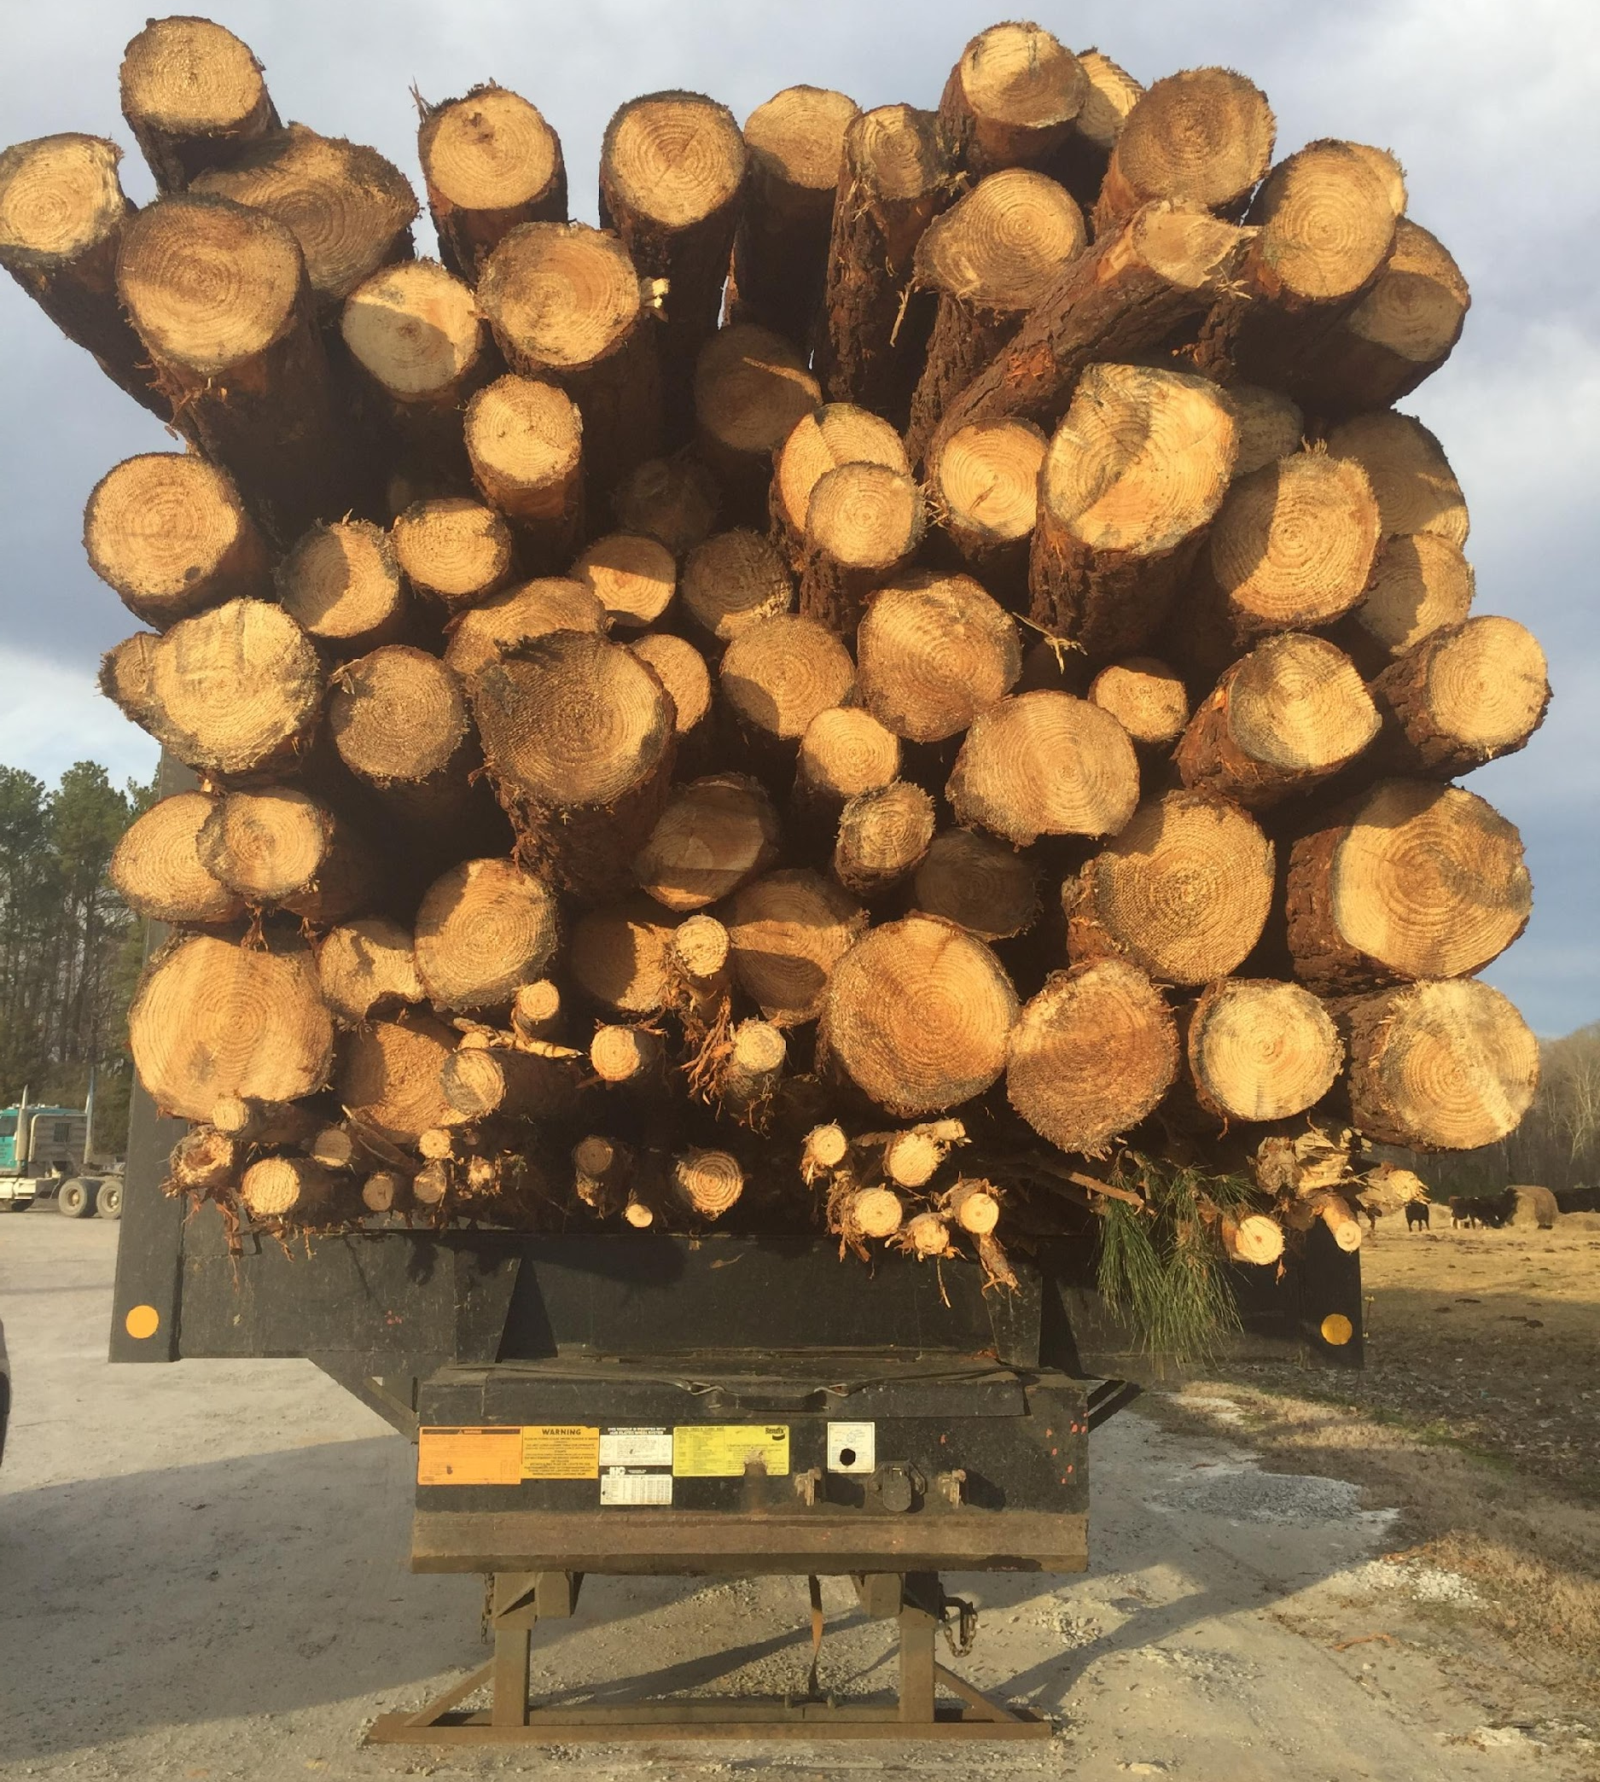
“THE BUNDLE OF STICKS”
(ALL SEVERABLE)
Riparian (surface) Water Rights
(e.g. Deed to adjacent parcel right to draw surface water)
Right to Timber
(e.g. timber deed to timber buyer)
Right to
Groundwater
(e.g. shared with
another entity or parcel)
Right to Subdivide
(e.g. Deed to land trust
in form of conservation easement)
Right to Take Wildlife
(e.g. leased to hunting club)
Right of sole possession (e.g. deed of access easement to adjacent parcel)
Right to Farm (e.g. Leased to farmer)
Right to subsurface minerals
(e.g. Conveyance to energy developer)
Right of sole possession (e.g. deeded right of way/easement to utility)
Right to transfer/control equity
(e.g. Deed of Trust to lender)
Notes:
Instructions: Easements can be sold or donated, review the slide, and point out some commonly sold and secured easements.
Time: 2 minutes
Materials: None
Handouts: None
Notes:

Slide 65
BEFORE YOU VISIT PROFESSIONAL ADVISORS
Notes:
Instructions: Give introduction to section: “Before you visit professional advisors”
Time: 1 minute
Materials: none
Handouts: none

Slide 66
BEFORE YOU VISIT YOUR ATTORNEY, CPA OR FINANCIAL PLANNER …
Assess your resources
Consider the abilities of your heirs
Set goals, both long and short term
Do your homework
Attorneys and CPAs are expensive, know what you want to accomplish in advance.
Gather your documents
Talk with your family
Learn about your options
In short…create a blueprint that reflects your goals and desires and turn it into a succession and estate plan.
Notes:
Instructions: Go through the list.
Time: 2 minutes
Materials: None
Handouts: None
Notes:

Slide 67
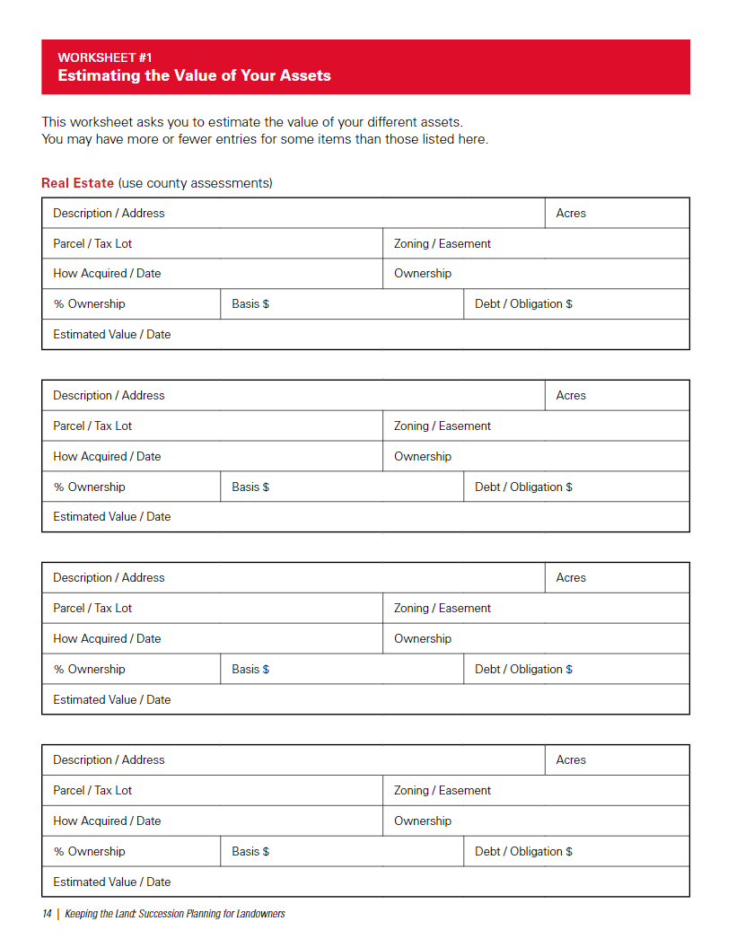
HANDOUT: ESTIMATING THE VALUE OF YOUR ASSETS
This worksheet will create a record of the
inventory of all assets and a rough estimate
of the value of each.
Consulting your local tax assessor’s office is a
good starting point for learning the value of
land and buildings.
It is best to revise and update this inventory every five years to record changes in your assets and current values.
Notes:
Instructions: Think through and list all of your assets that have value, you may be surprised. Start with your county tax assessor's office to get some value for your property and buildings.
Time: 2 minutes
Materials: None
Handouts: Estimating the Value of Your Assets
Notes:

Slide 68
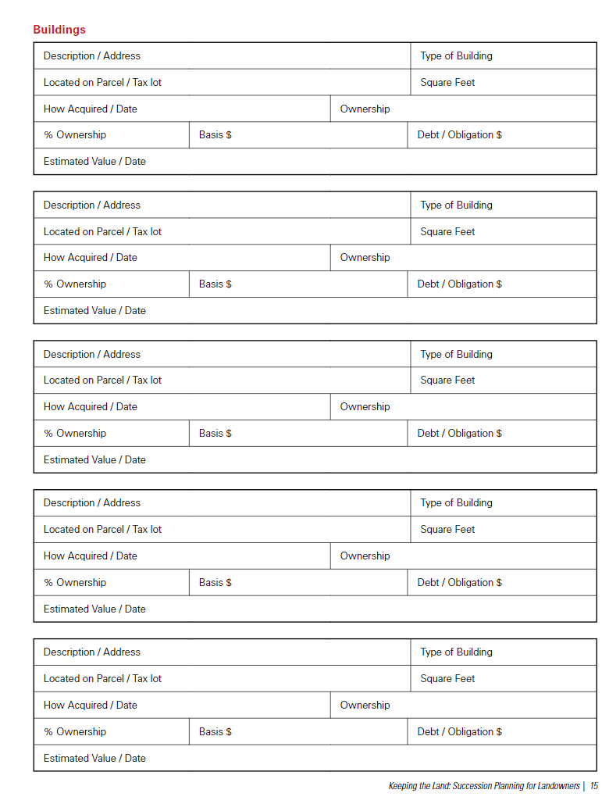
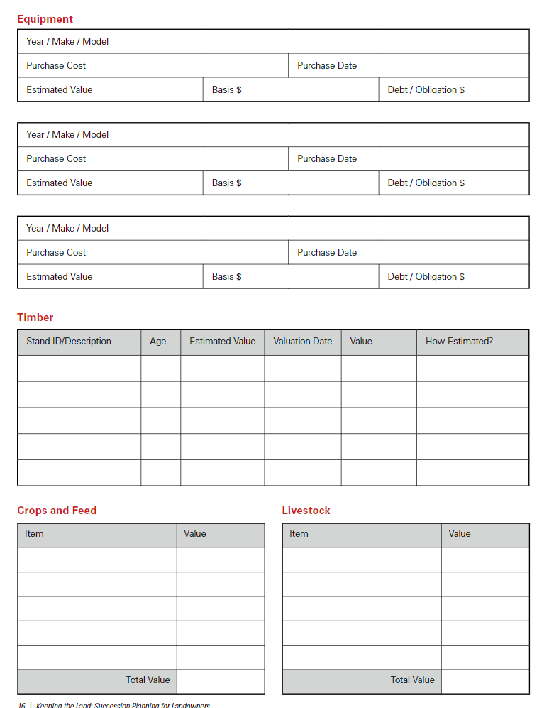
LISTING ASSETS CONTINUED
Notes:
Instructions: Think through and list all of your assets that have value, you may be surprised. Start with your county tax assessor's office to get some value for your property and buildings.
Time: 2 minutes
Materials: None
Handouts: Estimating the Value of Your Assets
Notes: Don't forget other assets like equipment and timber, crops and livestock.

Slide 69
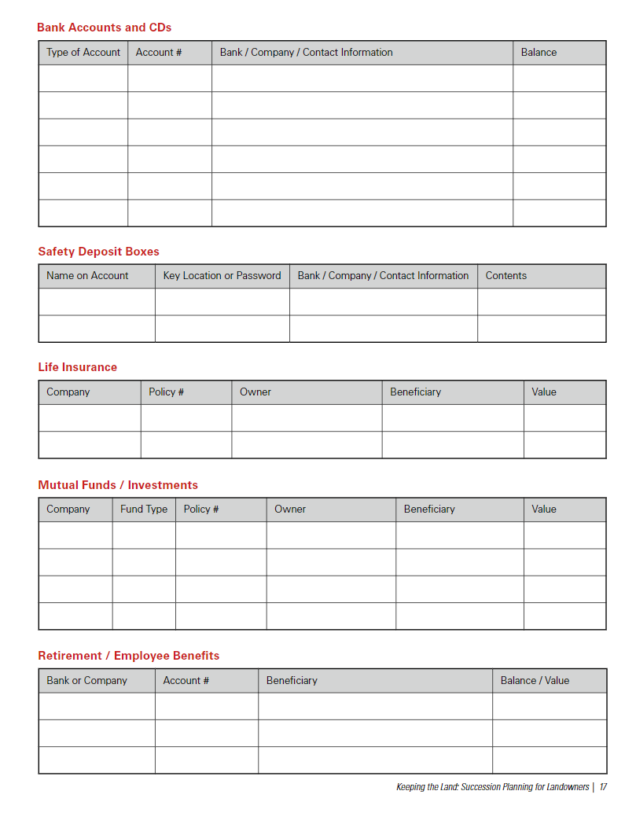
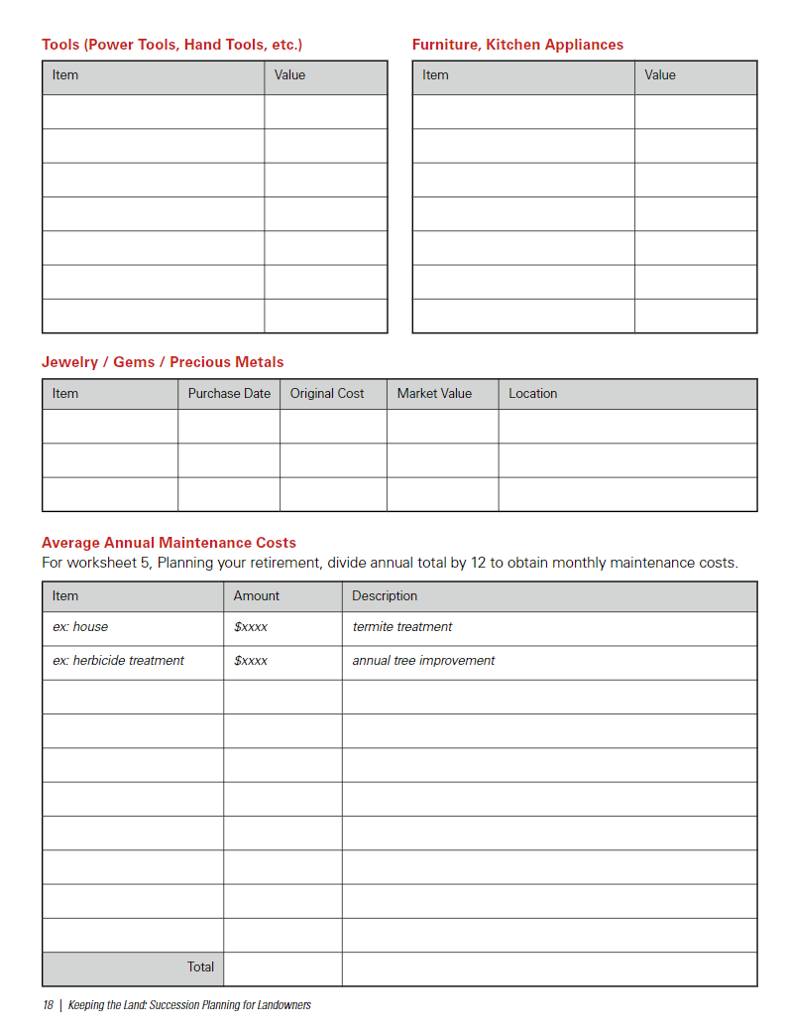
LISTING ASSETS CONTINUED
Notes:
Instructions: Think through and list all of your assets that have value, you may be surprised. Start with your county tax assessor's office to get some value for your property and buildings.
Time: 2 minutes
Materials: None
Handouts: Estimating the Value of Your Assets
Notes: Don't forget about CD’s Insurance, and other investments, even jewelry of other items of value.

Slide 70
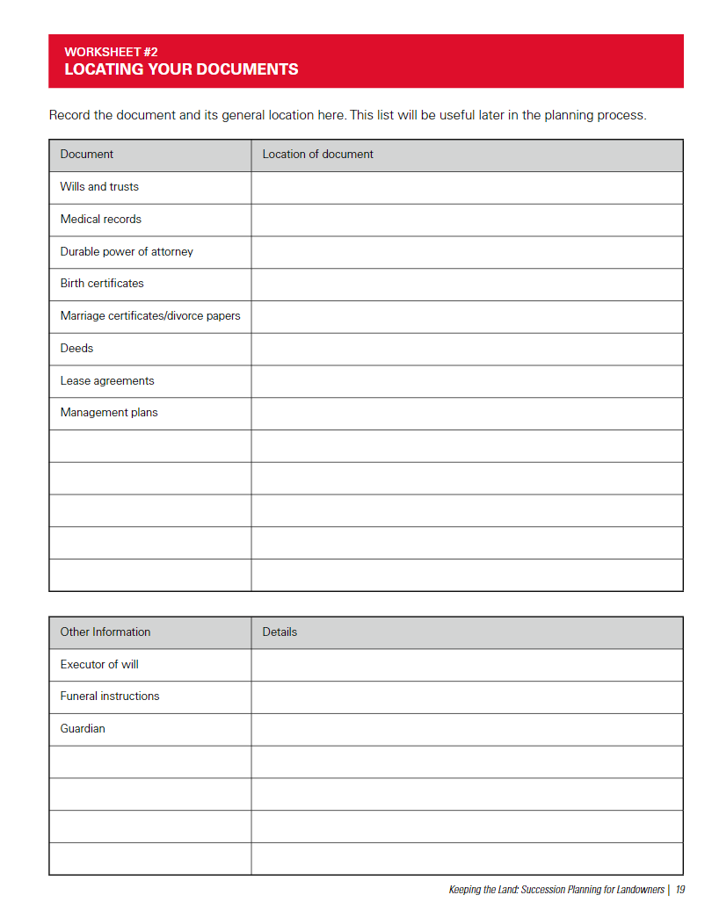
HANDOUT: LOCATING YOUR DOCUMENTS
This worksheet will record the location of important legal and financial documents such as deeds, titles, bank statements, insurance policies, and wills.
This will help you and others locate the documents when needed.
Notes:
Instructions: Ask the audience, “Can you tell me exactly where all your documents are located? Wills, records, birth certificates, funeral instructions? If not, think this through and record it here for your heirs.
Time: 2 minutes
Materials: None
Handouts: Locating Your Documents
Notes:

Slide 71
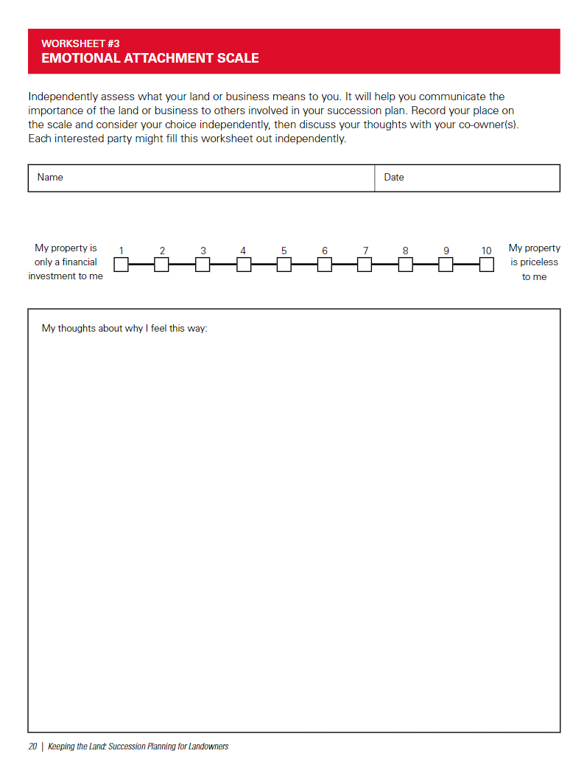
HANDOUT: EMOTIONAL ATTACHMENT SCALE
This form will help you reflect on how you feel about your land and/or business. This should encourage you to think about your passions related to your land and business and what is important to you. This could include preserving your family heritage, being a good steward of the land, or providing income for your family.
Notes:
Instructions: This is an important slide!!! The way you think about this impacts everything!
It's important to know how you feel about your property and business, and for your heirs to perhaps assess this as well. How you feel about this will impact your decisions about your business and property. Knowing how your heirs feel about it will also give you insight. Pause for 60 seconds give the audience some time to reflect on this, potential open it up to one or two comments from the audience
Time: 5 minutes
Materials: None
Handouts: Emotional Attachment Scale
Notes:

Slide 72
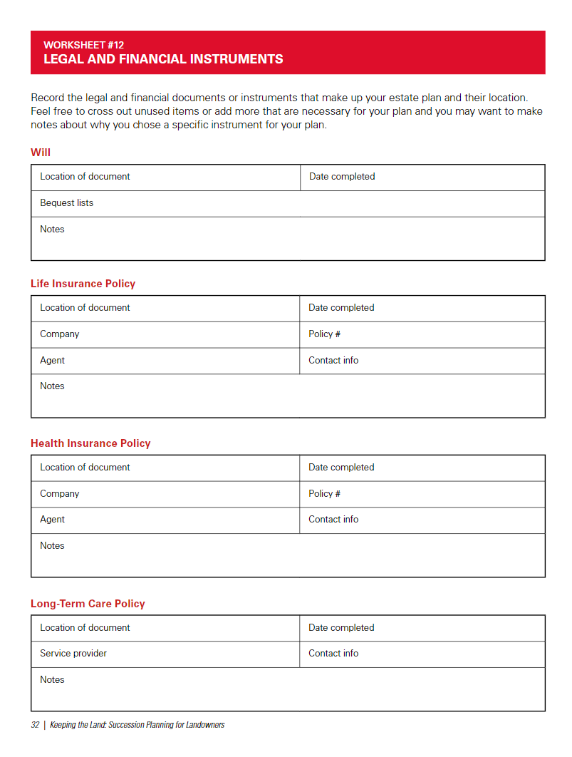
HANDOUT: LEGAL AND FINANCIAL INSTRUCTIONS
Legal and Financial Instruments
Record the legal and financial documents or
instruments that make up your estate plan and
their location. Feel free to cross out unused items
or add more that are necessary for your plan and
you may want to make notes about why you
chose a specific instrument for your plan.
This form records the legal and financial documents or instruments that comprise your estate plan and their location.
Notes:
Instructions: Similar to some of the other forms, helping your heirs be able to find these documents and policies is an important exercise.
Time: 2 minutes
Materials: None
Handouts: Legal and Financial Instruments
Notes:

Slide 73
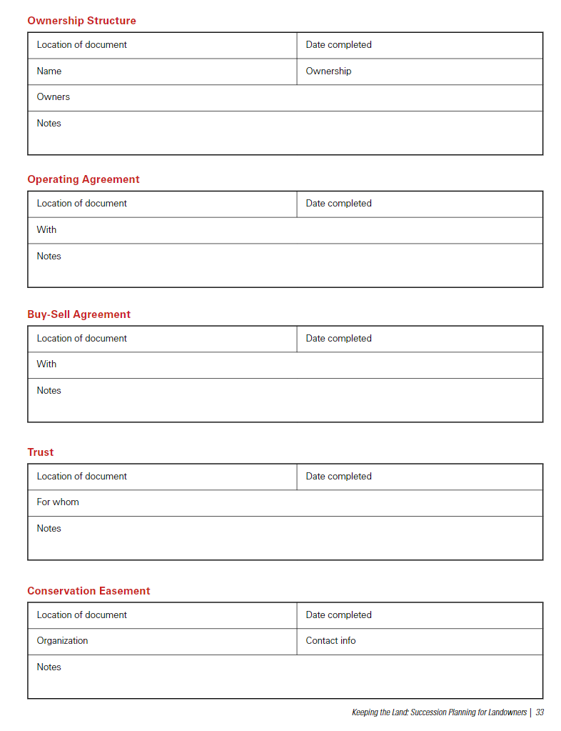
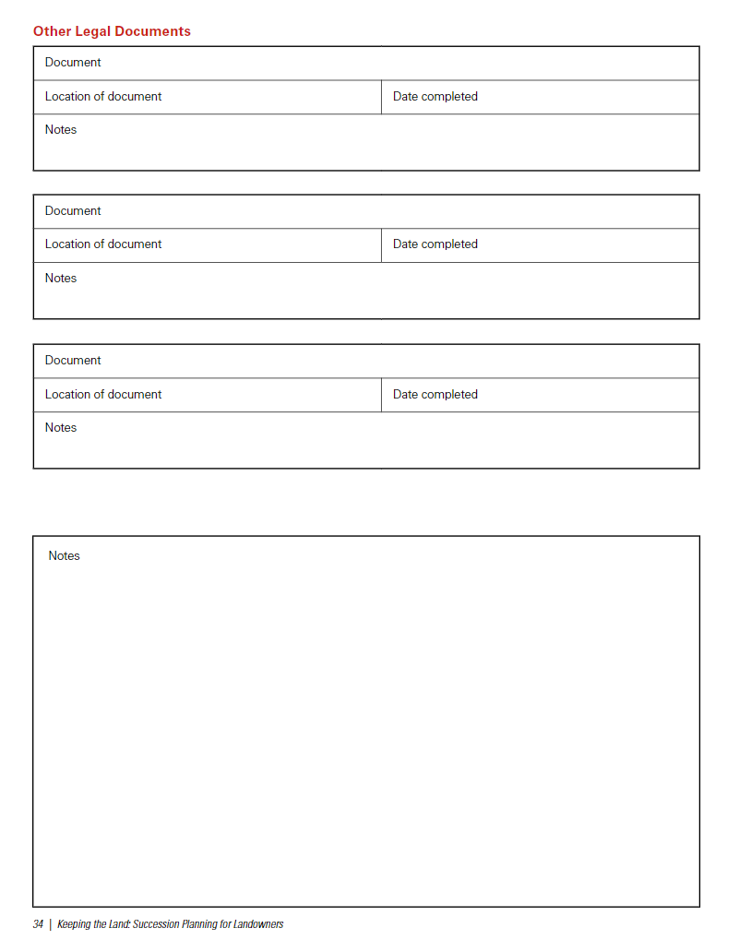
LEGAL AND FINANCIAL INSTRUMENTS
Notes:
Instructions: Another possible document-read out loud.
Time: 2 minutes
Materials: None
Handouts: Legal and Financial Instruments
Notes:

Slide 74


THERE ARE MANY TOOLS OUT THERE!
Here is one that is easy and simple to use
It will serve as a tool to organize your thinking and help you map out your goals and next steps to accomplishing them
Let's walk through it…
Notes:
Instructions: A tool or workbook you can use and download to help you think along with your family about succession, use the tools that help you think and prepare you to see a professional.
Time: 1 minute
Materials: None
Handouts: None
Notes:

Slide 75

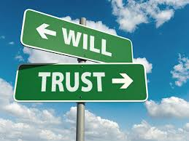
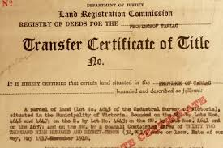


NOW YOU’RE READY TO GO!
You’re now clear headed and clear eyed about what you want to do, why and who will be a part of it. Take this information to a professional to help you codify and craft your plan in a way that will work with your wishes and the laws of your state.
Notes:
Instructions: Highlight the need to have a professional execute documents to help you realize your plan.
Time: 1 minute
Materials: None
Handouts: None
Notes:

Slide 76
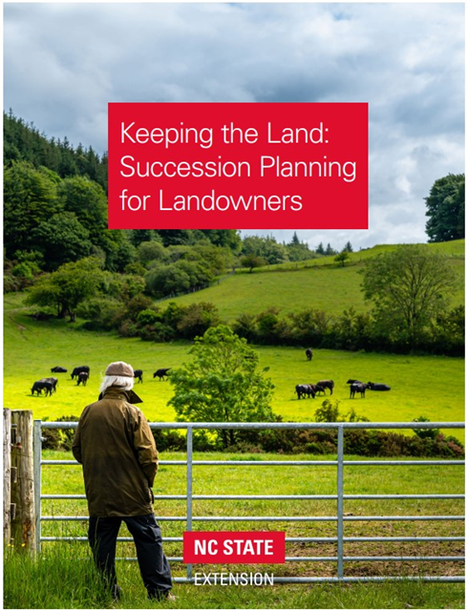
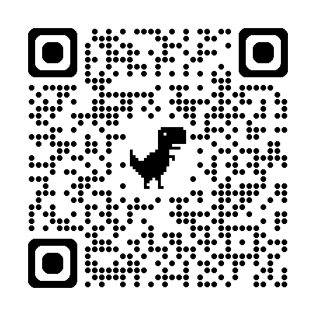
KEEPING THE LAND: SUCCESSION PLANNING FOR LANDOWNERS
To download a copy of this publication, visit
content.ces.ncsu.edu/keeping-the-land
or scan the QR code.
A tool with information as well as worksheets to build your succession plan with your heirs.
Notes:
Instructions: Hold your camera over this QR code or visit the web address
Time: 1 minute
Materials: None
Handouts: None
Notes:

Slide 77
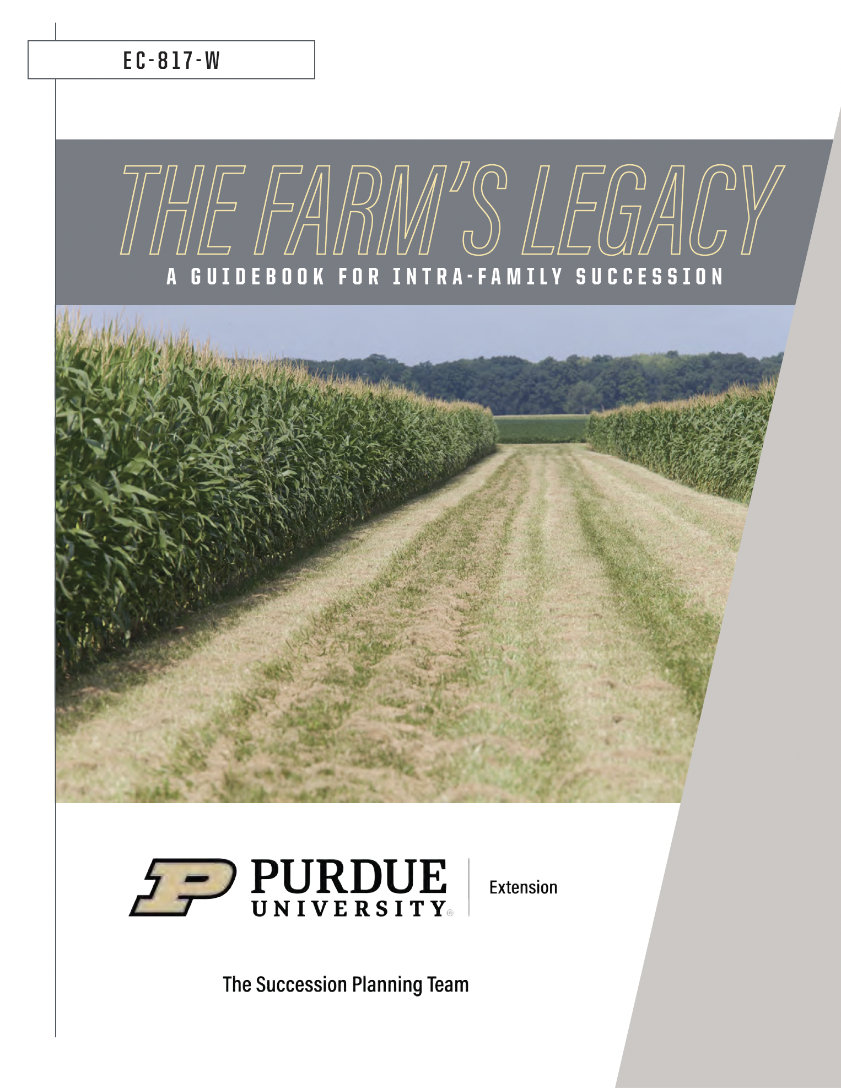
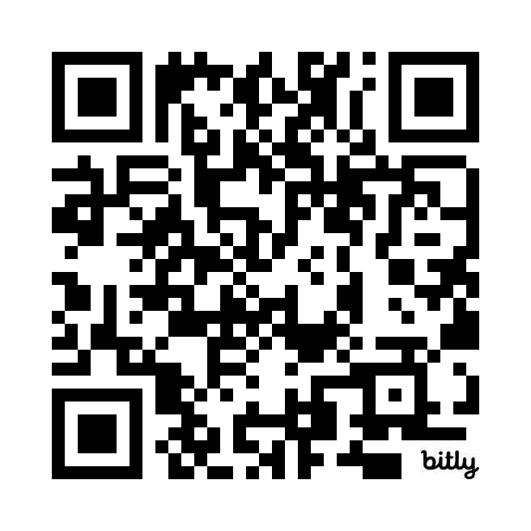
THE FARM’S LEGACY: A GUIDEBOOK FOR INTRA-FAMILY SUCCESSION
To download a copy of this publication, visit
edustore.purdue.edu/item.asp?Item_Number=EC-817-W or scan the QR code
Notes:
Instructions: Hold your camera over this QR code or visit the web address.
Time: 1 minute
Materials: None
Handouts: None
Notes:

Slide 78
Questions
Notes:
Instructions: Thank the participants and ask for any additional questions.
Time: 1 minute
Materials: None
Handouts: None

Slide 79
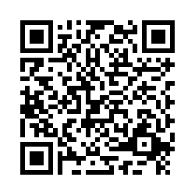
Please share your thoughts.
Notes:
Instructions: Thank the participants and ask for any additional questions.
Time: 1 minute
Materials: None
Handouts: None
https://msudafvm.co1.qualtrics.com/jfe/form/SV_9N1I26nMJ0v9QYS

