Slide 1
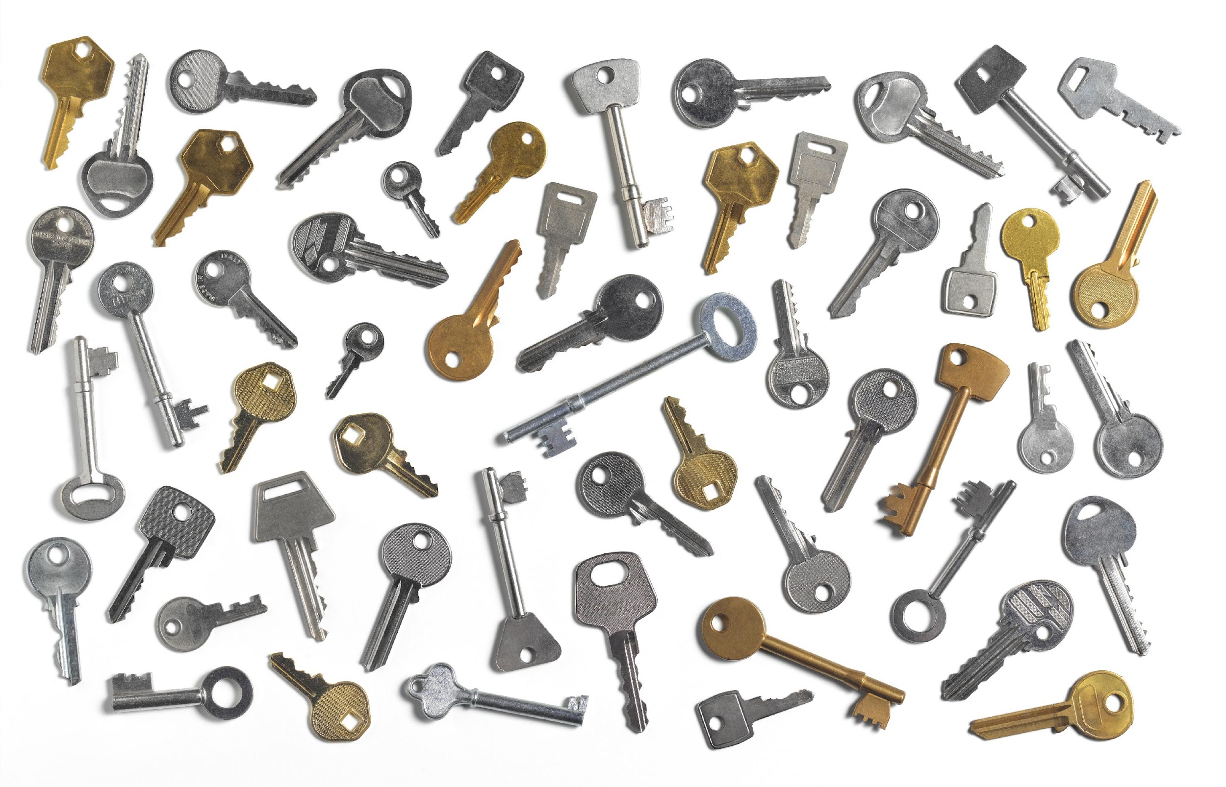

Key Players in Succession:
Who Should Be Involved?
Notes:
Instructions: This slide introduces the topic.
Time: 1 minute
Materials: None
Handouts: None

Slide 2




Partnering Organizations
Notes:
Instructions: This slide highlights the partnering organizations that have worked together to develop materials and host trainings.
Time: 1 minute
Materials: None
Handouts: None

Slide 3

Purpose:
Succession planning encompasses many emotional and financial aspects of a family and a business, making decisions and moving forward more difficult. This research-based curriculum with comprehensive handouts integrated will give participants the confidence they need to learn strategies for moving succession forward with their property or business. Both soft and hard skills are covered in the materials and will empower owners to develop and implement their succession plan.
Funding to develop this training provided by:
&
Notes:
Instructions: Explain the purpose of the overall curriculum.
Time: 1 minute
Handouts: None
Materials: none

Slide 4
Primary Authors
Renee Wiatt
Research and Extension Specialist | North Central Regional Center for Rural Development
Family Business Management Specialist | Purdue Institute for Family Business
Department of Agricultural Economics | Purdue University, West Lafayette, IN
Dr. Kurt Smith
Assistant Professor of Forestry and Environmental Resources
North Carolina State University
Dr. Rebecca Smith
Associate Extension Professor | Mississippi State University Extension
Notes:
Instructions: Please acknowledge the primary and contributing authors to this material as well as the funding stream through the Southern Rural Development Center and the Socially Disadvantaged Farmers and Ranchers Policy Research Center at Alcorn State University.
Time: 1 minute
Materials: none
Handouts: none

Slide 5
PRESENTERS
Enter presenter information on this slide
Notes:
Instructions: Add presenter information and introduce yourselves.
Time: 1 minute
Materials: none
Handouts: none

Slide 6
Important notes before we begin:
These materials are intended to present general information on succession planning.
The information may not be applicable to every state or territory.
These materials do not provide legal advice. Specific advice should be obtained from an attorney or another professional well versed in the facts and circumstances related to the individual seeking advice and the jurisdiction where the property is located.
Notes:
Instructions: Read the disclaimer and answer any questions that may arise.
Time: 1 minute
Materials: none
Handouts: None

Slide 7
PROTECTING YOUR INFORMATION
No personal stories.
General questions are welcome.
Personal questions should be asked outside of the group setting.
Notes:
Instructions: Go over these guidelines with participants to ensure that participants understand the reasons for not including stories or questions of a personal nature.
Time: 1 minute
Materials: none
Handouts: None

Slide 8
Defining Succession Planning & Estate Planning
When we say: | We are referring to:
Succession Planning | The plan for transfer of management (decision-making abilities and authority) and/or ownership (shares, farm or forest assets, etc.) during the life of the owner(s)
Estate Planning | The plan for transfer of personal assets and property that will transition after the owner’s life to designated beneficiaries
*Disclaimer: The terms Succession Planning and Estate Planning are defined differently depending on state/region. However, for use of this training, the definitions above are implemented.
Notes:
Instructions: Be sure that attendees understand the difference between “Succession Planning” and “Estate Planning” as we move through the program.
Time: 1 minute
Materials: none
Handouts: None

Slide 9
Defining Generations and Roles in Succession
When we say: | We are referring to:
Successor | The junior generation in the land/business, next individual(s) who will manage and/or own the land/business
Incumbent | The senior generation in the land/business, current owner/manager of the land/business
Notes:
Instructions: Be sure that attendees understand the difference between “Successor” and “Incumbent” as we move through the program.
Time: 1 minute
Materials: none
Handouts: None

Slide 10
Defining Businesses and Land
When we say: | We are referring to:
Businesses | Entities that could be farms, an LLC, sole proprietorship, land in a trust, corporation, company, and/or partnerships
Land | Any type of land, including but not limited to forests, bare land, vacant land, farmland, pasture, and land with buildings/barns
Notes:
Instructions: Be sure that attendees understand the difference between “Businesses” and “Land” as we move through the program.
Time: 1 minute
Materials: none
Handouts: None

Slide 11
TOPICS TO EXPLORE
MODULE #2: KEY PLAYERS IN SUCCESSION: WHO SHOULD BE INVOLVED? | Who is involved in your farm business or land?
 | Who gets a vote? Involvement in the farm
 | Who makes decisions in the farm?
 | What advisors could you need for the transfer of your farm business or land?
 | Selecting Advisors and Questions to Ask
Purpose of Module #2
To better understand who should be involved, who makes decisions, and who you should ask for help for your family and/or farm during the succession process.
Notes:
Instructions: Give instructions including any activities
Time: 1 minute
Materials: None
Handouts: None

Slide 12
Who is involved in your farm business or land?
Notes:
Instructions: Intro to section
Time: 1 minute
Materials: None
Handouts: None

Slide 13
THREE-CIRCLE FAMILY BUSINESS MODEL
Ownership
Family
Business
Source: Renato Tagiuri and John Davis
Notes:
Instructions: Explain that in a family business or with family land ownership, there are many “circles” and “intersections” that members can be placed. Each circle has its own concerns, motivations, and needs. Also, as time goes on, people can transition from circle/intersection to another place.
Time: 2 minutes
Materials: None
Handouts: None

Slide 14
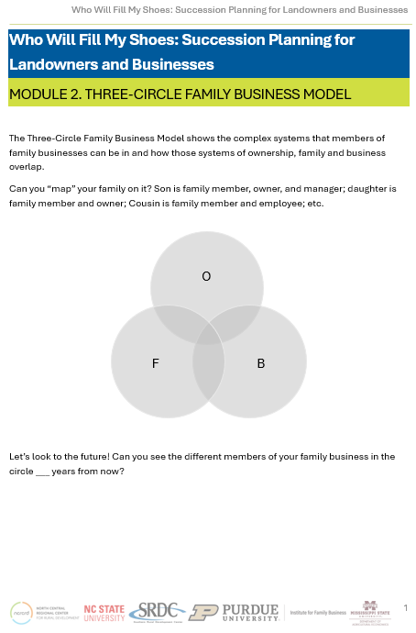
HANDOUT: THREE-CIRCLE FAMILY BUSINESS MODEL
Please take some time to complete the handout.
Map your own farm or land as it is NOW.
Next, choose several years (ideally 5-10) in the future and map who you think will be involved in your farm or land in the FUTURE.
Notes:
Instructions: Map where members of your land or farm are now and then again where you expect them to be in the next 5-10 years.
Time: 5 minutes
Materials: handout
Handouts: Three-Circle Family Business Model Handout

Slide 15
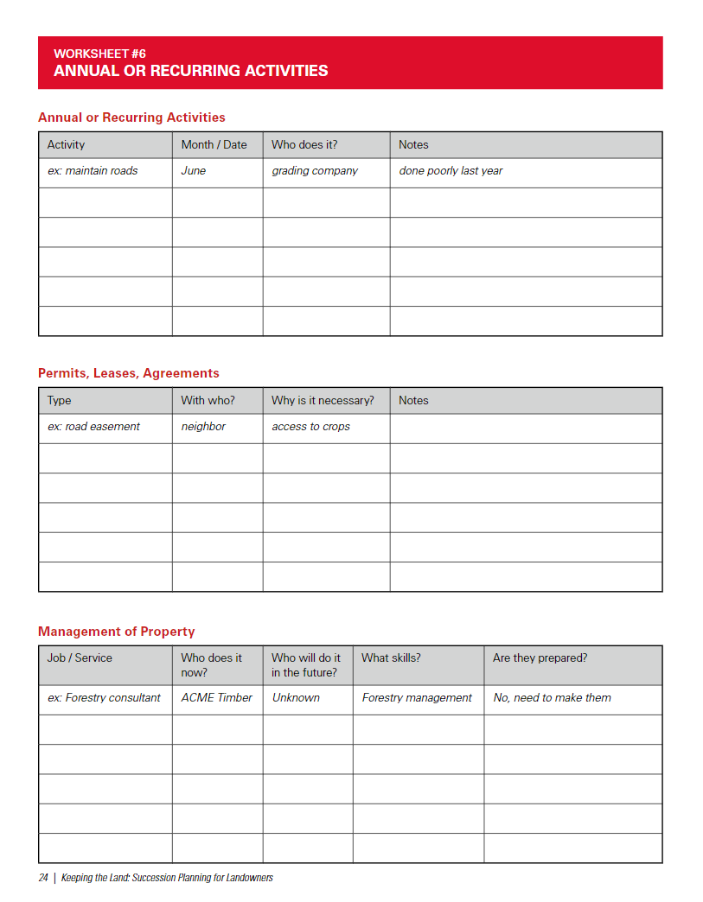
HANDOUT: OVERVIEW OF YOUR MANAGEMENT STRUCTURE
Overview of Your Management Structure: Annual or Recurring Events
This form focuses on who currently does what on your land and the professionals you work with, the timing of management activities, and any permits in place on your land.
You should consider your current
management structure and plan for any changes in the future.
Notes:
Instructions: Your heirs will find this useful and important information which is often hard to recover when you're gone. Allow participants to fill out this worksheet.
Time: 5 minutes
Materials: handout
Handouts: Annual or Recurring Activities

Slide 16
Who gets a vote? Involvement in the farm
Notes:
Instructions: Intro to section
Time: 1 minute
Materials: None
Handouts: None

Slide 17
WHO IS INVOLVED IN THE LAND/BUSINESS?
Owner/Owners: incumbents
Actively participating heirs/successors: active in management of the land/business
Non-active heirs: successors
Tangentially related family members: family but will not inherit or manage. *Note: This group can be different for each family.
              Unrelated business members: employees, tenants, etc.
Notes:
Instructions: One of the hardest questions when thinking about succession is “who should be involved in what process?”. It is often unclear who should “have a say” and when their “vote should count”. Let’s explore some of the different categories in which people can fall when discussing farm and land transfer.
Time: 2 minutes
Materials: None
Handouts: None

Slide 18
WHO HAS THE POWER TO MAKE DECISIONS?
Owner/Owners (incumbents)
Typically hold [almost] all the financial power (assets and control)
Should be the ones who initiate succession discussions, realizing that new management and/or ownership is needed and inviting in the next generation
Successors (both on-farm and off-farm)
Typically hold the power of continuity (can decide the future of the farm and its potential)
Farm employees and non-immediate family members
May (not always) feel as though they are entitled to a say in the process, but really don’t possess power in the process
Notes:
Instructions: Discuss how different parties owners, successors, and farm employees/non-immediate family members have different power to make decisions in the succession process.
Time: 3 minutes
Materials: None
Handouts: None

Slide 19
HOW TO DETERMINE WHO IS INVOLVED
Relation to the Land/Farm | Levels of Involvement | Do they get a vote?
Owner (Incumbent) | Ideal position to initiate succession discussions Involved in every aspect of the process | Yes! This group gets a vote on everything (as they hold all of the assets and control).
On-farm heirs (successors) | Involved in most aspects of the process Input should be considered closely to assure that succession is achieved | Yes! This group should get a vote on most aspects (as they are the next gen taking over).
Notes:
Instructions: Cover relation to the farm or land and who should get a vote.
Time: 5 minutes
Materials: None
Handouts: None

Slide 20
HOW TO DETERMINE WHO IS INVOLVED
Relation to the Land/Farm | Levels of Involvement | Do they get a vote?
Off-farm heirs (potential successors) | Involved in ownership-related topics if they will inherit some assets (land, shares of a corporation/company, etc.) Fair vs. equal discussions could be difficult if on-farm and off-farm heirs will inherit asymmetrically. May feel like they should have more of a vote than is practical | Sometimes. If off-farm heirs will eventually be owners, then they can vote on some aspects of the farm that could affect them.
Tangentially related family members (family but will not inherit or manage) | Have interest in seeing the farm succeed but will not be financially involved Interested in the family legacy component of succession May feel as though they have a say | No, although they would likely appreciate being informed.
Unrelated business members (employees, tenants, etc.) | Have a financial interest in seeing the succession process succeed (employment, contracts, or land access may hinge on the farm continuing to the next generation) | No, although they would likely appreciate being informed.
Notes:
Instructions: Cover relation to the farm or land and who should get a vote.
Time: 5 minutes
Materials: None
Handouts: None

Slide 21
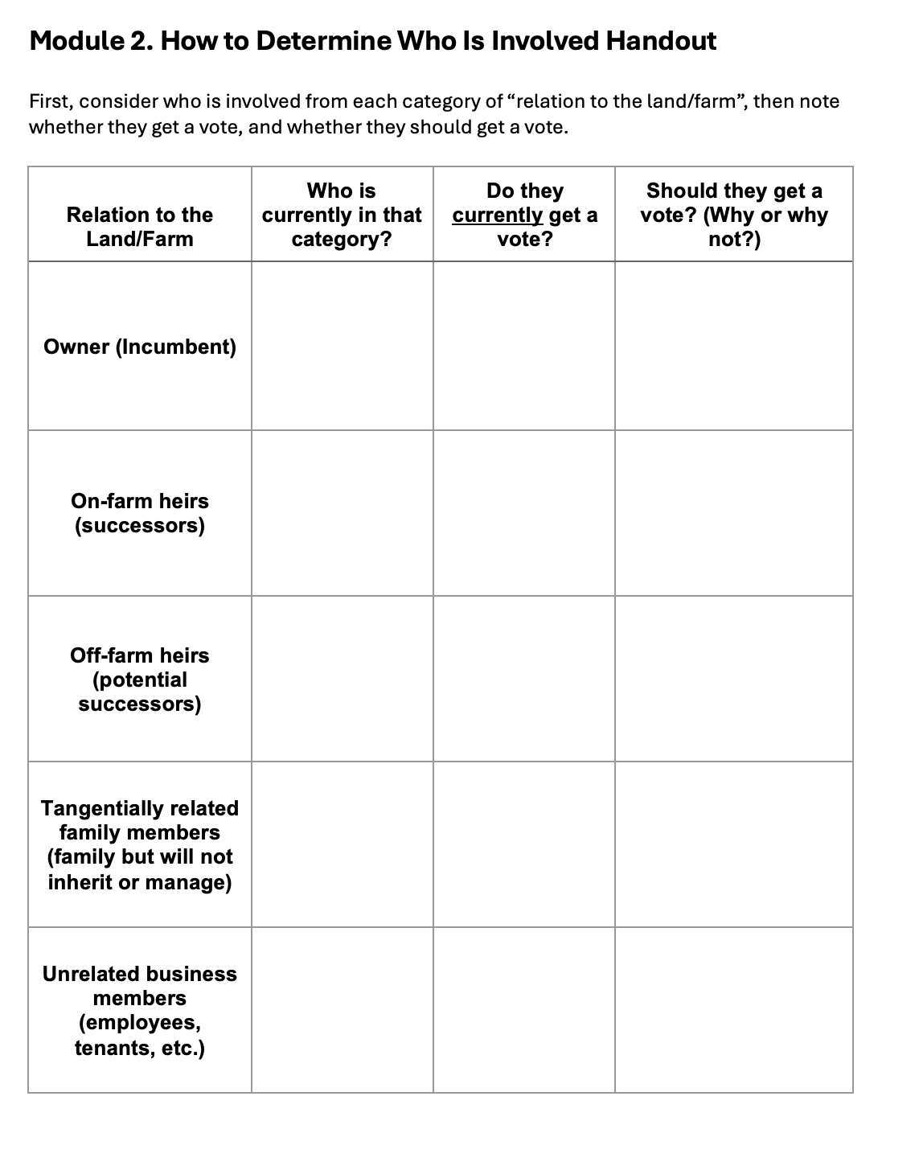
HANDOUT:
HOW TO DETERMINE WHO IS INVOLVED
Take 5 minutes to complete the handout.
Notes:
Instructions: Participants should list who is in each category, whether they currently get a vote, and if they should get a vote.
Time: 5 minutes
Materials: None
Handouts: How to Determine Who Is Involved

Slide 22
What advisors could you need for the transfer of your business or land?
Notes:
Instructions: Intro to section
Time: 1 minute
Materials: None
Handouts: None

Slide 23

WHY DO YOU NEED ADVISOR(S)?
Issues and processes in a plan are very complex
Team (of advisors) approach coordinates advice and discussions
  Advantageous for the team (of advisors) to get know each other and address a common problem
Can save the family/business significant time and financial resources in the long run
  Coordinated advice and multiple perspectives
Advisors have seen many scenarios and can help to navigate the common pitfalls in succession
Notes:
Instructions: Advisors are needed in the succession process. Cover slide material
Time: 2 minute
Materials: None
Handouts: None

Slide 24

POTENTIAL KEY PROFESSIONAL TEAM MEMBERS
Attorney: Legal advice
Certified Public Accountant: Key financial advice on business performance and financial status
Certified Financial Planner: Advice on retirement investments
Insurance Agent: Advice on life and business insurance and risk management
Lender: Input on financial health and appropriate debt structure
Mediators
Extension Educators, Management Consultants & Respected Peers: Facilitators – should be unbiased
Notes:
Instructions: Advisors are needed in the succession process. Cover slide material
Time: 2 minute
Materials: None
Handouts: None

Slide 25

POTENTIAL PERSONAL ADVISORS
Executor or Personal Representative
  Makes sure wishes are carried out and manages the estate
Trustee
Guardians
Notes:
Instructions: Advisors are needed in the succession process. Cover slide material
Time: 2 minute
Materials: None
Handouts: None

Slide 26
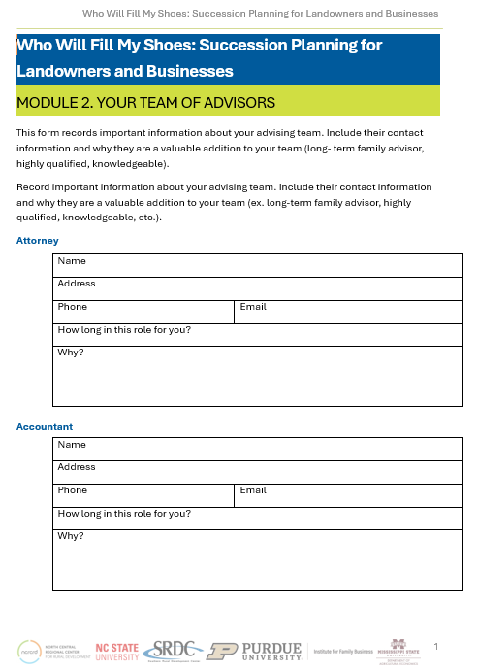
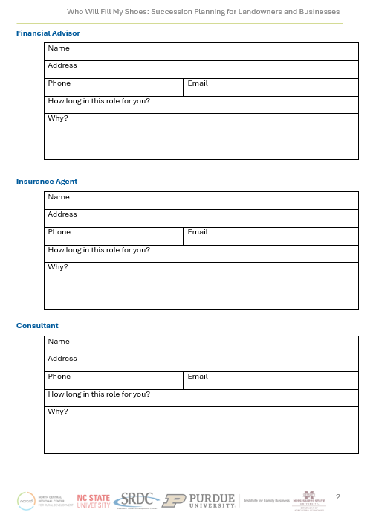
HANDOUT: YOUR TEAM OF ADVISORS
Your Team of Advisors
This form records important information about your advising team. Include their contact information and why they are a valuable addition to your team (long-term family advisor, highly qualified, knowledgeable).
Notes:
Instructions: This is an important form to fill out, if for no other reason then to provide ease of access for your heirs should you become incapacitated or die.
Time: 5 minutes
Materials: handout
Handouts: Your Team of Advisors

Slide 27
Selecting Advisors & Questions to Ask
Notes:
Instructions: Intro to section
Time: 1 minute
Materials: None
Handouts: None

Slide 28
SELECTING ADVISORS
Selecting advisors is an important step in the planning process
Organized process
Consider it like hiring an employee for the business
Develop a job description for each member
Interview potential members
Notes:
Instructions: Advisors are needed in the succession process. Cover slide material
Time: 2 minute
Materials: None
Handouts: None

Slide 29
SELECTING ADVISORS
Selecting advisors is an important step in the planning process
Ask your friends or other farms who they have used
Ask you other professionals for recommendations
May consider a referral service
Collect at least 3 names for each professional to begin the selection process
Notes:
Instructions: Advisors are needed in the succession process. Cover slide material
Time: 2 minute
Materials: None
Handouts: None

Slide 30
EXAMPLE QUESTIONS TO ASK
What is your experience with similar situations?
Can you provide references from other farms you have worked with? (confidentiality may be an issue)
How long have you been working in this field?
What professional credentials do you hold?
How long would it take for them to complete the process?
Notes:
Instructions: Advisors are needed in the succession process. Cover slide material
Time: 2 minute
Materials: None
Handouts: None

Slide 31
EXAMPLE QUESTIONS TO ASK
Do you have any sample/example plans used with other clients we can review?
Can you please provide a clear breakdown of their fee structure?
Are you comfortable working with the person? Would your family be comfortable working with this person after you are gone?
Notes:
Instructions: Advisors are needed in the succession process. Cover slide material
Time: 2 minute
Materials: None
Handouts: None

Slide 32
Questions
Notes:
Instructions: Thank the participants and ask for any additional questions.
Time: 1 minute
Materials: None
Handouts: None

Slide 33
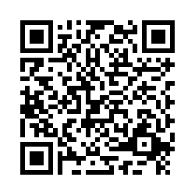
Please share your thoughts.
Notes:
Instructions: Thank the participants and ask for any additional questions.
Time: 1 minute
Materials: None
Handouts: None
https://msudafvm.co1.qualtrics.com/jfe/form/SV_9N1I26nMJ0v9QYS

