Slide 1


Roadmapping and Goals
in Succession:
Who, When and How to Transfer?
Notes:
Instructions: Introduction to Module 4
Time: 1 minute
Materials: None
Handouts: None

Slide 2




Partnering Organizations
Notes:
Instructions: This slide highlights the partnering organizations that have worked together to develop materials and host trainings.
Time: 1 minute
Materials: None
Handouts: None

Slide 3

Purpose:
Succession planning encompasses many emotional and financial aspects of a family and a business, making decisions and moving forward more difficult. This research-based curriculum with comprehensive handouts integrated will give participants the confidence they need to learn strategies for moving succession forward with their property or business. Both soft and hard skills are covered in the materials and will empower owners to develop and implement their succession plan.
Funding to develop this training provided by:
&
Notes:
Instructions: Explain the purpose of the overall curriculum.
Time: 1 minute
Handouts: None
Materials: none

Slide 4
Primary Authors
Renee Wiatt
Research and Extension Specialist | North Central Regional Center for Rural Development
Family Business Management Specialist | Purdue Institute for Family Business
Department of Agricultural Economics | Purdue University, West Lafayette, IN
Dr. Kurt Smith
Assistant Professor of Forestry and Environmental Resources
North Carolina State University
Dr. Rebecca Smith
Associate Extension Professor | Mississippi State University Extension
Notes:
Instructions: Please acknowledge the primary and contributing authors to this material as well as the funding stream through the Southern Rural Development Center and the Socially Disadvantaged Farmers and Ranchers Policy Research Center at Alcorn State University.
Time: 1 minute
Materials: none
Handouts: none

Slide 5
PRESENTERS
Enter presenter information on this slide
Notes:
Instructions: Add presenter information and introduce yourselves.
Time: 1 minute
Materials: none
Handouts: none

Slide 6
Important notes before we begin:
These materials are intended to present general information on succession planning.
The information may not be applicable to every state or territory.
These materials do not provide legal advice. Specific advice should be obtained from an attorney or another professional well versed in the facts and circumstances related to the individual seeking advice and the jurisdiction where the property is located.
Notes:
Instructions: Read the disclaimer and answer any questions that may arise.
Time: 1 minute
Materials: none
Handouts: None

Slide 7
PROTECTING YOUR INFORMATION
No personal stories
General questions are welcome
Personal questions should be asked outside of the group setting
Notes:
Instructions: Go over these guidelines with participants to ensure that participants understand the reasons for not including stories or questions of a personal nature.
Time: 1 minute
Materials: none
Handouts: None

Slide 8
ICE BREAKER
Given all we discussed…
At your table consider the following questions:
What are topics you are fuzzy on?
What questions do you have now?
Write them on the “parking lot” page for now.
Notes:
Instructions: Go around the room quickly, give some folks a chance to comment or ask questions of each other. Typically, people make connections with each other through this exercise that will carry through the workshop.
Time: 3-4 minutes
Materials: None
Handouts: None

Slide 9
Defining Succession Planning & Estate Planning
When we say: | We are referring to:
Succession Planning | The plan for transfer of management (decision-making abilities and authority) and/or ownership (shares, farm or forest assets, etc.) during the life of the owner(s)
Estate Planning | The plan for transfer of personal assets and property that will transition after the owner’s life to designated beneficiaries
*Disclaimer: The terms Succession Planning and Estate Planning are defined differently depending on state/region. However, for use of this training, the definitions above are implemented.
Notes:
Instructions: Be sure that attendees understand the difference between “Succession Planning” and “Estate Planning” as we move through the program.
Time: 1 minute
Materials: none
Handouts: None

Slide 10
Defining Generations and Roles in Succession
When we say: | We are referring to:
Successor | The junior generation in the land/business, next individual(s) who will manage and/or own the land/business
Incumbent | The senior generation in the land/business, current owner/manager of the land/business
Notes:
Instructions: Be sure that attendees understand the difference between “Successor” and “Incumbent” as we move through the program.
Time: 1 minute
Materials: none
Handouts: None

Slide 11
Defining Businesses and Land
When we say: | We are referring to:
Businesses | Entities that could be farms, an LLC, sole proprietorship, land in a trust, corporation, company, and/or partnerships
Land | Any type of land, including but not limited to forests, bare land, vacant land, farmland, pasture, and land with buildings/barns
Notes:
Instructions: Be sure that attendees understand the difference between “Businesses” and “Land” as we move through the program.
Time: 1 minute
Materials: none
Handouts: None

Slide 12
TOPICS TO EXPLORE
Module #4: ROADMAPPING AND GOALS IN SUCCESSION: WHO, WHEN, AND HOW TO TRANSFER? | Purpose
 | Setting Goals
 | Vision & Mission
 | How do we Plan to Transfer Management and Ownership?
 | Roadmapping your Succession Process
Purpose of Module #4
To better understand who should be involved, who makes decisions, and who you should ask for help for your family and/or farm during the succession process.
Notes:
Instructions: Give instructions including any activities.
Time: Add how much time is needed, i.e. 2 minutes
Materials: list or say “none”
Handouts: list or say “none”

Slide 13
Setting Goals
Notes:
Instructions: Intro to section
Time: 1 minute
Materials: None
Handouts: None

Slide 14

GOALS & OBJECTIVES ARE IMPORTANT
Goals can help to shape where you are going, and objectives are how you will get there
  Personally and professionally
Goals and objectives give you something to work towards
  Timelines and metrics can be established
  You can set goals and objectives related to management and ownership succession
Notes:
Instructions: Discuss why setting goals is important.
Time: 1 minute
Materials: none
Handouts: none

Slide 15

GOALS CAN BE FINANCIAL OR
NON-FINANCIAL
Financial
  Profit
  Growth
  Revenue
  Sales
Non-financial
  Transgenerational control
  Status and reputation
  Benevolent social ties
  Emotional commitment
Notes:
Instructions: Discuss how different family members and business members may have financial or non-financial goals for the land/business.
Time: 1 minute
Materials: none
Handouts: none

Slide 16

DISCUSSING GOALS TAKES TIME
Don’t expect everyone in the family to have the same goals
The first goals discussion you have, may just be a fact-finding mission
Family members will have different perspectives
Find a consensus on 4-5 goals for the land/business
Setting goals related to succession planning is important
Notes:
Instructions: Discussing goals take time and patience from all family members.
Time: 2 minutes
Materials: none
Handouts: none

Slide 17
Vision & Mission
Notes:
Instructions: Intro to section
Time: 1 minute
Materials: None
Handouts: None

Slide 18
VALUES AFFECT THE VISION FOR THE LAND/BUSINESS
Family Values
Family Vision
Business Strategy/Structure
Notes:
Instructions: Values should be what guides the vision for the land/business and affect how the succession plan is formed.
Time: 1 minute
Materials: none
Handouts: none

Slide 19
VISION VS. MISSION
Vision
  Where you want your business to go
Mission
  The steps that you will take to achieve the business' vision
Notes:
Instructions: Difference between vision and mission
Time: 1 minute
Materials: none
Handouts: none

Slide 20

DEVELOPING A VISION
Description of what/where the land/business would be like some years from now
Provides the context for managing the changes that will be necessary to reach goals
Provides direction for developing strategy, finding opportunities, and allocating resources
Rooted in reality, but focused on the future
Notes:
Instructions: Discuss how you develop a vision.
Time: 2 minutes
Materials: none
Handouts: none

Slide 21

DEVELOPING YOUR VISION
How do we want our land/business to look like in 10 years?
What new activities will our land/business be pursuing?
What will we be especially good at? What will make our business unique?
What will be the new roles of family members and/or employees in the business?
How does succession fit into our vision?
Lastly, what do we envision for our family?
Notes:
Instructions: Discuss how you develop a vision.
Time: 2 minutes
Materials: none
Handouts: none

Slide 22

MISSION
The steps that you will take to achieve the vision for your land/business
Mission statements will often begin with “to” or an action verb
Examples:
  IKEA: To create a better everyday life for the many people.
  Tesla: To accelerate the world's transition to sustainable energy.
Notes:
Instructions: Discuss how you develop a mission.
Time: 2 minutes
Materials: none
Handouts: none

Slide 23
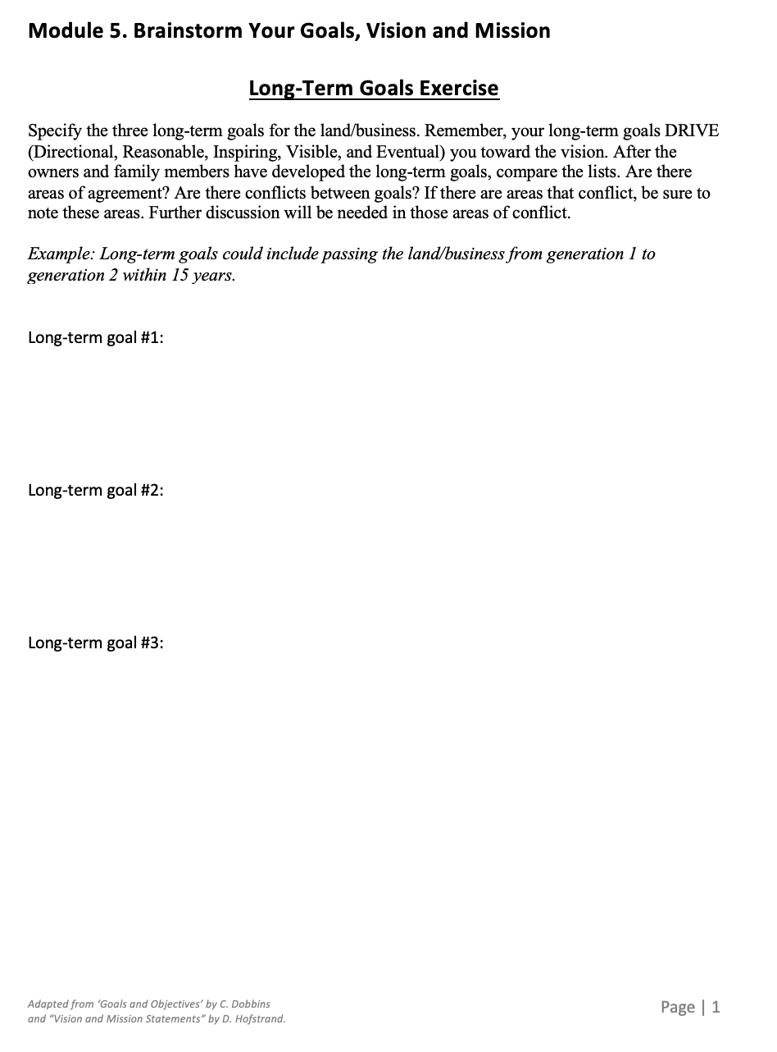
HANDOUT: BRAINSTORM YOUR GOALS, VISION AND MISSION
Refer Brainstorm Your Goals, Vision and Mission Handout. Complete a rough draft of some succession goals (long-term and short-term), a vision and a mission for your land/business.
Notes:
Instructions: Take a few minutes to start the roadmap: when, where and who will transition different responsibilities.
Time: 5 minutes
Materials: None
Handouts: Handout: Roadmapping Your Succession

Slide 24
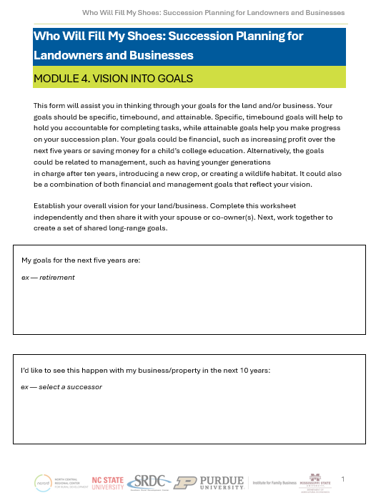
HANDOUT: VISION AND GOALS
This form will assist you in thinking through your goals for the land and/or business. Your goals should be specific, timebound, and attainable. Specific, time bound goals will help to hold you accountable for completing tasks, while attainable goals help you make progress on your succession plan.
Your goals could be financial, such as increasing profit over the next five years or saving money for a child’s college education. Goals could be related to management, such as having younger generations in charge after ten years. It could be a combination of both financial and management goals that reflect your vision.
Notes:
Instructions: "A journey of a thousand miles begins with a single step" is a common saying that originated from a Chinese proverb. Likewise, how do I get my thoughts and ideas into concrete actions. We start with articulating our vision into reaal steps to get us there. This worksheet will help you pause and think about how this might happen.
Ask the audience for an example of a vision they have for their business or property, and what would be some important steps for getting there.
Time: 5 minutes
Materials: None
Handouts: Vision and Goals

Slide 25
How do we plan to transfer management and ownership?
Notes:
Instructions: Intro to section
Time: 1 minute
Materials: None
Handouts: None

Slide 26
DEVELOPING A MANAGEMENT SUCCESSION PLAN
Step 1
Select the successor.
Step 2
Create a survival kit for the successor.
Step 3
Groom the successor.
Step 4
Promote an environment of trust and respect.
Step 5
Cope with the financial realities of estate and gift taxes.
Notes:
Instructions: Make it clear that children are not required to join the family business.
Do not assume that the successor must always come from within the family.
Give family members the opportunity to work outside the family business first.
Involve siblings in the process of identifying the successor.
Time: 2 minutes
Materials: none
Handouts: none

Slide 27

TIMING IS KEY IN SUCCESSION
In the event of a sale:
        Do you want to continue your involvement in
        the business if the new owner asks you to stay on?
        If you decide to stay on to help in the transition,
        how involved do you wish to be, especially if the new owner has plans for significant changes?
How much must the business sell for to earn you a comparable income?
What financial terms and conditions do you prefer?
What financial terms or conditions are unacceptable?
Notes:
Instructions: Timing is crucial in succession; early and often. Discuss questions that need to be covered.
Time: 2 minutes
Materials: none
Handouts: none

Slide 28
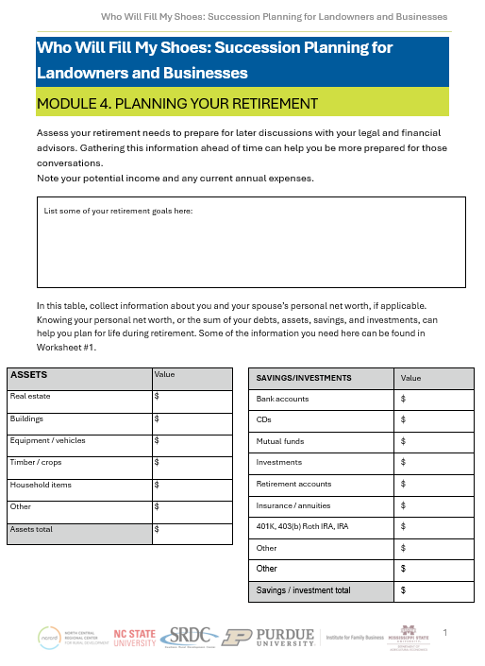
HANDOUT: PLANNING YOUR RETIREMENT
This form focuses on your retirement and your long-term care needs. This form will be helpful when you consult your financial advisor to discuss making your retirement goals a reality.
It could involve traveling the world for a year, completing certain projects, providing for the college education of a grandchild, or simply spending more time with your grandchildren and less on the land and business.
Notes:
Instructions: It's important to think about your potential needs and wants when you either stop working or no longer can. Are you prepared?
Time: 5 minutes
Materials: None
Handouts: Planning Your Retirement

Slide 29
Roadmapping Your Succession Process
Notes:
Instructions: Intro to section
Time: 1 minute
Materials: None
Handouts: None

Slide 30

WHAT IS A SUCCESSION ROADMAP?
Setting goals and tracking your family’s progress through the succession process
Notes:
Instructions: Introduce roadmap.
Time: 1 minute
Materials: None
Handouts: None

Slide 31

ROAD MAP
Defines the succession process in terms of:
  Who is responsible
  What the incumbent and successor are responsible for, respectively
  When responsibilities are transferred on the way to the transfer of full control
Notes:
Instructions: Timing is particularly critical. Argument for a shorter transition process, they are more likely to be successful. Needs to be a reasonable timeframe. Shorter is also better for competent successors.
Time: 1 minute
Materials: None
Handouts: None

Slide 32

SUCCESSION ROAD MAP
Long timeframe and sequential transfer lead to
conflict around roles, responsibilities, and economic
incentives
Can have uncertainties about roles and responsibilities if incumbent and successor are both involved in the business for extended periods
If successor is appointed to top management but has no ownership timeline, this leads to successor feeling punished for efforts
Roadmap can help address the inevitable governance challenges that will come up before succession is complete
Notes:
Instructions: Successor is ”punished” because of their effort lead to increase in value of the firm, they may have to acquire firm at higher value level than when they took over.
Time: 2 minutes
Materials: None
Handouts: None

Slide 33

ADAPTING ROLES FOR THE INCUMBENT
AND SUCCESSOR
It’s not only about changing roles, but also about a change in self-understanding of the people involved
  Incumbent transitions from leader/chief to
  eventually take on a consultant role
  Successor transitions from having no
  role to the leader/chief
Incumbent is the one that initiates the transition process
  They must realize the firm requires new managerial talent
Notes:
Instructions: Over time, the incumbent will transition from a leader/chief to eventually phasing out to be used as a consultant, to help the business when needed and consult on issues which they can bring their expertise that they gathered over the years.
The successor will transition from having no role in the business to being a helper, then a manager, then eventually being the leader/chief and only relying on the incumbent as a consultant when needed.
Time: 2 minutes
Materials: None
Handouts: None

Slide 34
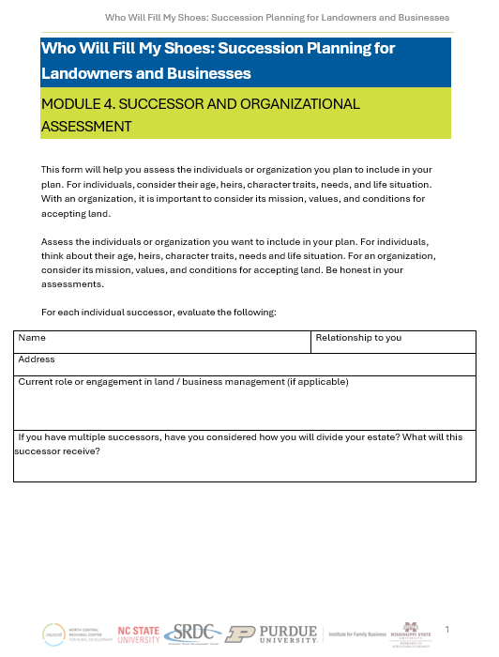
HANOUT: SUCCESSOR AND ORGANIZATIONAL ASSESSMENT
This form will help you assess the individuals or organization you plan to include in your plan. For individuals, consider their age, heirs, character traits, needs, and life situation.
With an organization, it is important to consider its mission, values, and conditions for accepting land.
Notes:
Instructions: A tool to help you think about your potential successors.
Time: 5 minutes
Materials: None
Handouts: Planning Your Retirement

Slide 35
WHAT WILL TRANSITION?
Governance Transition:
        Ownership percentage
        Management
Transition of Functional Responsibilities:
        Human resources
        Business strategy
        Marketing
Other Transitions: Dividend disbursement
Adapted from: (c) Thomas Zellweger, 2016
Notes:
Instructions: Transitions covered in the roadmap activity.
Time: 2 minutes
Materials: None
Handouts: None

Slide 36
EXIT QUADRANT:
INCUMBENT GENERATION CONSIDERATIONS
‘Well off, but chooses to work’
-Family succession: gift
-Transfer to employees
‘Rich and ready to go’
-Family succession: gift
-Transfer to employees
-Charity
-Sell
Financial readiness to let go
‘Stay and grow’
-Grow firm and improve efficiency
-Extract dividends
-Bring in financial partner
‘Exit at highest price’
-Sell business at highest price possible
Mental readiness to go
Adapted from:
(c) Thomas Zellweger, 2016
Notes:
Instructions: Incumbent has to ask two important questions: Am I financially ready to let go? Am I mentally ready to let go?
Whatever the financial or mental readiness, incumbents usually have in mind some kind of order of preference in relation to exit options. But doesn’t mean that the preference options will be feasible.
Incumbent should consider various options and exit scenarios and sort them along a timeline.
Time: 2 minutes
Materials: None
Handouts: None

Slide 37
SUCCESSOR CONSIDERATIONS:
WILLINGNESS AND ABILITY OF THE SUCCESSOR
‘Not interested but able’
Discuss motivations, options to develop business, accept differing interests
‘Interested and able’
Define entry path into the business
Ability
(regarding the particular job profile)
‘Not interested, not able’
Better not to involve successor, accept differing interests of next generation, acknowledge different abilities
‘Interested but not able’
Clarify job expectations, consider alternative job inside and outside the business
Willingness
(degree of affective commitment)
Adapted from: (c) Thomas Zellweger, 2016
Notes:
Instructions: The ideal successor is both highly willing and committed to take on a role inside the firm.
Harder to learn skills or develop motivation and commitment: Skills may be learned or added by hiring people with complementary skills in management or on a board. In contrast, motivation and commitment to a firm seems to be much harder to build.
Time: 2 minutes
Materials: None
Handouts: None

Slide 38
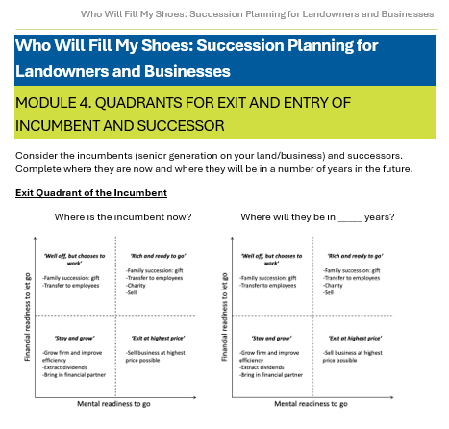
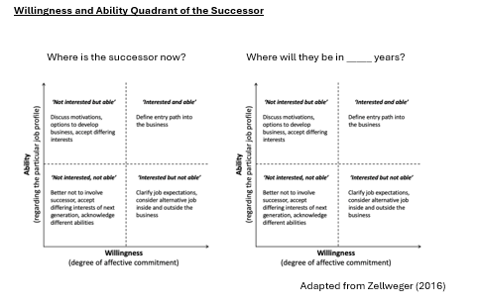
HANDOUT: QUADRANTS FOR EXIT AND ENTRY OF INCUMBENT AND SUCCESSOR
Please take some time to complete the handout. First indicate on the quadrant where the incumbent and successor are NOW.
Then, choose a number of years in the FUTURE and indicate where you would expect for the successor and incumbent to be at that time.
Notes:
Instructions: Take a few minutes to assess where the incumbent(s) and successor(s) are now and in the future.
Time: 5 minutes
Materials: None
Handouts: Handout: Quadrants for Exit and Entry of Incumbent and Successor

Slide 39

GOALS OF INCUMBENT
AND SUCCESSOR
Incumbents often seek a fit between their own personal values and preferences and the characteristics of the successor
Incumbent and successor are mutually dependent; both parties need to acknowledge each other’s goals and concerns
It is critical to make the goals, considerations, and fears of both sides clear and explicit; if understanding is lacking, it is difficult if not impossible, to close the deal to the satisfaction of both parties
Notes:
Instructions: When thinking about adding a family member to the business, think about more than just paying them.
Some things to consider are management, policies, and financial proficiencies:
Once you add another family member, you have to have entered the realm of human resources.
Make sure that you have the proper management practices and policies in place to keep hiring policies (who can enter the business, what proficiencies they must have to be considered), compensation upon hiring, advancement, hierarchy, review processes, job descriptions, and expectations.
Without the proper financial proficiencies, family members hired in can quickly create conflict in the family and the business.
Expectations must be set at the beginning and there must be follow through.
Time: 2 minutes
Materials: None
Handouts: None

Slide 40

PLANNING FOR RESPONSIBILITY TRANSFER
Time usually elapsed between some initial discussion about succession and the actual handover of both management and ownership control
  Intra-family succession is about 6.5 years
  Transfer to employees is about 3.3 years
  Sales are about 1.6 years
Notes:
Instructions: Next to picking the right buyer, planning the structure of the deal is the most important decision a seller can make.
A seller who doesn’t consider the tax implications of the deal can wind up paying as much as 70% of the proceeds in the form of capital gains and other taxes. A skilled tax adviser or financial planner can help you legally minimize the bite various taxes take out of the proceeds of the sale.
Time: 2 minutes
Materials: None
Handouts: None

Slide 41
ROADMAP EXAMPLE
 |  |  | Year T | Year +1 | Year+2 | Year T+3 | Year T+4 | Year T+5 | Year T+6
Age | Incumbent: Peter |  | 65 | 66 | 67 | 68 | 69 | 70 | 71
 | Successor: Ruth |  | 35 | 36 | 37 | 38 | 39 | 40 | 41
Governance Transition
Ownership Percentage |  | Incumbent | 100 | 100 | 80 | 80 | 20 | 20 | 0
 |  | Successor | 0 | 0 | 20 | 20 | 80 | 80 | 100
Board Management |  | Incumbent | CEO | CEO | CEO | CEO | Advisor | Advisor | Advisor
 |  | Successor | Manager | Manager | Manager | Manager | CEO | CEO | CEO
Transition of Functional Responsibilities
Human Resources |  |  | Peter | Both | Both | Both | Ruth | Ruth | Ruth
Business Strategy |  |  | Peter | Both | Both | Both | Ruth | Ruth | Ruth
Marketing |  |  | Peter | Ruth | Ruth | Ruth | Ruth | Ruth | Ruth
Transition Miscellaneous
Dividend |  |  | 100K to Peter | 50K to Peter | 0 | 0 | 0 | 0 | 0
Adapted from: (c) Thomas Zellweger, 2016
Notes:
Instructions: The roadmap is a tool that businesses can use to help clarify the goals and progression of the expected succession process for both the INCUMBENT generation and the SUCCESSOR generation.
It puts timing to an otherwise uncertain process.
The roadmap specifies who has decision authority and defines the changing roles and responsibilities along the whole succession process.
It specifies when one party should consult the other or bring a question to the attention of the board.
Roles and responsibilities for each party may lack clear definition, and the successor may be tempted to engage in backseat driving, thus undermining the successor’s decisions.
This roadmap can be altered to include different responsibilities and/or categories that are not covered. Also, if your business includes multiple entities with different successors, one roadmap can be completed for each business entity.
Time: 3 minutes
Materials: None
Handouts: None

Slide 42
ROADMAP ACTIVITY
 |  |  | Year T | Year +1 | Year+2 | Year T+3 | Year T+4 | Year T+5 | Year T+6
Age | Incumbent:
 | Successor:
Governance Transition
Ownership Percentage |  | Incumbent | 100 |  |  |  |  |  | 0
 |  | Successor | 0 |  |  |  |  |  | 100
Board Management |  | Incumbent
 |  | Successor
Transition of Functional Responsibilities
Human Resources
Business Strategy
Marketing
Transition Miscellaneous
Dividend
Adapted from: (c) Thomas Zellweger, 2016
Notes:
Instructions: Take a few minutes to explain that this is the blank roadmap; can be modified to adapt to any farm/business/land transition that needs to take place.
Time: 3 minutes
Materials: None
Handouts: None

Slide 43
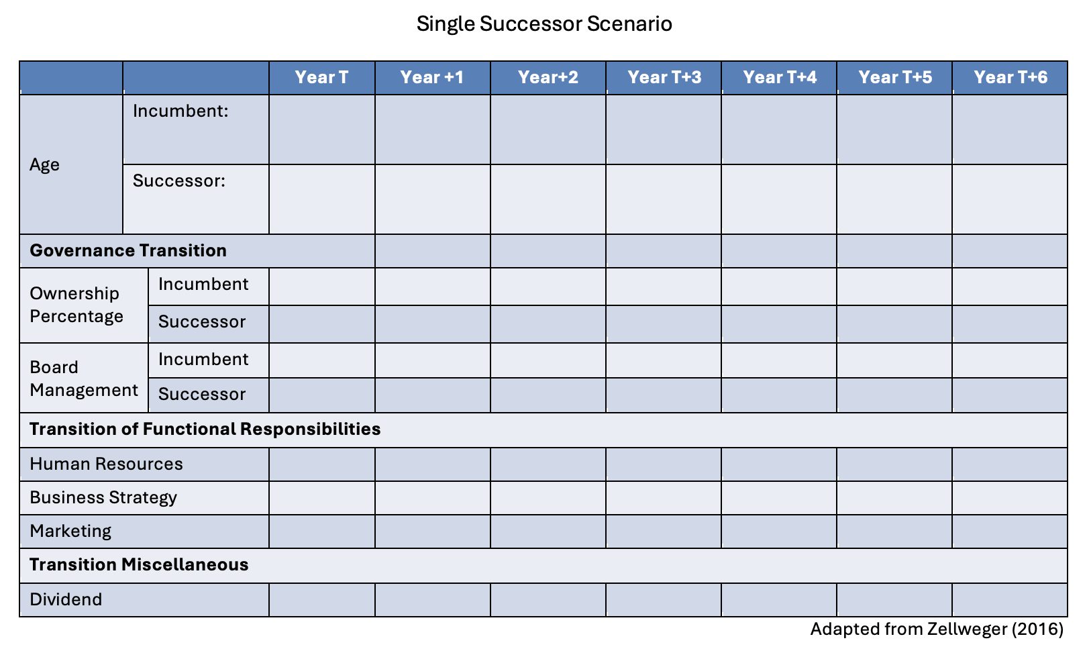
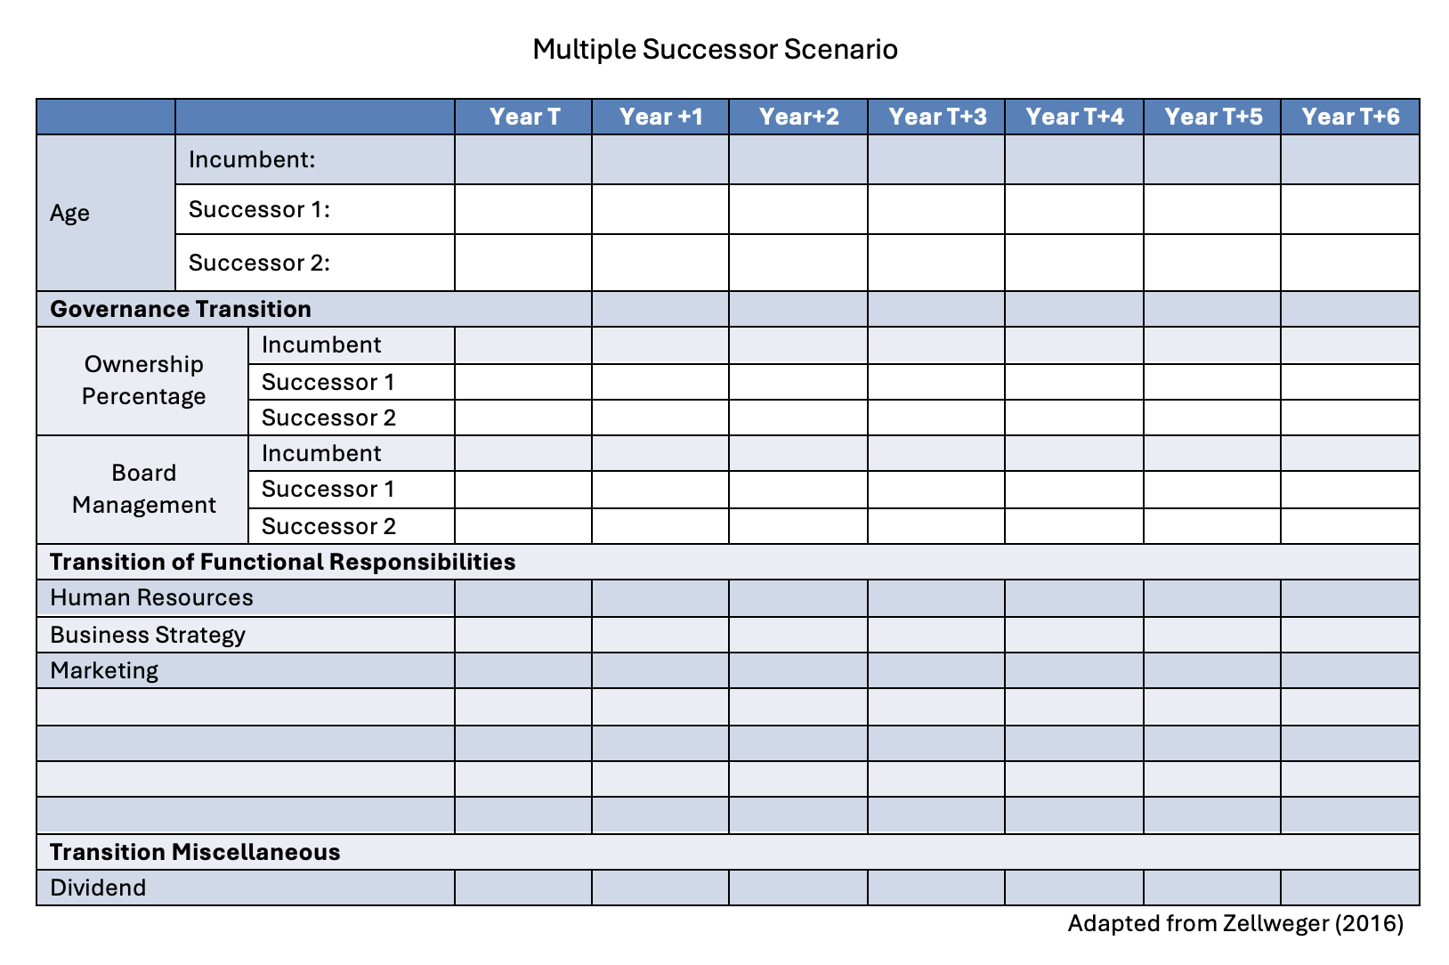
HANDOUT: ROADMAPPING YOUR SUCCESSION
Refer Roadmapping Your Succession Handout. Page 2 is a single successor scenario and page 3 is a multiple successor scenario.
Notes:
Instructions: Take a few minutes to start the roadmap: when, where and who will transition different responsibilities
Time: 5 minutes
Materials: None
Handouts: Handout: Roadmapping Your Succession

Slide 44
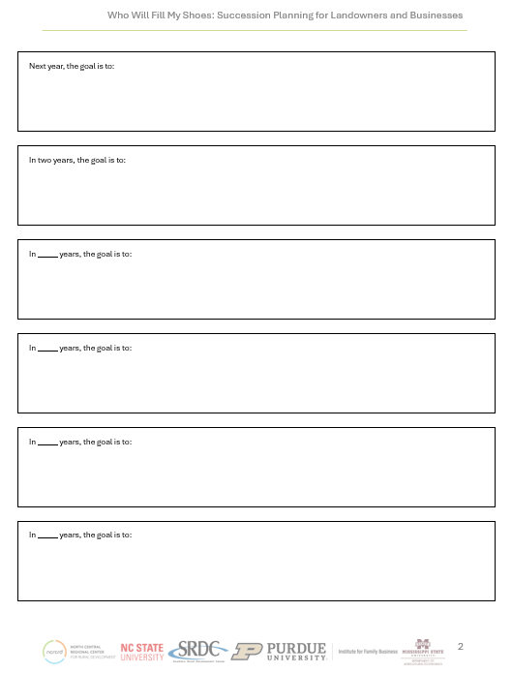
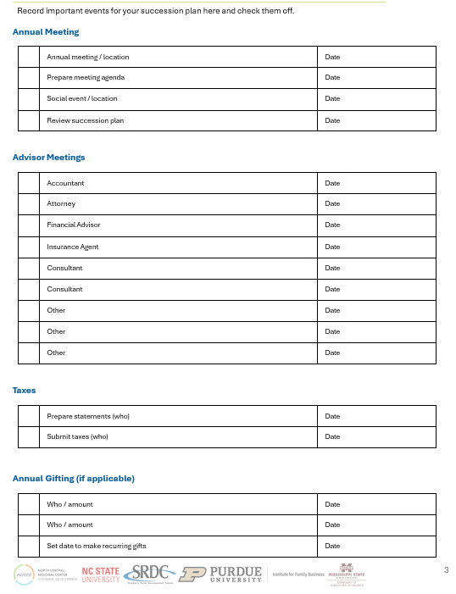
HANDOUT: YOUR SUCCESSION PLANNING TIMELINE
You can record and retain your important dates or milestones for your succession plan.
Notes:
Instructions: Milestones are important, they help you celebrate your progress, drive you to take necessary actions, and keep you organized. Consider this form or make your own to track your plan and associated milestones.
Time: 5 minutes
Materials: None
Handouts: Your Succession Plan Timeline

Slide 45
PLANNING FOR SUCCESSION
Start early
Start planning early for succession
Involve family
Involve your family in business succession discussions
Be realistic
Look at your family realistically and plan accordingly
Don't assume
Get over the idea that everyone must have equal shares
Train successors
Train your successor(s) and work with them
Get help
Obtain outside help throughout succession planning process
Notes:
Instructions: Discuss planning for succession.
Time: 2 minutes
Materials: None
Handouts: None

Slide 46
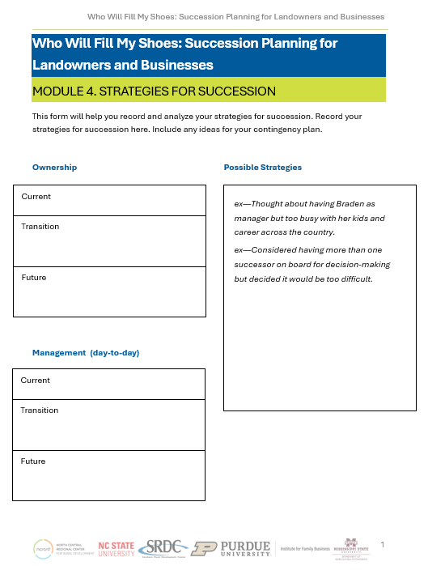
HANDOUT: STRATEGIES FOR SUCCESSION
This form will help you record and analyze your strategies for succession.
Notes:
Instructions: This form will help you record and analyze your strategies for succession.
Time: 3 minutes
Materials: None
Handouts: Strategies for Succession

Slide 47
Questions
Notes:
Instructions: Thank the participants and ask for any additional questions.
Time: 1 minute
Materials: None
Handouts: None

Slide 48
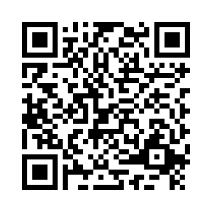
Please share your thoughts.
Notes:
Instructions: Thank the participants and ask for any additional questions.
Time: 1 minute
Materials: None
Handouts: None
https://msudafvm.co1.qualtrics.com/jfe/form/SV_9N1I26nMJ0v9QYS

