Slide 1


Meeting Planning and Coordination for Succession
Notes:
Instructions: Introduction to Module 5
Time: 1 minute
Materials: None
Handouts: None

Slide 2




Partnering Organizations
Notes:
Instructions: This slide highlights the partnering organizations that have worked together to develop materials and host trainings.
Time: 1 minute
Materials: None
Handouts: None

Slide 3

Purpose:
Succession planning encompasses many emotional and financial aspects of a family and a business, making decisions and moving forward more difficult. This research-based curriculum with comprehensive handouts integrated will give participants the confidence they need to learn strategies for moving succession forward with their property or business. Both soft and hard skills are covered in the materials and will empower owners to develop and implement their succession plan.
Funding to develop this training provided by:
&
Notes:
Instructions: Explain the purpose of the overall curriculum.
Time: 1 minute
Handouts: None
Materials: none

Slide 4
Primary Authors
Renee Wiatt
Research and Extension Specialist | North Central Regional Center for Rural Development
Family Business Management Specialist | Purdue Institute for Family Business
Department of Agricultural Economics | Purdue University, West Lafayette, IN
Dr. Kurt Smith
Assistant Professor of Forestry and Environmental Resources
North Carolina State University
Dr. Rebecca Smith
Associate Extension Professor | Mississippi State University Extension
Notes:
Instructions: Please acknowledge the primary and contributing authors to this material as well as the funding stream through the Southern Rural Development Center and the Socially Disadvantaged Farmers and Ranchers Policy Research Center at Alcorn State University.
Time: 1 minute
Materials: none
Handouts: none

Slide 5
PRESENTERS
Enter presenter information on this slide
Notes:
Instructions: Add presenter information and introduce yourselves.
Time: 1 minute
Materials: none
Handouts: none

Slide 6
Important notes before we begin:
These materials are intended to present general information on succession planning.
The information may not be applicable to every state or territory.
These materials do not provide legal advice. Specific advice should be obtained from an attorney or another professional well versed in the facts and circumstances related to the individual seeking advice and the jurisdiction where the property is located.
Notes:
Instructions: Read the disclaimer and answer any questions that may arise.
Time: 1 minute
Materials: none
Handouts: None

Slide 7
PROTECTING YOUR INFORMATION
No personal stories
General questions are welcome
Personal questions should be asked outside of the group setting
Notes:
Instructions: Go over these guidelines with participants to ensure that participants understand the reasons for not including stories or questions of a personal nature.
Time: 1 minute
Materials: none
Handouts: None

Slide 8
Defining Succession Planning & Estate Planning
When we say: | We are referring to:
Succession Planning | The plan for transfer of management (decision-making abilities and authority) and/or ownership (shares, farm or forest assets, etc.) during the life of the owner(s)
Estate Planning | The plan for transfer of personal assets and property that will transition after the owner’s life to designated beneficiaries
*Disclaimer: The terms Succession Planning and Estate Planning are defined differently depending on state/region. However, for use of this training, the definitions above are implemented.
Notes:
Instructions: Be sure that attendees understand the difference between “Succession Planning” and “Estate Planning” as we move through the program.
Time: 1 minute
Materials: none
Handouts: None

Slide 9
Defining Generations and Roles in Succession
When we say: | We are referring to:
Successor | The junior generation in the land/business, next individual(s) who will manage and/or own the land/business
Incumbent | The senior generation in the land/business, current owner/manager of the land/business
Notes:
Instructions: Be sure that attendees understand the difference between “Successor” and “Incumbent” as we move through the program.
Time: 1 minute
Materials: none
Handouts: None

Slide 10
Defining Businesses and Land
When we say: | We are referring to:
Businesses | Entities that could be farms, an LLC, sole proprietorship, land in a trust, corporation, company, and/or partnerships
Land | Any type of land, including but not limited to: forests, bare land, vacant land, farm land, pasture, and land with buildings/barns
Notes:
Instructions: Be sure that attendees understand the difference between “Businesses” and “Land” as we move through the program.
Time: 1 minute
Materials: none
Handouts: None

Slide 11
TOPICS TO EXPLORE
Module #5: MEETING PLANNING AND COORDINATION FOR SUCCESSION | Purpose
 | Challenges of Meetings
 | Do we Need to have Meetings?
Purpose of Module #5
To better understand who should be involved, who makes decisions, and who you should ask for help for your family and/or farm during the succession process.
Notes:
Instructions: Introduction to Module 5
Time: 1 minute
Materials: None
Handouts: None

Slide 12
Challenges of Meetings
Notes:
Instructions: Introduction to Challenges of Meetings
Time: 1 minute
Materials: None
Handouts: None

Slide 13

WHY ARE MEETINGS DIFFICULT?
Take five minutes and write down three things that will present a challenge to conducting a meeting to discuss a succession plan with your family or business partners.
1.
2.
3.
Example - All of my family members live in different states
Notes:
Instructions: Allow five minutes for participants to think and write down the challenges that come to mind quickly.
Time: 5 minutes
Materials: none
Handouts: Why Are Meetings Difficult?

Slide 14

WHAT ARE SOME OF THE CHALLENGES?
Any volunteers to share?
What are some strategies that can help?
Notes:
Instructions: Take volunteers to share their obstacles and discuss strategies that can help
Time: 15 minute
Materials: none
Handouts: Why Are Meetings Difficult?

Slide 15
Do we NEED to have meetings?
Notes:
Instructions: Intro to section
Time: 1 minute
Materials: None
Handouts: None

Slide 16

Why Have Meetings?
To openly discuss issues related to the land/business operation
To ensure everyone is on the same page
To give everyone a voice
To ensure records are kept up-to-date
TO MOVE YOUR SUCCESSION PLAN FORWARD
Notes:
Instructions: When we discuss having a team meeting, the question always comes up “Who should be involved in team meeting?” Discuss how important having meeting is.
Time: 1 minute
Materials: None
Handouts: None

Slide 17
Common Meeting Pitfalls
Not having meetings
Not having timely regular meetings
Dominate stakeholder(s)
Generational differences
Never taking a break from the meeting
Not understanding nonverbal communication
Notes:
Instructions: Discuss common meeting pitfalls.
Time: 2 minutes
Materials: None
Handouts: None

Slide 18
3 Different Types of Meetings
Day to Day Meetings
Focusing on the daily operations that need to take place
Strategic Planning
Regular scheduled meetings that focus on long range activities
Annual Business Meeting
Focuses on estate/succession planning
Notes:
Instructions: Discuss different types of meetings that are needed to move the land/business transition forward
Time: 2 minutes
Materials: None
Handouts: None

Slide 19
HOW TO DETERMINE WHO IS INVOLVED
Relation to the Land/Farm | Levels of Involvement | Do they get a vote?
Owner (Incumbent) | Ideal position to initiate succession discussions Involved in every aspect of the process | Yes! This group gets a vote on everything (as they hold all of the assets and control).
On-farm/forest heirs (successors) | Involved in most aspects of the process Input should be considered closely to assure that succession is achieved | Yes! This group should get a vote on most aspects (as they are the next gen taking over).
Notes:
Instructions: Cover relation to the farm or land and who should get a vote.
As a reminder, this was covered in Module 2 (Key Players)
Time: 5 minutes
Materials: None
Handouts: None

Slide 20
HOW TO DETERMINE WHO IS INVOLVED
Relation to the Land/Farm | Levels of Involvement | Do they get a vote?
Off-farm/forest heirs (potential successors) | Involved in ownership-related topics if they will inherit some assets (land, shares of a corporation/company, etc.) Fair vs. equal discussions could be difficult if on-farm and off-farm heirs will inherit asymmetrically. May feel like they should have more of a vote than is practical | Sometimes. If off-farm heirs will eventually be owners, then they can vote on some aspects of the farm that could affect them.
Tangentially related family members (family but will not inherit or manage) | Have interest in seeing the farm succeed but will not be financially involved Interested in the family legacy component of succession May feel as though they have a say | No, although they would likely appreciate being informed.
Unrelated business members (employees, tenants, etc.) | Have a financial interest in seeing the succession process succeed (employment, contracts, or land access may hinge on the farm continuing to the next generation) | No, although they would likely appreciate being informed.
Notes:
Instructions: As a reminder, this was covered in Module 2 (Key Players) Cover relation to the farm or land and who should get a vote.
Time: 5 minutes
Materials: None
Handouts: None

Slide 21

Who’s at the Table and When?
Current Owners: Starting point – establish planning goals and operation goals, establish key players
2nd Tier Participants: Children/next generation owners – modifying the plan, receiving feedback
3rd Tier Participants: Spouses/extended family – sharing the plan
Notes:
Instructions: Discuss who is at the table and when, considering different people who could be involved.
Time: 2 minutes
Materials: None
Handouts: None

Slide 22
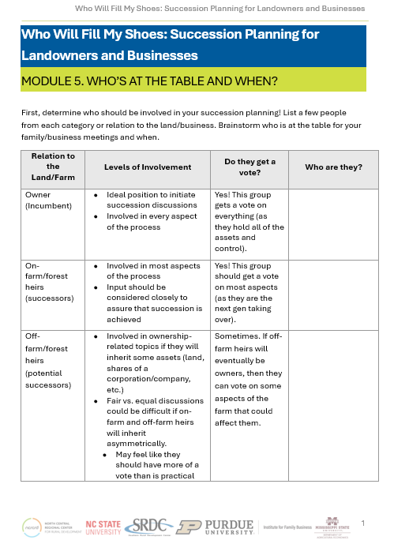
HANDOUT: WHO’S AT THE
TABLE AND WHEN?
First, determine who should be involved in your succession planning!
List a few people from each category or relation to the land/business.
Brainstorm who is at the table for your family/business meetings and when.
Notes:
Instructions: First, determine who should be involved in your succession planning! List a few people from each category or relation to the land/business. Brainstorm who is at the table for your family/business meetings and when.
Time: 5 minutes
Materials: None
Handouts: Who’s at the Table and When?

Slide 23
How to Prepare for Your Meeting
Invite the correct group of people to the meeting
Have ground rules
Develop an agenda
Avoid having the meeting at the kitchen table
Allow each person to share their opinion
Respect each other's time
Decide and talk about how decisions are going to be made
Notes:
Instructions:
Ground Rules – This way you know the expectations and how to prevent communication breakdowns. This would include when you need to show up for the meeting, how to give and receive respect. Know the role of the person leading the meeting.
An agenda will help you keep on task and allows you to know what to prepare for. Have a set date and time when individuals need to have agenda items turned in. Remember the items on the agenda should vary based on what “team” is meeting.
Respect each other’s time – do not allow the meeting to drag on and on. Set a limit as to how long you want to meet and go over the agenda.
Time: 2 minutes
Materials: None
Handouts: None

Slide 24
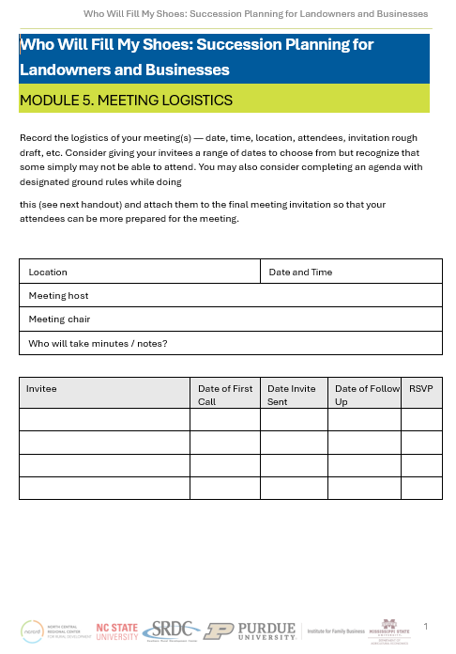
HANDOUT: MEETING LOGISTICS
This form will help you record the logistics of your meeting(s) — such as date, time, location, attendees, and rough draft of an invitation.
Consider providing your invitees with a range of dates.
You may also consider completing an agenda with designated ground rules and
attaching them to the final meeting invitation so that your attendees can be prepared for the meeting.
Notes:
Instructions: Not everyone will have a problem planning a family meeting, but for some this can be a challenging exercise. Here is a tool for planning and a sample invitation for you and your family to talk about succession in a concerted way. You may find an heir you thought was your successor to be uninterested or unable, or you may find a grandchild or family friend that would be ideally suited to take over your enterprise
Respect each other’s time – do not allow the meeting to drag on and on. Set a limit as to how long you want to meet and go over the agenda.
Time: 3 minutes
Materials: None
Handouts: Meetings Logistics

Slide 25
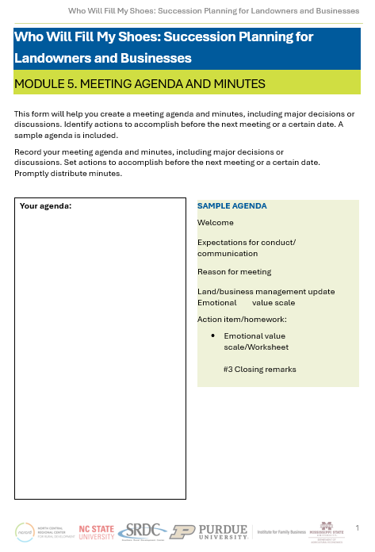
HANDOUT: MEETING AGENDA MINUTES
This form will help you create a meeting agenda and minutes, including major decisions or discussions.
Identify actions to accomplish before the next meeting or a certain date.
A sample agenda is included.
Notes:
Instructions: Not for everyone, but the larger point is to have a directed conversation with your heirs. Don’t conflate this meeting with a social gathering or other event.
Time: 2 minutes
Materials: None
Handouts: Meeting Agenda and Minutes

Slide 26
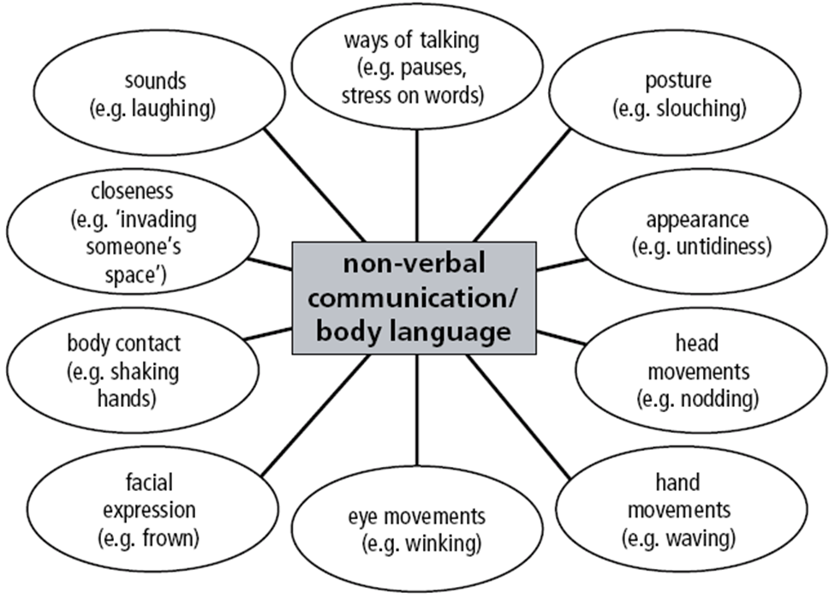
Interpreting Non-Verbal
Communication
Notes:
Instructions: Non-verbal communication is so important when working with family and business owners. Be cognizant of what your body language says about how you feel on the different succession topics.
Time: 2 minutes
Materials: None
Handouts: None

Slide 27
TIPS FOR EFFECTIVE MEETINGS &
CREATING A SAFE SPACE
Ground Rules:
Take your turn to speak
We listen to and respect everyone’s opinions and ideas
We will listen to learn
We repeat what we hear to clarify communications
We will critique the message not the messenger
Notes:
Instructions: Discuss meeting ground rules
Time: 2 minutes
Materials: None
Handouts: None

Slide 28
TIPS FOR EFFECTIVE MEETINGS &
CREATING A SAFE SPACE
Start and end on time
Stay on topic
Share meeting notes and action plan, honor commitments and decisions made by the group
Everyone participates
Agree on a process to make important decisions
Notes:
Instructions: Discuss meeting ground rules
Time: 2 minutes
Materials: None
Handouts: None

Slide 29
TIPS FOR EFFECTIVE MEETINGS &
CREATING A SAFE SPACE
Rotate meeting leadership
Come prepared
No side conversations or comments
Be honest and respectful
Provide an agenda a few days in advance
No interrupting
Silence = Agreement
Notes:
Instructions: Discuss meeting ground rules
Time: 2 minutes
Materials: None
Handouts: None

Slide 30

ULTIMATE GOAL
Focus on the message and the underlying feelings of the speaker and yourself!
Notes:
Instructions: Discuss meeting ground rules
Time: 2 minutes
Materials: None
Handouts: None

Slide 31
Questions
Notes:
Instructions: Thank the participants and ask for any additional questions.
Time: 1 minute
Materials: None
Handouts: None

Slide 32
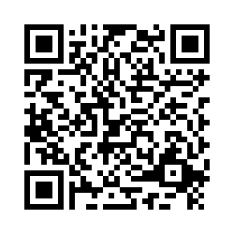
Please share your thoughts.
Notes:
Instructions: Thank the participants and ask for any additional questions.
Time: 1 minute
Materials: None
Handouts: None
https://msudafvm.co1.qualtrics.com/jfe/form/SV_9N1I26nMJ0v9QYS

